Slide 1
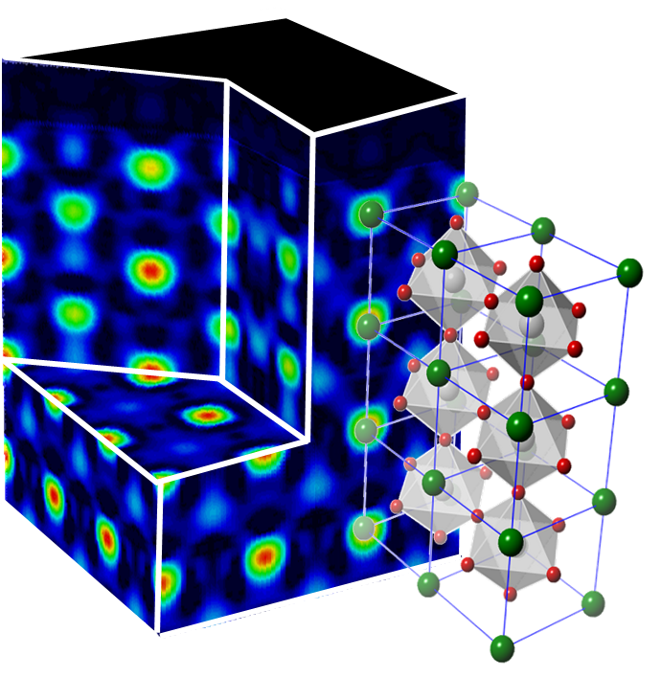
Using a single atomic layer to turn an insulator into a metal
By precisely controlling the surface composition of thin oxide films, films can be switched from a metal to an insulator. Atomic-scale control of the surface is achieved using molecular beams of atoms (the molecular beam epitaxy growth method). To understand why the thin film changes from a metal to an insulator, the surface is imaged using x-rays scattered from the film (see 3D image of film on left). It turns out that the surface itself generates an electric field in the film. When the atoms on the surface are changed, the electric field changes direction, which changes the film from a metal to an insulator.
Kumah, Malashevich, Disa, Arena, Walker, Ismail-Beigi, & Ahn, Phys. Rev. Appl. 2 054004 (2014)
Notes:
Results: The molecular beam epitaxy technique is used to synthesize oxide materials thin films where the chemical composition of the film surface is controlled to either have a net negative or positive electric charge. Films terminated with negatively charged Nickle dioxide (NiO2) planes are insulating when the film thickness is below 2 nanometers. In contrast, films terminated with positively charged Lanthanum oxide (LaO) planes are metallic. The atomic scale structures of the films for the two terminations are measured using synchrotron x-ray diffraction, which reveals that distortions occur in the film structures with a strong dependence of the distortions on the composition and charge of the film surface layer. These distortions are confirmed using first principles density functional theory, and the differences in the distortions are shown to correlate with the observed transport properties.
Significance of the Results: These results show that electronic properties of oxide materials are sensitive to the electrostatic and mechanical boundary conditions governing the materials. In designing oxide heterostructures for device applications, macroscopic properties such as electronic conductivity can be tailored by modifying the film composition at the atomic scale.

