Slide 1
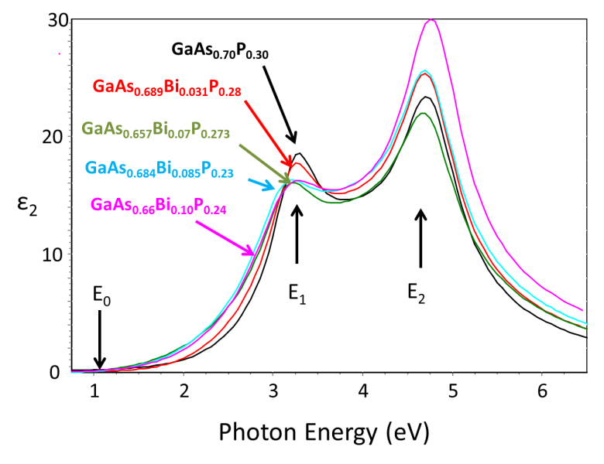
IRG 1: GaAs_{1-y-z}P_{y}Bi_{z} - New Near Lattice-Matched Materials to GaAs
S.E. Babcock, A.S. Brown, M. Losurdo (Univ. Bari, Italy), T.F. Kuech, L. J. Mawst, D. Morgan,
Ellipsometric Data for Electronic Structure Determination
The IRG has developed a new material, GaAs_{1-y-z}P_{y}Bi_{z}, as an alternative to the nitride–based bismide materials, specifically GaAs_{1-y-z}Bi_{y}N_{z}. Alloying in both Bi and N complicates growth, since both elements are sparingly soluble in GaAs. GaAs_{1-y}P_{y}, on the other hand, shows complete solid solubility over all y. Consequently GaAs_{1-y}P_{y} acts as the host material for Bi incorporation in the new material. These alloys are predicted, initially using DFT calculations, to have a tunable band gap in the desirable ~1 eV range and, simultaneously, GaAs_{1-y-z}P_{y}Bi_{z} is lattice matched to GaAs at y~10z. We have synthesized, using metal organic vapor phase epitaxy, GaAs_{1-y-z}P_{y}Bi_{z} alloys. Our collaborators at the University of Bari (Italy) have used ellipsometry to determine band gaps reported in the table to the right. Furthermore, we have achieved the highest Bi content at lattice match to GaAs to date. We are exploring the electronic structure of these new materials as well as the optical properties.
Film Composition | E_{g} [eV]
GaAs_{0.694}P_{0.306} | 1.63
GaAs_{0.689}P_{0.28} Bi_{0.031} | 1.25
GaAs_{0.657}P_{0.273} Bi_{0.07} | 1.19
GaAs_{0.684}P_{0.23} Bi_{0.085} | 1.11
GaAs_{0.66}P_{0.24} Bi_{0.10} | 0.87
PI: Nicholas Abbott
DMR-1121288

