Slide 1
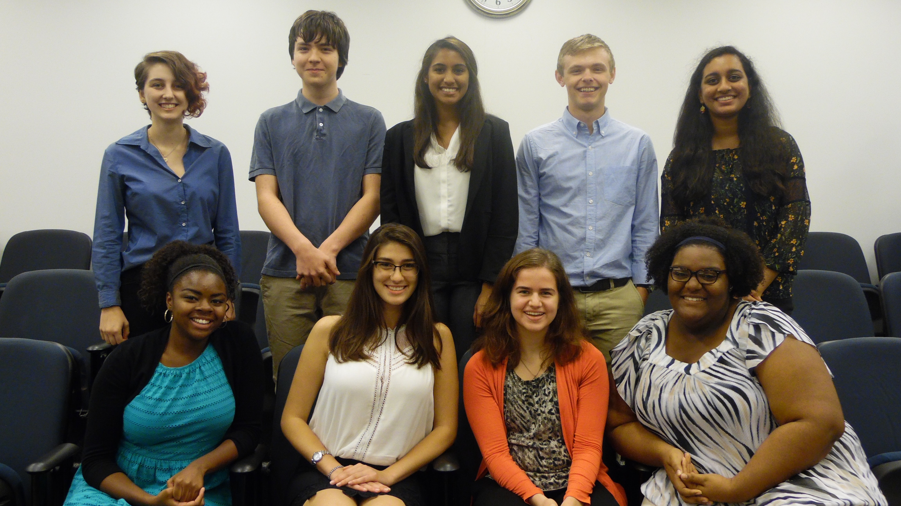
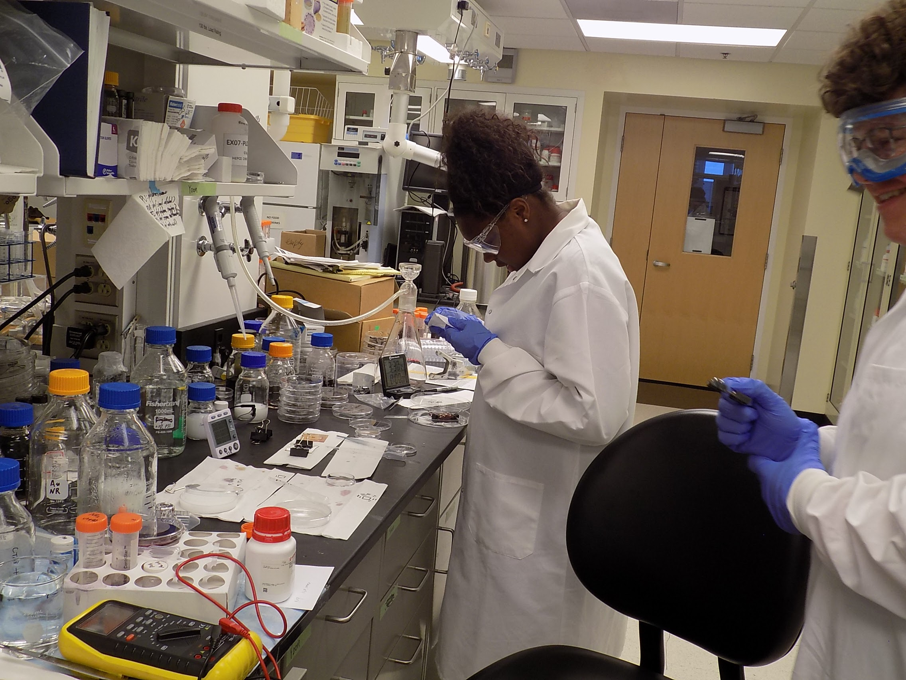
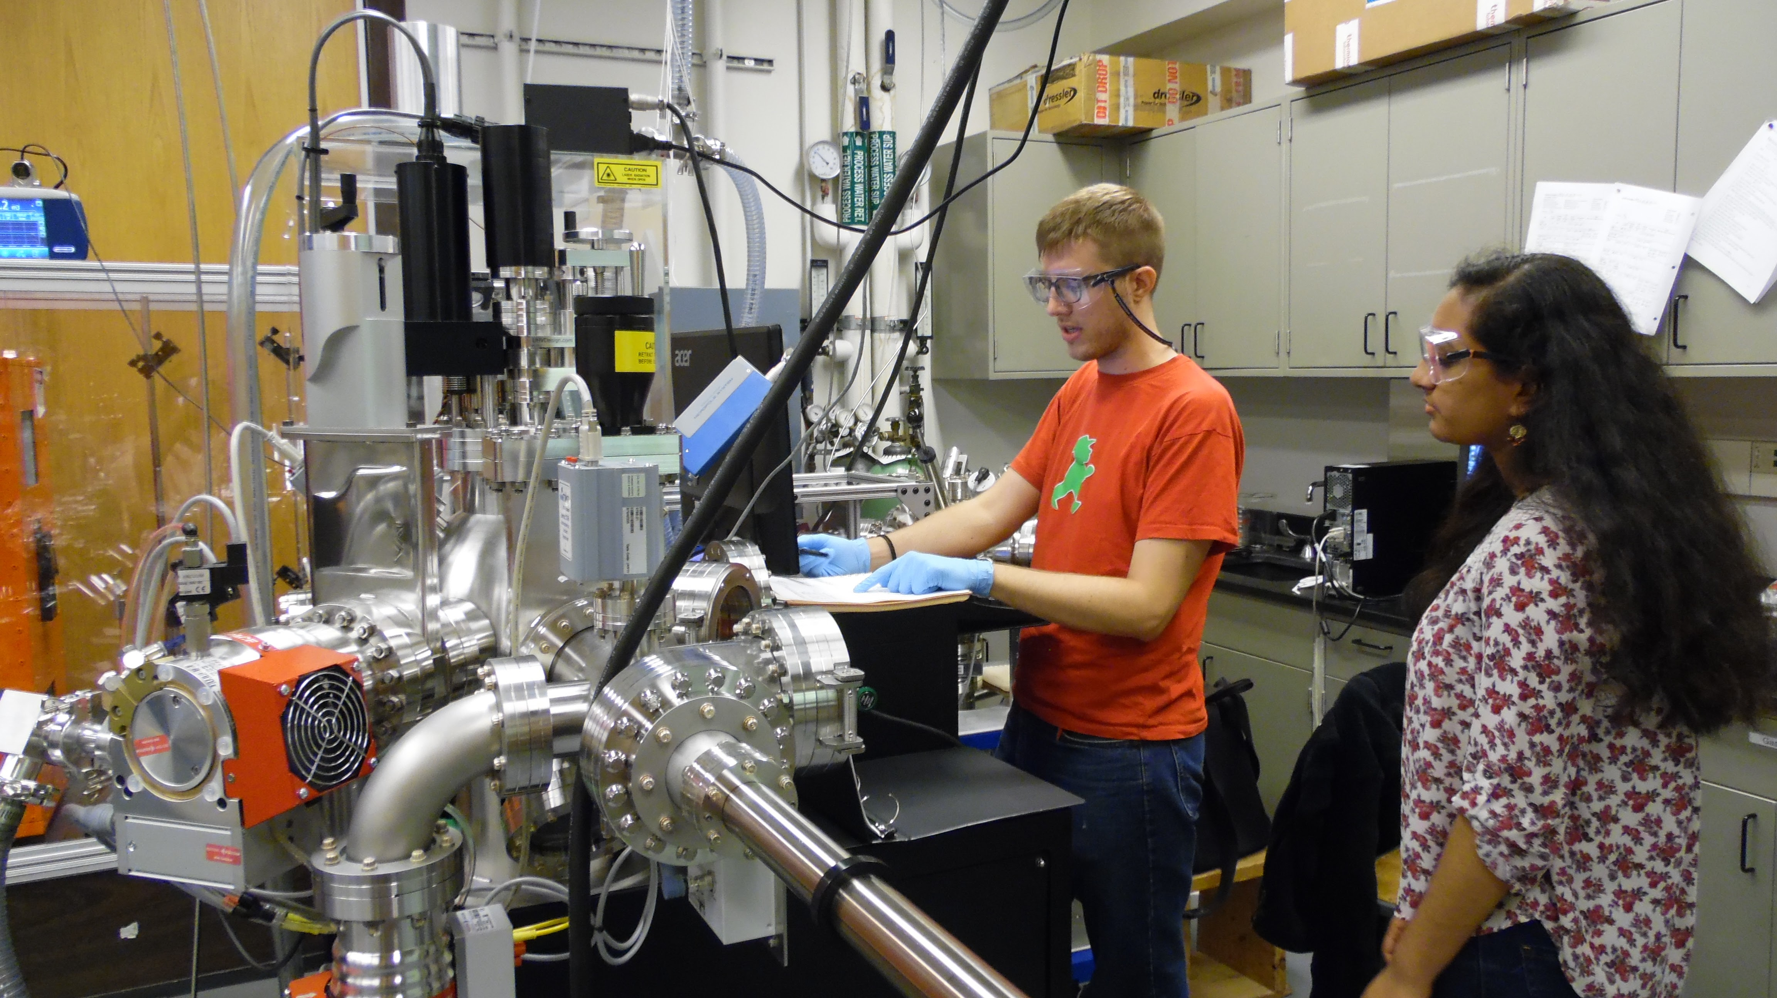
From High School to Professional Scientist: Developing a Pipeline
Akesha C. Moore* and Rachel S. Goldman**
*EECS Department, **MSE Department, University of Michigan
With declining numbers of STEM degrees and limited diversity in the STEM workforce, there is a need for expansion of research opportunities for undergraduate and high school students, in particular those from underrepresented groups. To date, 34 students (53% female, 21% URM) have participated in the C-PHOM High School Research Program, an 8-week residential program for incoming HS juniors and seniors. All of these students have subsequently attended college at top U.S. universities, with 60% now enrolled in UM as science and engineering Majors.
(Top Left): 2016 C-PHOM High School Research Program Participants.
(Bottom Left): 2016 High School student working in the lab with Grad mentor.
(Right): 2016 High School student working in the lab.
Sponsored by NSF-MRSEC
through contract DMR-1120923

