Slide 1
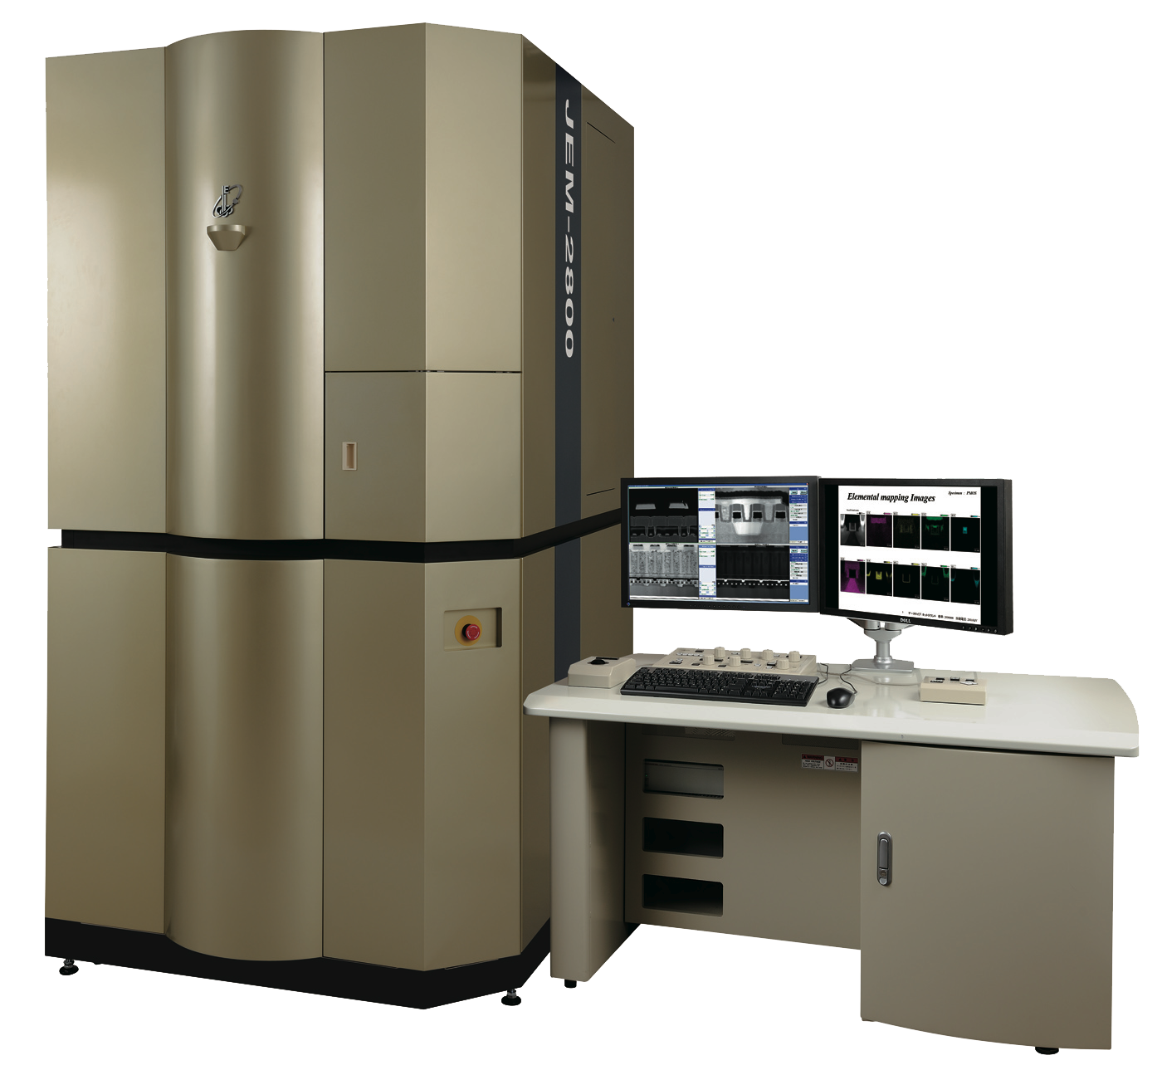
New MRSEC/USTAR Purchased Analytical S/TEM
Ian Harvey
JEOL JEM-2800
Ultrafast dual-detector energy dispersive spectroscopy (2D, 3D element mapping)
Best-in-class resolution (atomic-scale imaging)
First of its kind in the Americas
University of Utah will be a JEOL demo facility
Expected delivery in June 2014
 | MRSEC | Other Major Users | Other Minor Users
Investigator Interest (total) | 11 | 12 | 11
Need atomic resolution | 3 | 3 | 2
Need electron energy loss spectroscopy | 5 | 7 | 3
Anticipated annual user fees | $31,500 | $66,000 | $11,000

