Slide 1
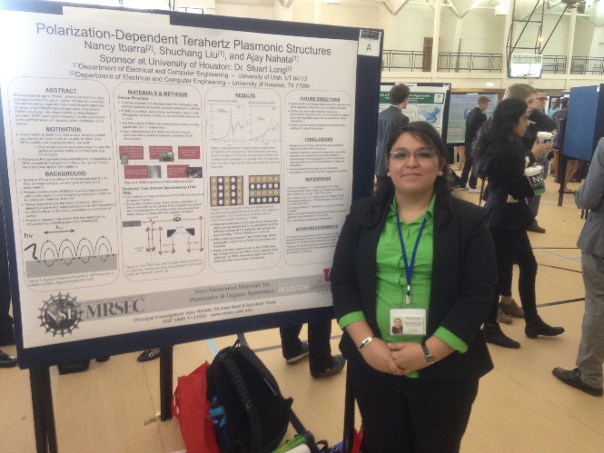
Presenting Undergraduate Research at the National Level
Objective: Train Utah MRSEC students to effectively present materials research.
Approach: The REU poster session winner is invited to submit an abstract to the National Conference for Undergraduates the following spring. The conference is fully funded by Utah MRSEC if the student is selected to present.
Results and Significance: Enabled a student, underrepresented in engineering, to present her REU summer project research “Polarization-Dependent Terahertz Plasmonic Structures” at the national level at NCUR.
University of Utah MRSEC REU participant Nancy Ibarra presenting her research at NCUR 2016 in Asheville, NC
Principal Investigators: Ajay Nahata, Steve Blair & Ashutosh Tiwari
NSF DMR 11-21252; www.mrsec.utah.edu

