Slide 1
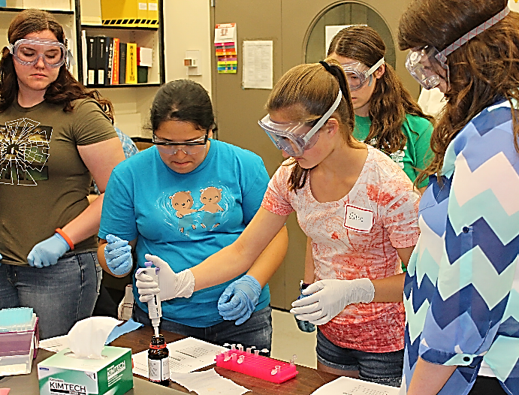
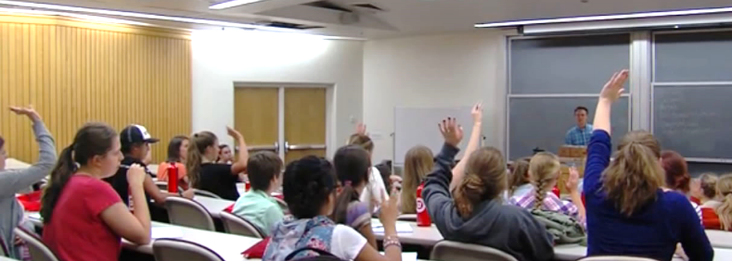
Utah MRSEC Leads Materials Module at All-female Engineering Camp
Objective: Support existing programs focused on exposing diverse learners to science and engineering by providing materials science expertise through outreach.
Approach: Augment existing engineering camp by funding and creating a materials science module.
Results and Significance: The camp attracted local news coverage as 27 females in grades 9-11 explored various types of engineering and corresponding careers.
MRSEC Education & Outreach Director Jeff Bates and REU students led summer engineering camp activities.
Principal Investigators: Ajay Nahata, Steve Blair & Ashutosh Tiwari
NSF DMR 11-21252; www.mrsec.utah.edu

