Slide 1
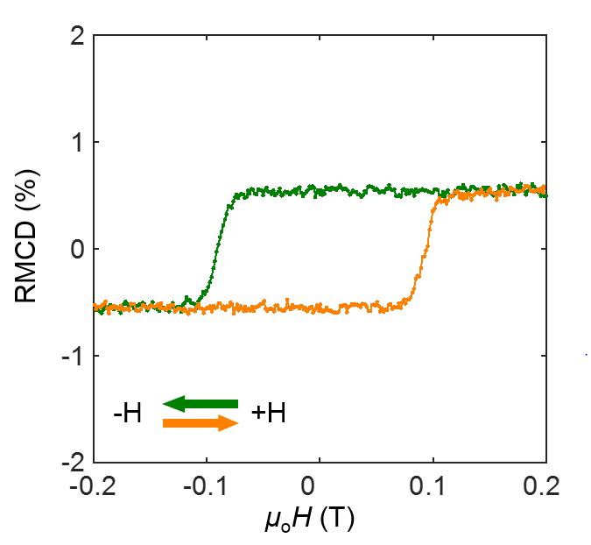
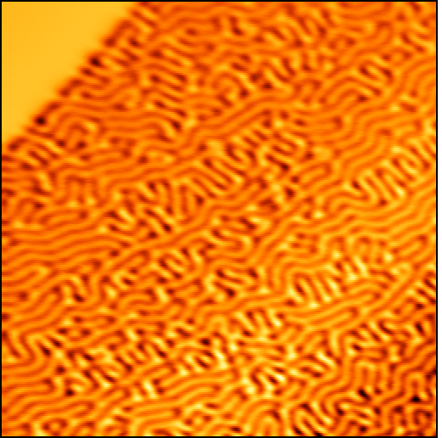
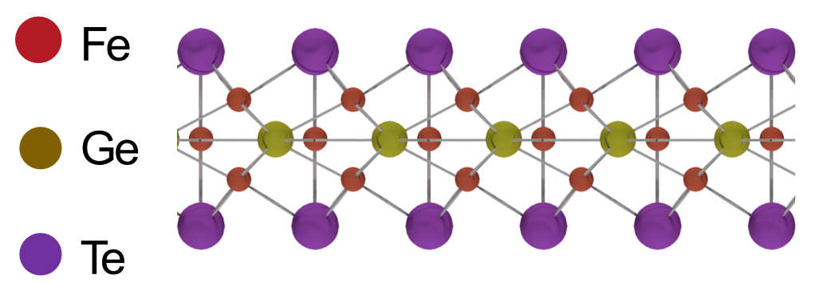
Two-Dimensional Itinerant Ising Ferromagnetism in Atomically thin Fe₃GeTe₂
Materials Research Science and Engineering Center
DMR-1719797
2018
David Cobden and Xiaosong Xu
Molecular Engineering Materials Center (MEM-C)
University of Washington, Seattle
Ferromagnetism in monolayer van der Waals materials (vdW) has recently drawn tremendous attention since they were first discovered last year. Most of the materials found, however, are semiconductors and extremely air sensitive, so a vdW material that is metallic and stable under ambient conditions is highly desirable.
By investigating the electrical transport and optical properties of atomically thin iron germanium telluride (Fe₃GeTe₂), a ferromagnetic metal in the bulk form, we demonstrate that monolayer Fe₃GeTe₂ (~0.8 nm thick) is a robust 2D itinerant ferromagnet (Fig. 1a, hallmark of a ferromagnet), with a relatively high Curie temperature (130 K). For flakes thicker than ~15 nm, the formation of labyrinthine domain patterns (Fig. 1b) appear at intermediate temperatures, eventually becoming the predominant magnetic structure for much thicker flakes. A compiled thickness-temperature phase diagram is shown in Fig. 1c.
This work introduces a novel atomically thin ferromagnetic metal that could be useful to study the external control of 2D itinerant Ising ferromagnetism. It could also be employed for ferromagnetic contacts for injecting spins to other 2D materials, and for the creation and investigation of emergent physical phenomena and heterostructure spintronics.
a
b
5 μm
c
PM
FM2
FM1
Figure 1 | a, Magnetic hysteresis loop of an Fe₃GeTe₂ monolayer at 15 K. Inset: atomic lattice of monolayer Fe₃GeTe₂. b, MFM image of a 300 nm flake at 0.03 T, showing labyrinthine domain structures. c, Compiled thickness-temperature phase diagram.
Z. Fei*, B. Huang, P. Malinowski*, W. Wang, T. Song, J. Sanchez, W. Yao, D. Xiao, X. Zhu, A. May, W. Wu, D. Cobden*, J. Chu*, X. Xu*; et al. arXiv:1803.02559 (2018)
*member of MEM-C

