Slide 1
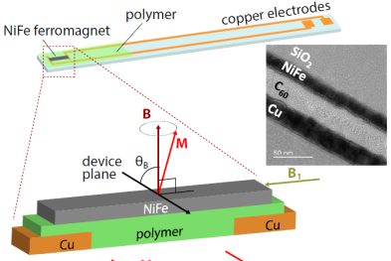
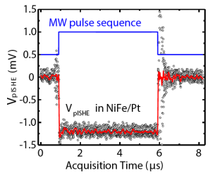
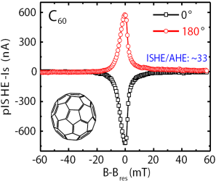
Pulse Inverse Spin-Hall Effect in Organic Semiconductors
Christoph Boehme and Z. Valy Vardeny
Objective: Estimate spin-orbit coupling in in a wide variety of organic semiconductors.
Approach: Use pulsed microwave excitation in ferromagnets to generate spin-current in organic semiconductor thin films with weak spin orbit coupling, which induces a measurable voltage.
Results and Significance: The ability to pump large pure spin currents into most classes of organic semiconductors offers a robust methodology for investigating spin-transport properties, and a simple method to probe the strength of the spin-orbit coupling in these devices.
Upper left: The experimental set-up for the. Upper right: The transient voltage from NiFe/Pt bilayer excited with microwave pulses with ~1kW peak-power. Lower panel: Measured response of NiFe/C₆₀ bilayer measured for two opposite field directions
D. Sun, K. J. van Schooten, M. Kavand, H. Malissa, C. Zhang, M. Groesbeck, C. Boehme, and Z. V. Vardeny, Nat. Mater. advance online publication, (2016).

