Slide 1
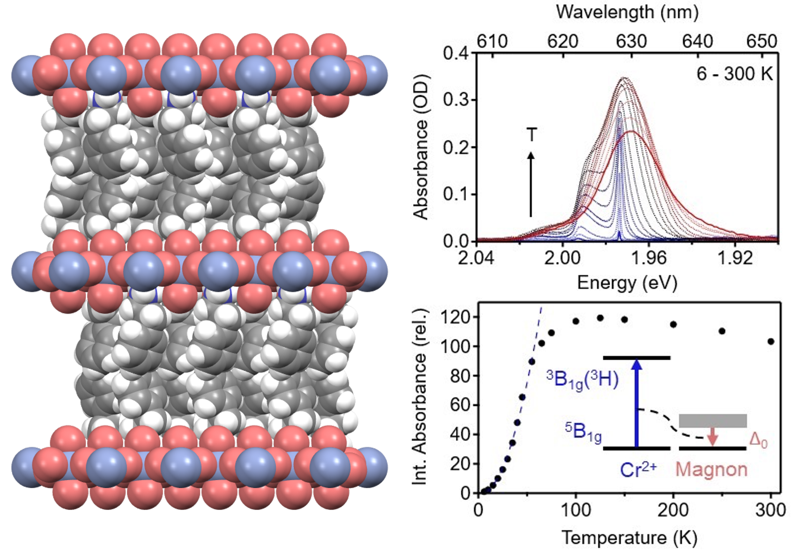
U. Washington MRSEC
DMR-2308979
MEM-C IRG-1: Spin-Photonic Coupling in a Ferromagnetic
Hybrid Layered Perovskite, (PEA)₂CrCl₄
Daniel R. Gamelin, Jiun-Haw Chu
The Cr²⁺-based compounds, A₂CrX₄, where A = M⁺ (e.g., K⁺, Cs⁺, Rb⁺) or RNH₃⁺ (e.g., MeNH₃⁺) and X = Cl⁻, Br⁻, are an underexplored family of lead-free layered metal-halide perovskites. These compounds attracted a great deal of interest in the 1970s and 1980s after their "transparent ferromagnetism" was discovered, but they have received virtually no attention since, perhaps because they are extremely unstable in air. Further investigation into their chemistry and properties is warranted.
Large crystals of the new compound, (PEA)₂CrCl₄ (PEA = phenethylammonium) have been synthesized via antisolvent vapor diffusion. Remarkably, these crystals are stable in air for many days. The structure of (PEA)₂CrCl₄ shows 2D sheets of distorted [CrCl₆]⁴⁻ octahedra spaced by bulky PEA bilayers. Air stability is believed to come from this PEA bulkiness. These crystals can be mechanically exfoliated down to single monolayers with micron lateral dimensions. Magnetic measurements show in-plane ferromagnetic ordering with T_{C} = 44 K. These materials display a unique manifestation of spin-photonic coupling: strongly forbidden Cr²⁺ spin-flip excitations in the visible become allowed by coupling to deexcitation of thermal "hot" magnons at zero field. A simple absorption spectrum thus gives insights into 2D spin correlations in these materials.
Space-filling representation of an edge view of (PEA)₂CrCl₄, and electronic absorption spectra of a (PEA)₂CrCl₄ single crystal in the ⁵B_{1g} → ³B_{1g}(³H) region, collected between 6 and 300 K. The integrated absorbance has a dramatic temperature dependence that reflects coupling of this Cr²⁺ spin-flip excitation with annihilation of thermally populated 2D magnons (inset).
Notes:
What Has Been Achieved: The new 2D ferromagnetic hybrid perovskite (PEA)₂CrCl₄ (PEA = phenethylammonium) has been synthesized and its structure characterized by single-crystal x-ray diffraction. Its structure shows isolated inorganic sheets separated by bilayers of the bulky PEA cation. The inorganic sheets consist of networked [CrCl₆]⁴⁻ octahedra with ordered in-plane Jahn-Teller distortions. The PEA cations impart air stability to these otherwise highly hygroscopic and oxidatively unstable compounds. (PEA)₂CrCl₄ is ferromagnetically ordered with T_{C} = 44 K and shows rich temperature-dependent absorption in the visible that reflects coupling of Cr²⁺ optical spin-flip transitions to 2D magnons. The van der Waals lattice structure has allowed mechanical exfoliation of monolayers with micron lateral dimensions, and air stability is largely retained. These attributes make (PEA)₂CrCl₄ an attractive platform for development of 2D perovskite chemistry that links structure, magnetism, and magneto-optics, including at the monolayer limit.
Importance of the Achievement: This study represents the first example of an air-stable A₂CrCl₄ compound, and the first example of exfoliation of any A₂CrCl₄ compound. These attributes have facilitated various physical measurements on (PEA)₂CrCl₄, including variable-temperature optical and magnetic measurements. The former shows a dramatic manifestation of spin-photonic coupling, in which normally highly forbidden Cr²⁺ spin-flip transitions become strongly allowed by coupling to thermally populated 2D magnons. The temperature dependence of the "hot" magnon population imparts an extremely strong and unusual temperature dependence to the absorption spectrum, analysis of which shows that this absorption provides an optical probe of both long- and short-range spin correlations within the 2D inorganic sheets.
How is the achievement related to the IRG, and how does it help it achieve its goals? These results demonstrate (PEA)₂CrCl₄ as a remarkable platform for developing further chemistries and optical tools to probe and manipulate spin-photonic coupling at nanoscale dimensions. This work advances our basic-science understanding of spin-photonic coupling in layered perovskites, it opens doors to developing structure/function relationships in this class of materials based on post-synthetic chemical transformations of this lattice, and it opens opportunities for both photonic probing and control of magnetic phenomena in low-dimensional materials.
Where the findings are published: Smith, Walsh, Jiang, Chu, Gamelin, "An Air-Stable and Exfoliable Ferromagnetic 2D-Perovskite, (Phenethylammonium)₂CrCl₄." Chem. Mater., 2024, 36, 1571–1578. DOI: 10.1021/acs.chemmater.3c02824.

