Slide 1
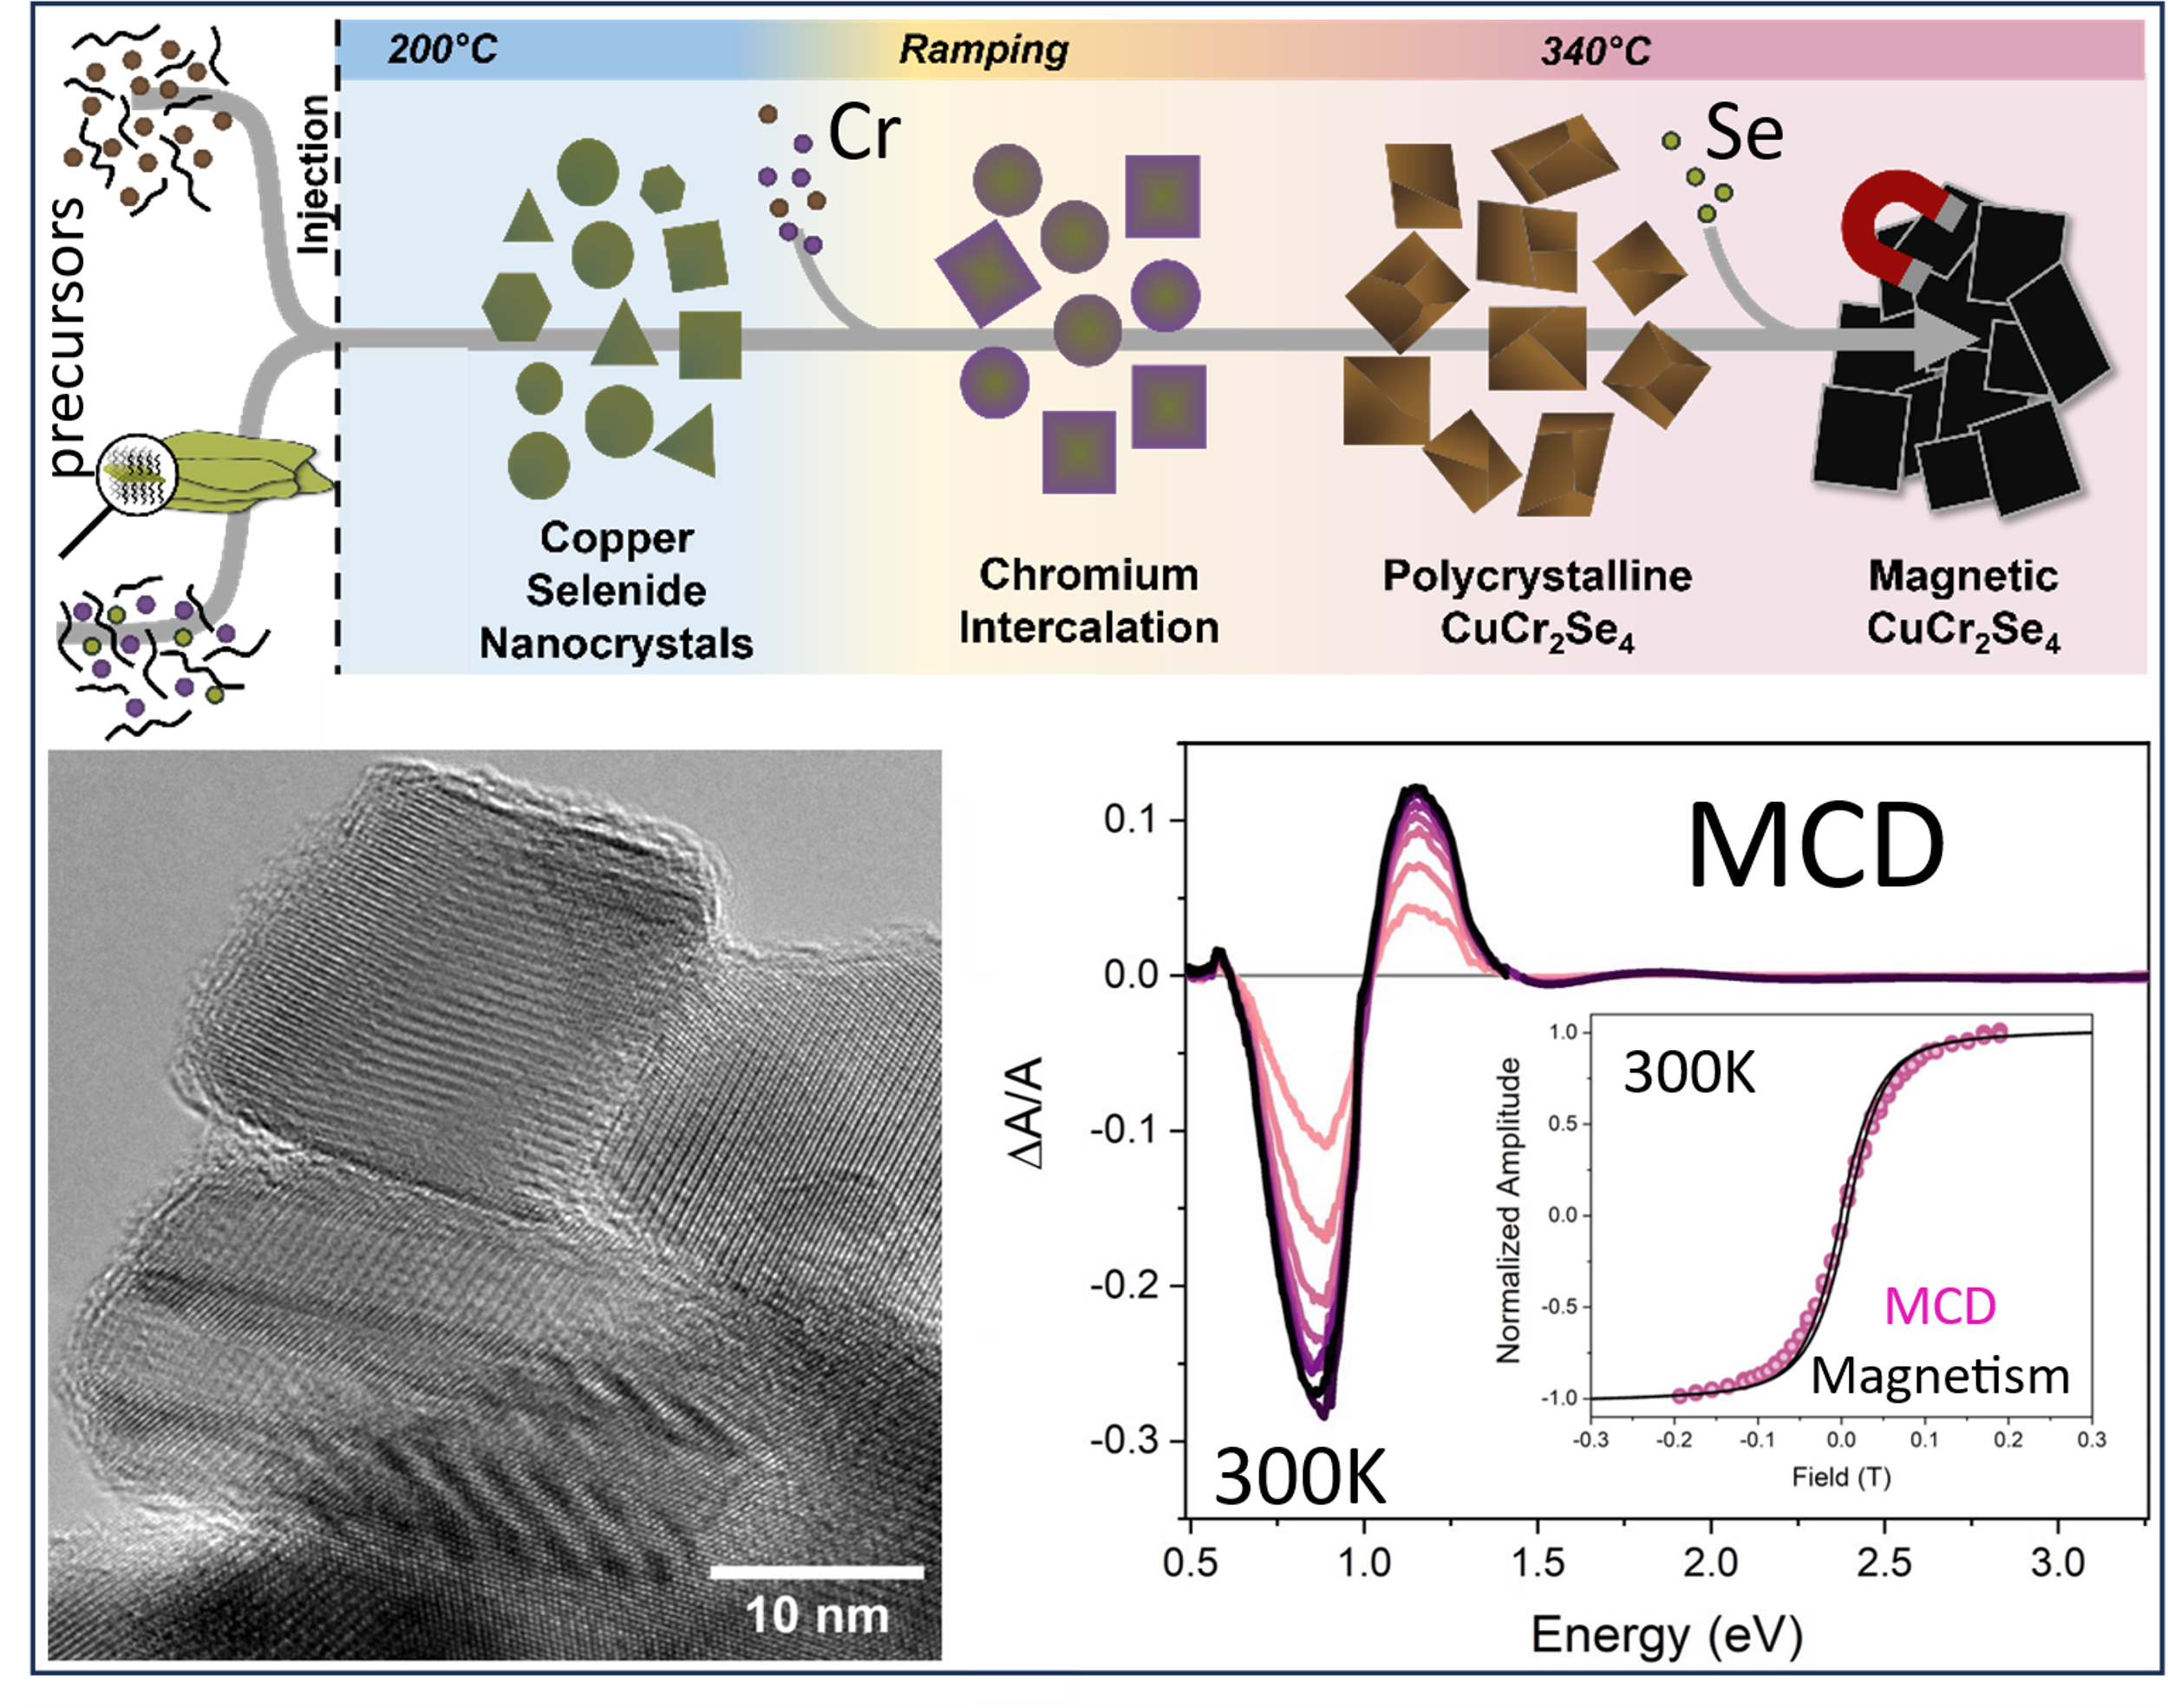
U. Washington MRSEC
DMR-2308979
MEM-C IRG-1: Ferrimagnetic CuCr₂Se₄ Nanocrystals with
Strong Room-Temperature Magnetic Circular Dichroism
Brandi Cossairt, Daniel R. Gamelin, Jiun-Haw Chu
Magnetic materials are vital in technologies from spintronics to biomedicine. Coupling magnetism with optical responses broadens their utility to sensing, magneto-optical memory, and optical isolation. Chromium chalcogenide spinels display particularly rich magnetism and magneto-optical properties. Colloidal nanocrystals (NCs) offer routes to solution-processing, heterointegration, and property modulation through size, shape, or heterostructure control, but many chalcogenide spinels have never been synthesized at the nanoscale, and little control over size or morphology has been demonstrated.
This work examines CuCr₂Se₄ NC synthesis, revealing that precursor injection first forms copper selenide (Cu_{2-x}Se) NCs, which then template spinel formation. Slow Cr and Se in-diffusion forms polycrystalline CuCr₂Se₄ at the NC edges, and colloidal annealing then yields single-crystalline CuCr₂Se₄ NCs with bulk-like ferrimagnetism at room temperature. Spin-coated NC films show strong magnetic circular dichroism (MCD) at the bulk plasma frequency (ℏω_{pl} ~ 1.0 eV), reflecting bulk-like metallicity and optical properties. MCD intensities track NC magnetization, saturating at low fields. These CuCr₂Se₄ NCs thus offer a path for introducing magneto-optical functionality into next-generation spin-photonic architectures.
Synthesis of colloidal CuCr₂Se₄ NCs starts with formation of copper selenide NCs followed by slow in-diffusion of Cr³⁺ to form the spinel. Colloidal annealing activates ferrimagnetism. A TEM image of single-crystalline CuCr₂Se₄ NCs, and 300K magnetic circular dichroism results showing strong near-IR magneto-optical response.
Notes:
What Has Been Achieved: Colloidal nanocrystals of the spinel compound CuCr₂Se₄ have been synthesized and their formation mechanism and physical properties studied. Detailed studies of their formation mechanism have revealed that Cu_{2-x}Se nanocrystals form as a transient intermediate, and these then template the formation of CuCr₂Se₄ nanocrystals via slow in-diffusion of Cr³⁺. The first spinel nanocrystals are polycrystalline with many domains, but colloidal annealing converts these into single-crystalline CuCr₂Se₄ nanocrystals. This conversion also leads to the appearance of room-temperature magnetic ordering, as measured by magnetic susceptibility. The resulting CuCr₂Se₄ nanocrystals show very strong magnetic circular dichroism (MCD) at 1.0 eV, coinciding with the telecommunications window. This MCD intensity tracks the room-temperature magnetization, maximizing at very low fields.
Importance of the Achievement: This study represents the first detailed investigation into the formation mechanism of CuCr₂Se₄ nanocrystals. The fundamental knowledge gained from this investigation has led to improvement of the product nanocrystals to the point where the attractive magnetic, optical, and magneto-optical properties found in bulk CuCr₂Se₄ have now been demonstrated in colloidal CuCr₂Se₄ for the first time. Combining these physical properties with colloidal processability opens new paths to integration of such materials in solution-processed device structures such as optical cavities or on-chip photonics. Moreover, these colloidal nanocrystals are now amenable to further modification via shelling, heterostructuring, shape control, and surface functionalization, vastly expanding the range of possible spin-photonic properties and applications that may be achievable.
How is the achievement related to the IRG, and how does it help it achieve its goals? These results demonstrate CuCr₂Se₄ nanocrystals as an attractive platform for developing further chemistries and integration tools to probe, manipulate, and exploit spin-photonic coupling at nanoscale dimensions. This work advances our basic-science understanding of formation mechanisms of chalcogenide spinel nanocrystals, it opens doors to developing post-synthetic chemical transformations of this material, and it opens opportunities for spin-photonics in low-dimensional materials.
Where the findings are published: Harvey, S.; DeStefano, J. M.; Chu, J.-H.; Gamelin, D. R.; & Cossairt, B. M. “Understanding the Formation of Colloidal Ferrimagnetic CuCr₂Se₄ Nanocrystals with Strong Room-Temperature Magnetic Circular Dichroism.” Chemistry of Materials, 2024. 36, 10746–10757. DOI: 10.1021/acs.chemmater.4c02365

