Slide 1
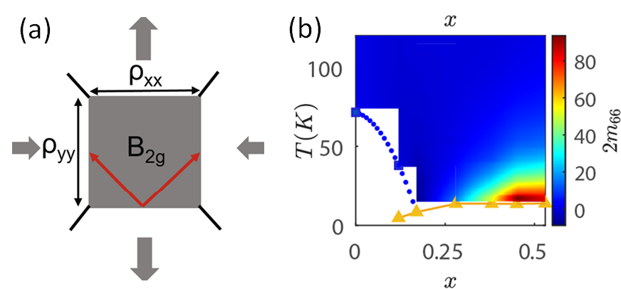
U. Washington MRSEC
DMR-1719797
MEM-C IRG-2: Nematic Fluctuations in an Orbital Selective
Superconductor Fe_{1+y}Te_{1-x}Se_{x}
Xiaodong Xu, Jiun-Haw Chu
Electronic nematicity is a correlated electronic state in solids that spontaneously breaks rotational symmetry. This work found that in Fe_{1+y}Te_{1-x}Se_{x}, one of the most strongly correlated iron-based superconductors, electronic nematicity is closely linked to magnetism, and its fluctuations may be responsible for superconducting pairing.
Although the relationship between nematicity, magnetism, and superconductivity has been observed in some iron-based superconductor families, it remained unclear whether this correlation would persist when the system is pushed to the strongly correlated limit. This limit involves a metal-insulator transition in part of the energy spectrum known as the orbital selective Mott transition (OSMT), which has been observed in Fe_{1+y}Te_{1-x}Se_{x}. This study showed that nematic fluctuations in Fe_{1+y}Te_{1-x}Se_{x} not only closely follow magnetic fluctuations but also exhibit an unusual temperature dependence resulting from the OSMT.
The observation of nematic fluctuations in Fe_{1+y}Te_{1-x}Se_{x} underscores its universal significance in iron-based superconductors, thereby paving the way for the manipulation and utilization of phase transitions in layered materials for practical applications.
(a) The elastoresistivity coefficient 2m66 measures the strength of nematic fluctuations. In an elastoresistivity measurement, the resistivity along x and y directions of a square sample are measured while anisotropic strain is applied. The 2m66 coefficient is the ratio of resistivity anisotropy to anisotropic strain. (b) The temperature and doping phase diagram of Fe_{1+y}Te_{1-x}Se_{x.,} The blue dotted line represents the magnetic phase boundary and the solid yellow line represents the superconducting phase boundary. The colors indicate the magnitude of 2m66. The nematic fluctuations reach a maximum just above the superconducting dome.
Notes:
What Has Been Achieved: Similar to the liquid crystal phase in soft condensed matter, electronic nematicity is a correlated electronic state in solids that spontaneously breaks rotational symmetry. In our study, we found that in Fe_{1+y}Te_{1-x}Se_{x}, one of the most strongly correlated iron-based superconductors, electronic nematicity is closely linked to magnetism, and its fluctuations may be responsible for superconducting pairing.
Importance of the Achievement: Although the relationship between nematicity, magnetism, and superconductivity has been observed in some iron-based superconductor families, it remains unclear whether this correlation would persist when the system is pushed to the strongly correlated limit. This limit involves a metal-insulator transition in part of the energy spectrum known as the orbital selective Mott transition (OSMT), which has been observed in Fe_{1+y}Te_{1-x}Se_{x}. Our study showed that nematic fluctuations in Fe_{1+y}Te_{1-x}Se_{x} not only closely follow magnetic fluctuations but also exhibit an unusual temperature dependence resulting from the OSMT.
How is the achievement related to the IRG, and how does it help it achieve its goals? The observation of nematic fluctuations in Fe_{1+y}Te_{1-x}Se_{x} further underscores its universal significance in iron-based superconductors, thereby paving the way for the manipulation and utilization of phase transitions in layered materials for practical applications.
Where the findings are published: Jiang, Q., Shi, Y., Christensen, M.H. et al. Nematic fluctuations in an orbital selective superconductor Fe_{1+y}Te_{1−x}Se_{x}. Commun Phys 6, 39 (2023). https://doi.org/10.1038/s42005-023-01154-8

