Slide 1
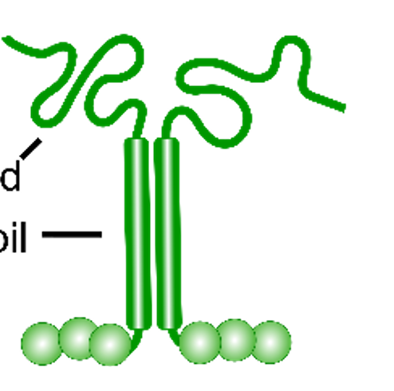
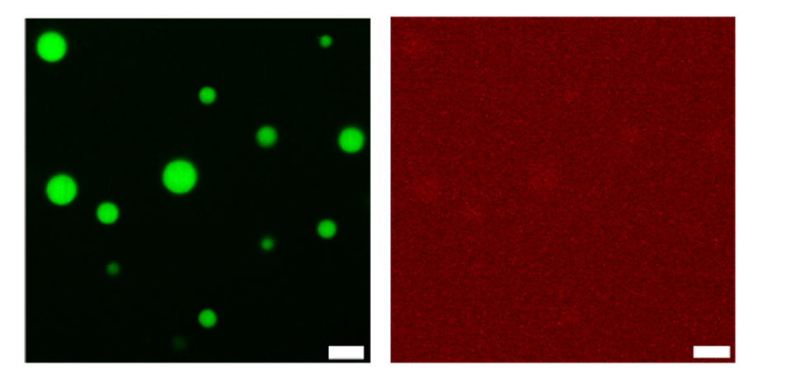
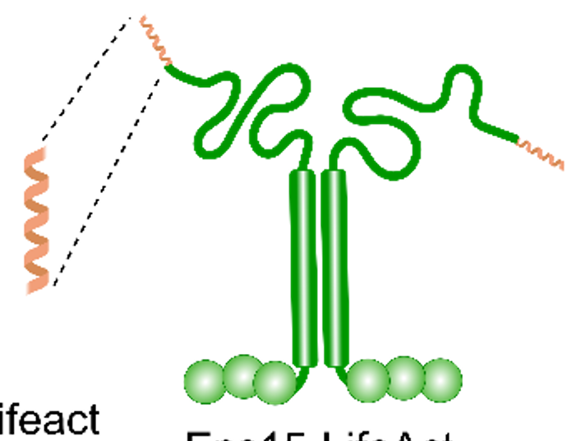
UT Austin MRSEC
DMR-2308817
Materials-Based Control of Actin Bundling
What has been achieved:
Our recent work has revealed two distinct approaches for controlling the bundling of actin filaments:
Varying the molecular weight and concentration of depletant polymers.
Assembling actin filaments inside biomolecular condensates composed of proteins that bind multi-valently to actin filaments.
Importance of Achievement:
Alignment of semi-rigid actin filaments to form bundles is a key step toward creating rigid structural elements that can withstand and apply tunable mechanical forces in actin-based materials.
Relationship of Achievement to IRG:
Now that we can control filament bundling, we are engineering fuel-driven bundling, a key step toward out-of-equilibrium actin-based materials.
UT Austin: Alvarado, Stachowiak, Truskett, Milliron, Rosales; RIT: Das
Actin bundling increases with the size and stoichiometry of polymer depletants. (Clarke et al, J Chem Phys 2024).
droplet
actin
Protein condensates that bind actin filaments can use their surface tension to drive actin bundling. (Walker et al, Dev Cell 2025).
no actin
with actin
Notes:
What Has Been Achieved: We have revealed major driving forces for bundling of actin filaments including (i) depletion effects, and (ii) multi-valent presentation of filament-binding domains.
Importance of the Achievement: In nature, actin bundling is a key capability that enables cells to apply substantial forces to overcome obstacles. Similarly, in the design of actin-based materials, the ability to bundle semi-rigid filaments into bundles of higher rigidity is a key step toward building more complex architectures. For this reason, developing a toolbox for controlling bundling is an important goal of our IRG. The approaches we have developed for controlling the bundling of actin filaments on a microscopic level allow us to construct actin-based materials with tunable mechanical properties.
How is the achievement related to the IRG, and how does it help it achieve its goals? Now that we have multiple ways to control actin bundling using both depletants and protein condensates, we will focus on making these processes fuel dependent. For example, assembly or protein condensates and depletants can each be triggered by light exposure. Using this approach, we will be able to drive the assembly of actin architectures outside thermodynamic equilibrium, which is one of the broad goals of IRG2.
Where the findings are published: J. Clarke, L. Melcher, A. D. Crowell, F. Cavanna, J. R. Houser, K. Graham, A. M. Green, J. C. Stachowiak, T. M. Truskett, D. J. Milliron, A. M. Rosales, M. Das, J. Alvarado, “Morphological control of bundled actin networks subject to fixed-mass depletion,” The Journal of Chemical Physics, 161, 8/2024. https://doi.org/10.1063/5.0197269
C. Walker, A. Chandrasekaran, D. Mansour, K. Graham, A. Torres, L. Want, E. M. Lafer, P. Rangamani, J. C. Stachowiak, “Liquid-like condensates that bind actin drive filament polymerization and bundling,” Developmental Cell, 2/25, Published In press. https://doi.org/10.1016/j.devcel.2025.01.012

