Slide 1
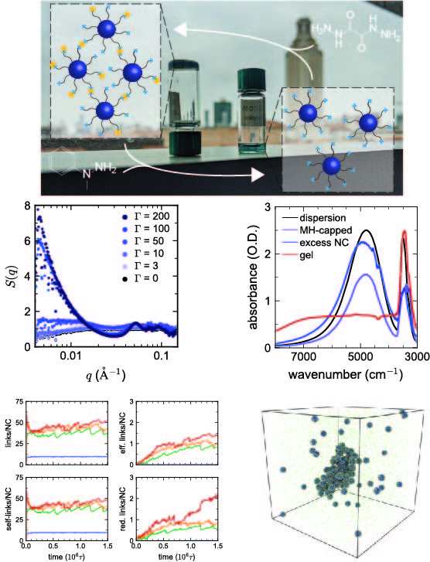
Assembly of Linked Nanocrystal Colloids by Reversible Covalent Bonds
MRSEC: DMR-1720595
2021
D. Milliron, E. Anslyn, T. Truskett: Univ. of Texas at Austin
Most colloidal assembly techniques are irreversible and rely on direct nanocrystal to nanocrystal bonding. Here we show how control of valence through molecular linkers gives control of clustering and gelation assembly.
This work demonstrated that dynamic covalent chemistry can be applied to control the gelation of colloidal nanocrystals through specific linking pairs as well as allow for the reversal of these assemblies.
The assembled state exhibited distinct optical properties from the original colloid, and using capping agents, was easily manipulated to recover the original optical response.
Molecular dynamics simulations and theory predictions were used to compute a phase diagram for the molecular linking system and nanocrystals as well as reveal the competition between looping and bridging linking motifs.
[Dominguez, M. N.; Howard, M. P.; Maier, J. M.; Valenzuela, S. A.; Sherman, Z. M.; Reuther, J. F.; Reimnitz, L. C.; Kang, J.; Cho, S. H.; Gibbs, S. L.; Menta, A. K.; Zhuang, D. L.; van der Stok, A.; Kline, S. J.; Anslyn, E. V.; Truskett, T. M.; Milliron, D. J. Assembly of Linked Nanocrystal Colloids by Reversible Covalent Bonds. Chemistry of Materials 2020, 32, 10235–10245.]
Notes:
This highlight demonstrates the combination of colloidal nanocrystals with uniquely developed ligands for the use of gelation assembly. Linking molecules that are paired with ligand functional groups are used for control the assembly from small clusters to full spanning gel networks. Small angle x-ray scattering was used to monitor the assembly over time and at different concentrations of linking agent, and to observe how the assembly can be reversed when molecular capping agents or excess nanocrystals with available functional groups are introduced to the gel assembly. Optical properties from the colloidal nanocrystals were manipulated when assembled and returned to their original state when the assembly was reversed. Molecular simulations revealed a competition between looping and bridging when linker molecules were introduced to nanocrystals capped with their linking pair. The assembly behavior was rationalized using a thermodynamic perturbation theory to compute a phase diagram. Through this combined experimental, computational and theoretical work provided a platform for controlling and designing the properties of reversible colloidal assemblies.
Publication citation for this work:
Dominguez, M. N.; Howard, M. P.; Maier, J. M.; Valenzuela, S. A.; Sherman, Z. M.; Reuther, J. F.; Reimnitz, L. C.; Kang, J.; Cho, S. H.; Gibbs, S. L.; Menta, A. K.; Zhuang, D. L.; van der Stok, A.; Kline, S. J.; Anslyn, E. V.; Truskett, T. M.; Milliron, D. J. Assembly of Linked Nanocrystal Colloids by Reversible Covalent Bonds. Chemistry of Materials 2020, 32, 10235–10245.

