Slide 1
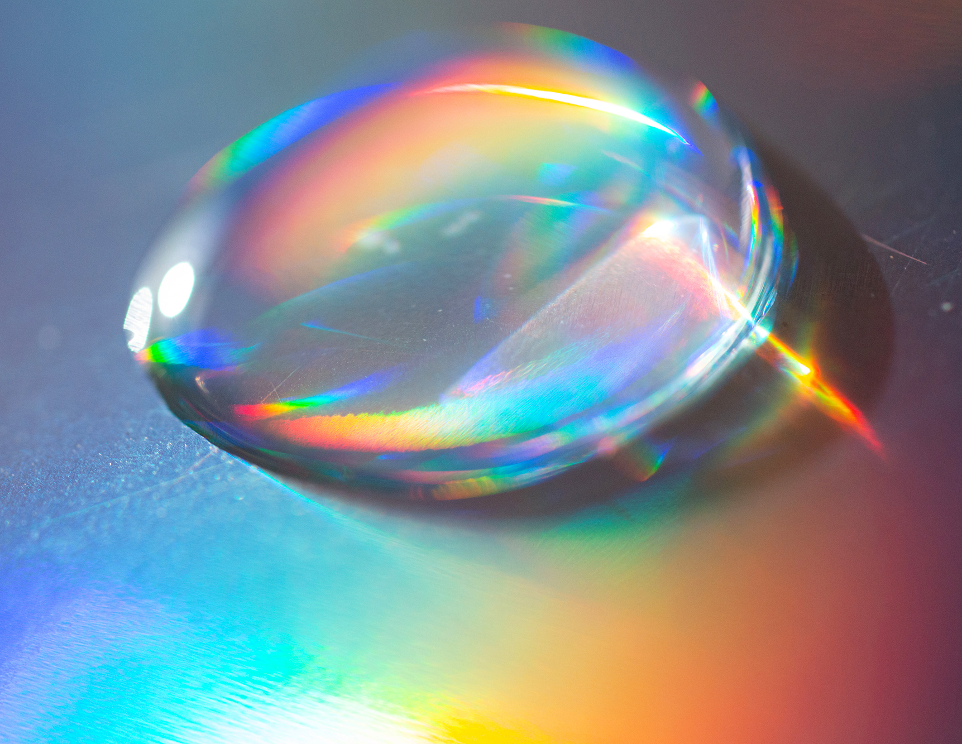
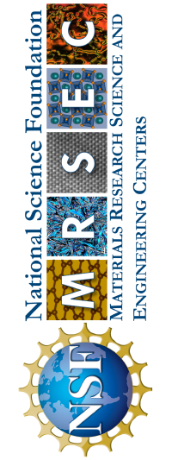
Penn MRSEC
DMR-2309043
Amphiphilic Nanopores:
Spontaneous Water Harvesting from Air
Daeyeon Lee and Amish Patel, University of Pennsylvania
Outcomes: Penn MRSEC researchers Lee and Patel developed nanoporous films that spontaneously condense water vapor from undersaturated air and release it as collectible droplets at room temperature, requiring no external energy.
Impacts and Benefits: This breakthrough enables energy-efficient water harvesting in arid environments, autonomous cooling systems for electronics, and sustainable water management technologies that could address water scarcity challenges globally.
Explanation: The team created amphiphilic nanoporous films by combining hydrophobic polymers with hydrophilic nanoparticles. These materials exploit capillary condensation to capture water vapor from air below saturation conditions, then spontaneously exude the condensed water as microscopic droplets on the surface. Unlike existing water harvesting technologies that require significant energy for cooling or heating, these materials work isothermally through carefully engineered nanoscale surface properties that balance hydrophilic water attraction with hydrophobic water release.
Extreme close up of water drop on the hologram color paper
BQ Kim, Z Vicars, M Füredi, LF Escobedo, RB Venkatesh, S Guldin, AJ Patel, and D Lee. “Amphiphilic nanopores that condense undersaturated water vapor and exude water droplets”, Science Advances (2025). https://doi.org/10.1126/sciadv.adu8349
Notes:
What has been achieved
The research team successfully demonstrated a new class of materials—polymer-infiltrated nanoparticle films (PINFs)—that can harvest water from humid air without any energy input. These materials condense water vapor at relative humidity levels as low as 90% and spontaneously release it as collectible droplets. The key innovation lies in creating amphiphilic nanopores that combine water-attracting and water-repelling surfaces at the nanoscale, enabling both condensation and release.
Importance of the Achievement
This discovery addresses critical global challenges in water scarcity and energy-efficient cooling. Current atmospheric water harvesting technologies require substantial energy for cooling below the dew point, making them impractical for many applications. These new materials work at ambient temperature with zero energy input, potentially revolutionizing water collection in arid regions and enabling passive cooling systems for electronics.
Relationship to Broader Research Goals
This achievement directly supports the research project's goal of understanding "Rules of Life" for condensed mesophases of polymers. The work demonstrates how engineered phase transitions in polymer systems can create functional materials with emergent properties. By controlling the structure and dynamics of polymer-nanoparticle assemblies, the team has created materials that exhibit spontaneous water collection behavior—a key step toward developing synthetic biomaterials that can augment cellular functions and create new biotechnological applications. This research provides fundamental insights into how mesoscale organization in synthetic materials can mimic and enhance biological processes.
Where the findings are published: BQ Kim, Z Vicars, M Füredi, LF Escobedo, RB Venkatesh, S Guldin, AJ Patel, and D Lee. “Amphiphilic nanopores that condense undersaturated water vapor and exude water droplets”, Science Advances (2025). https://doi.org/10.1126/sciadv.adu8349

