Slide 1
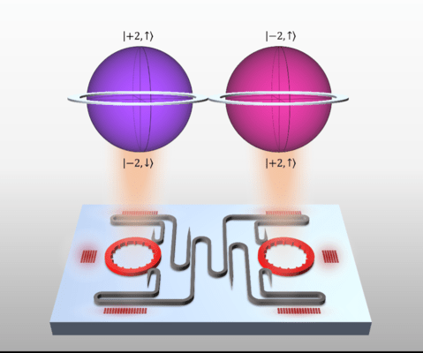
Univ. of Pennsylvania MRSEC
DMR-1720530
Adding new dimensions to quantum communication
Liang Feng and Ritesh Agarwal, University of Pennsylvania
A way to make communication and computing devices faster, better, and less noisy is to use more kinds of information and combine them in new ways. Quantum communication uses light particles that can be in many states at the same time. These states are different features of light particles, and they can only show one state when someone looks at them, making them hard to spy on or copy.
Researchers at the University of Pennsylvania have made a microfabricated laser using semiconductor fabrication methods that can control two features of the light particles: their orbit and their spin. This allows them to make light particles with four states simultaneously. These higher-dimensional quantum bits (qudits) can store more information and better avoid noise. They can also make quantum communication more secure and faster and allow more secure communications.
The hyperdimensional spin–orbit laser: Today’s quantum communication devices use qubits, which can store two kinds of information at the same time. But this is not enough to hold much information or avoid noise. This study reports the development of an on-chip microfabricated laser that makes qudits, which are light particles with four kinds of information simultaneously. The more kinds of information, the better the quantum communication device can work in the real world.
Reference
Zhang, Z., Zhao, H., Wu, S., Wu, T., Qiao, X., Gao, Z., Agarwal, R., Longhi, R., Litchinitser, N.M., Ge, L., Feng, L. Nature 612, 246-251 (2022).
Notes:
What Has Been Achieved: Add your narrative here.
Importance of the Achievement: Add your narrative here.
How is the achievement related to the IRG, and how does it help it achieve its goals? Add your narrative here.
Where the findings are published: Enter citation and DOI here.

