Slide 1
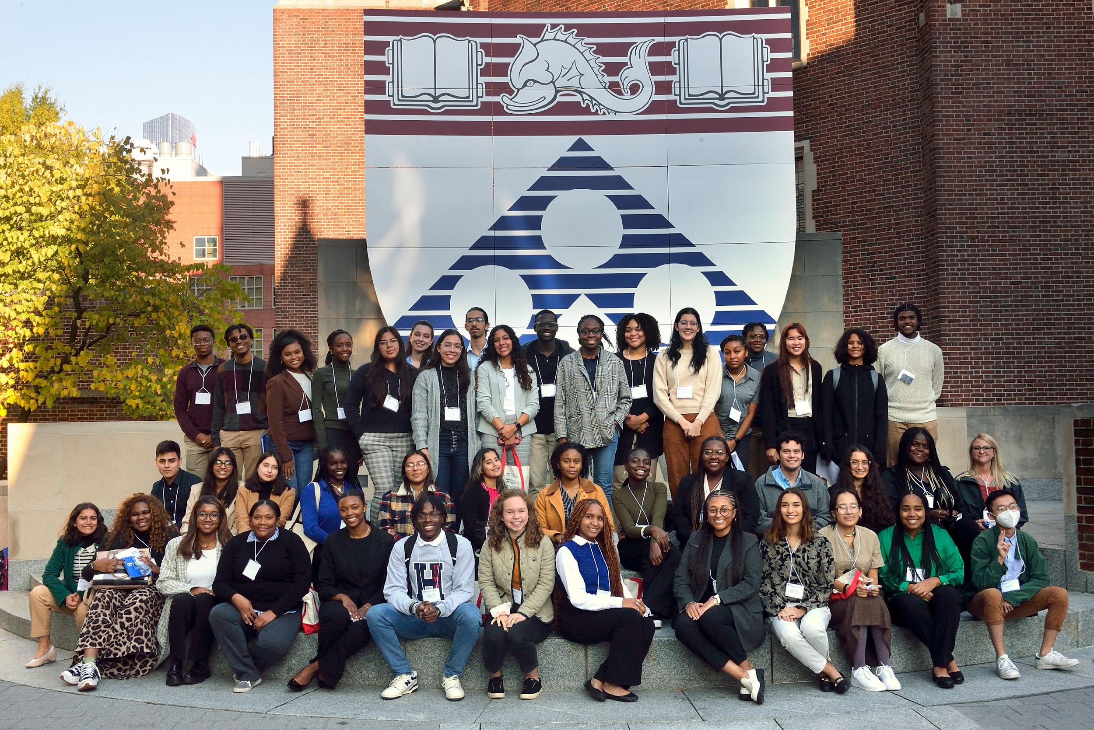
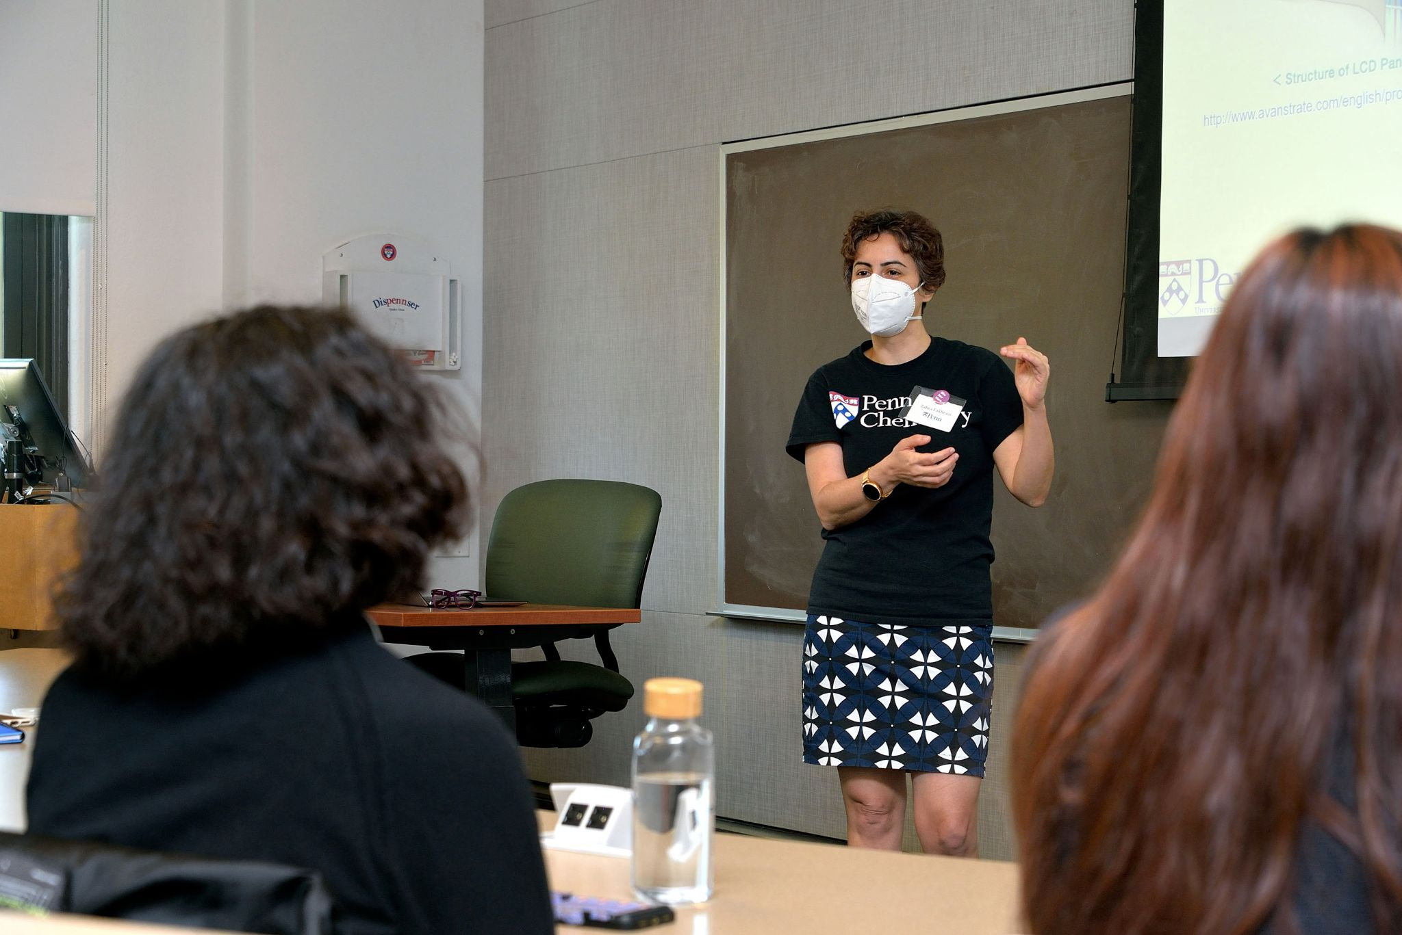
Univ. of Pennsylvania MRSEC
DMR-1720530
Supporting Diversity, Equity, and Engagement in STEM
Mark Licurse & Ashley Wallace, University of Pennsylvania
The LRSM spearheaded the inaugural Diversity Equity Engagement at Penn in STEM (DEEPenn STEM) weekend in October 2022. The initiative aims to proactively educate and recruit students from ethnically and racially minoritized communities (i.e. URMs), women, and first-generation low-income (FGLI) students to STEM-related graduate programs at Penn. Co-hosted by Penn’s School of Arts & Sciences (SAS), School of Engineering and Applied Science (SEAS), and Perelman School Medicine (PSOM), the event showcased the interdisciplinary nature of STEM-related graduate research at Penn and advanced efforts of fostering inclusivity by focusing on the recruitment of diverse candidates to STEM specific graduate programs. Forty-eight (48) prospective graduate students participated in the 3 day in-person event. The agenda contained sessions that covered the intricate details of graduate school preparation through a series of student panels, faculty research talks, poster presentations, and workshops.
Top: 2022 inaugural DEEPenn STEM cohort
Bottom: Zahra Fakhraai, LRSM faculty and professor of Chemistry at Penn, speaking to participants during the faculty research talk segment of the DEEPenn STEM weekend.

