Slide 1
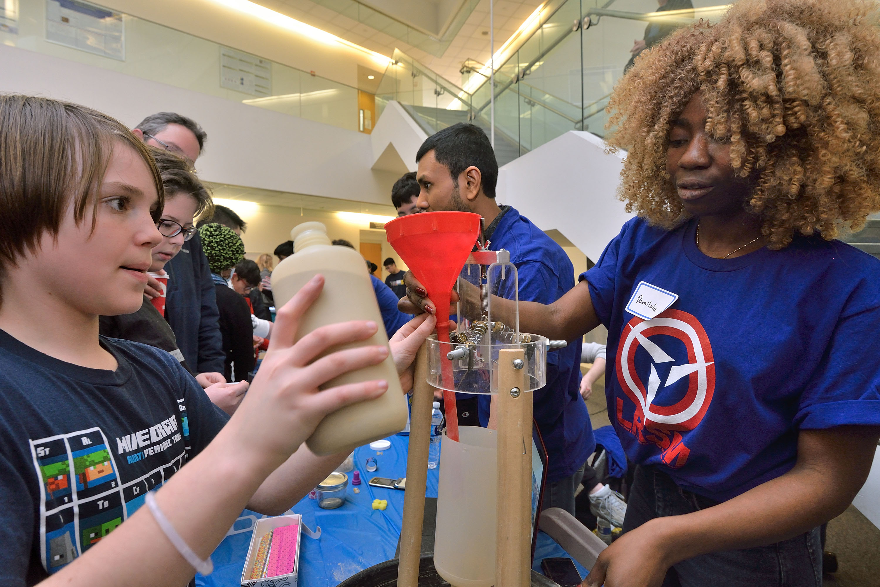
Univ. of Pennsylvania MRSEC
DMR-1720530
12th Annual Philadelphia Materials Day
Mark Licurse & Ashley Wallace, University of Pennsylvania
Philadelphia Materials Day is a collaborative effort between the University of Pennsylvania MRSEC and the Materials Science & Engineering Department at Drexel University to promote materials research in the region. The 12th annual Philadelphia Materials Day took place on February 11, 2023 at the Bossone Research Center at Drexel University.
More than 85 volunteers from 14 different University of Pennsylvania MRSEC-affiliated research groups combined efforts with Drexel to run a series of demonstrations for more than 600 attendees (K-12 and their families). University of Pennsylvania participating groups included & demo titles were as follows:
Eric Stach (MSE): Superconducting Levitation
Shu Yang (MSE): Origami/Kirigami and Hydrogels
Kevin Turner (MEAM): Sticky Materials
Zahra Fakhraai (Chemistry): Fun with Lights and Glasses
Ekaterina Grishchuk (Physiology): Why is blood liquid in our arteries but it clots quickly in laboratory tubes?
Liang Wu (MSE): Electromagnetism Demonstration
E. James Petersson (Chemistry): Bright Molecules for Brain Studies
Russel Composto (MSE): Shrinking Polymers
Kathleen Stebe (CBE): Introduction to Liquid Crystals
Arjun Yodh (Physics): What is an Emulsion?
Rob Carpick (MEAM): Tribology – The Science of Friction
Jordan Raney (MEAM): The Utility of Instability
Lee Bassett (ESE): Colors, Lasers, Fluorescence, and Computer Screens
Chris Murray (MSE): Visualizing Nanoscale Materials
Damilola Lawal, from the Raney lab, demonstrates The Utility of Instability to a K-12 student.

