Slide 1
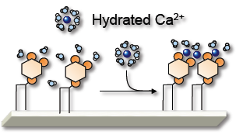
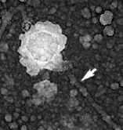
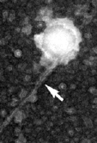
A Lipid-Clustering Mechanism to Trigger Actin Assembly in Cell Extracts
Paul A. Janmey and Dennis Discher
Filaments in the cytoplasm that constitute a three dimensional cytoskeleton are formed by polymerization of the protein actin, which is initiated at distinct sites near the cell membrane. Negatively charged lipids in the membrane corm clusters when intracellular calcium increases, and these lipid clusters activate proteins that initiate actin assembly.
80 nm
Support: Primary NSF MRSEC DMR-11-20901
Notes:
Hydrate calcium ions bind to PIP2 in a process that leads to their dehydration and strong binding to phosphomonoesters to ridge between two lipids. The multivalent structure of PIP2 leads to cluster formation in the presence of Ca2_ but not other divalent cations to form nan0doamosn with a finite size near 80 nm. Such clusters of PIP2 recruit and activate actin nucleating factors in brain extracts that in turn initiate actin assembly t site where the PIP2 is clustered.

