Slide 1
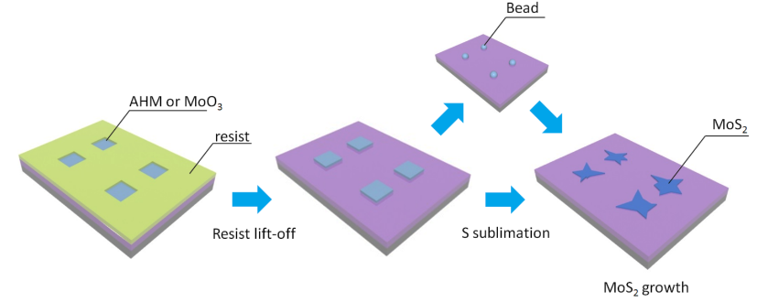
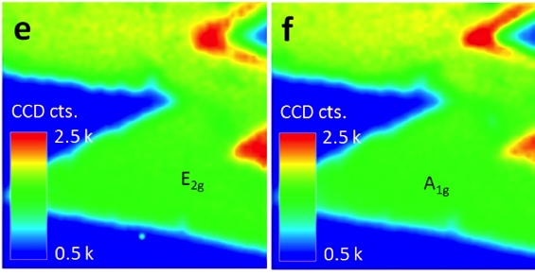
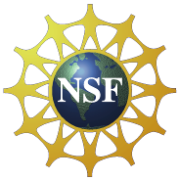
Seeded Growth of Highly Crystalline Molybdenum Disulfide Monolayers at Controlled Locations Ritesh Agarwal, and A.T. Charlie Johnson (Seed 8)
Monolayer molybdenum disulfide (MoS₂) is a 3-atom thick material with a direct band gap, making it of interest for fundamental science as well as applications in optoelectronics and chemical sensing. Our innovation is a scalable method for “seeded growth” of high quality monolayer MoS₂ at controlled locations, which is an important advance towards useful applications of the material.
Growth “seeds” of molybdenum-containing material are patterned at known locations with micrometer resolution. Crystalline islands of MoS₂ are grown from the seeds by chemical vapor deposition.
Raman map demonstrates uniformity across monolayer regions.
Structural, optical, and electrical measurements show that the growth is high quality monolayer MoS₂. With MoS₂ islands
at known locations, it is straightforward to fabricate MoS₂ transistors with minimal chemical contamination for device applications.
Support: Primary ENG-1312202 Secondary NSF MRSEC DMR-11-20901

