Slide 1
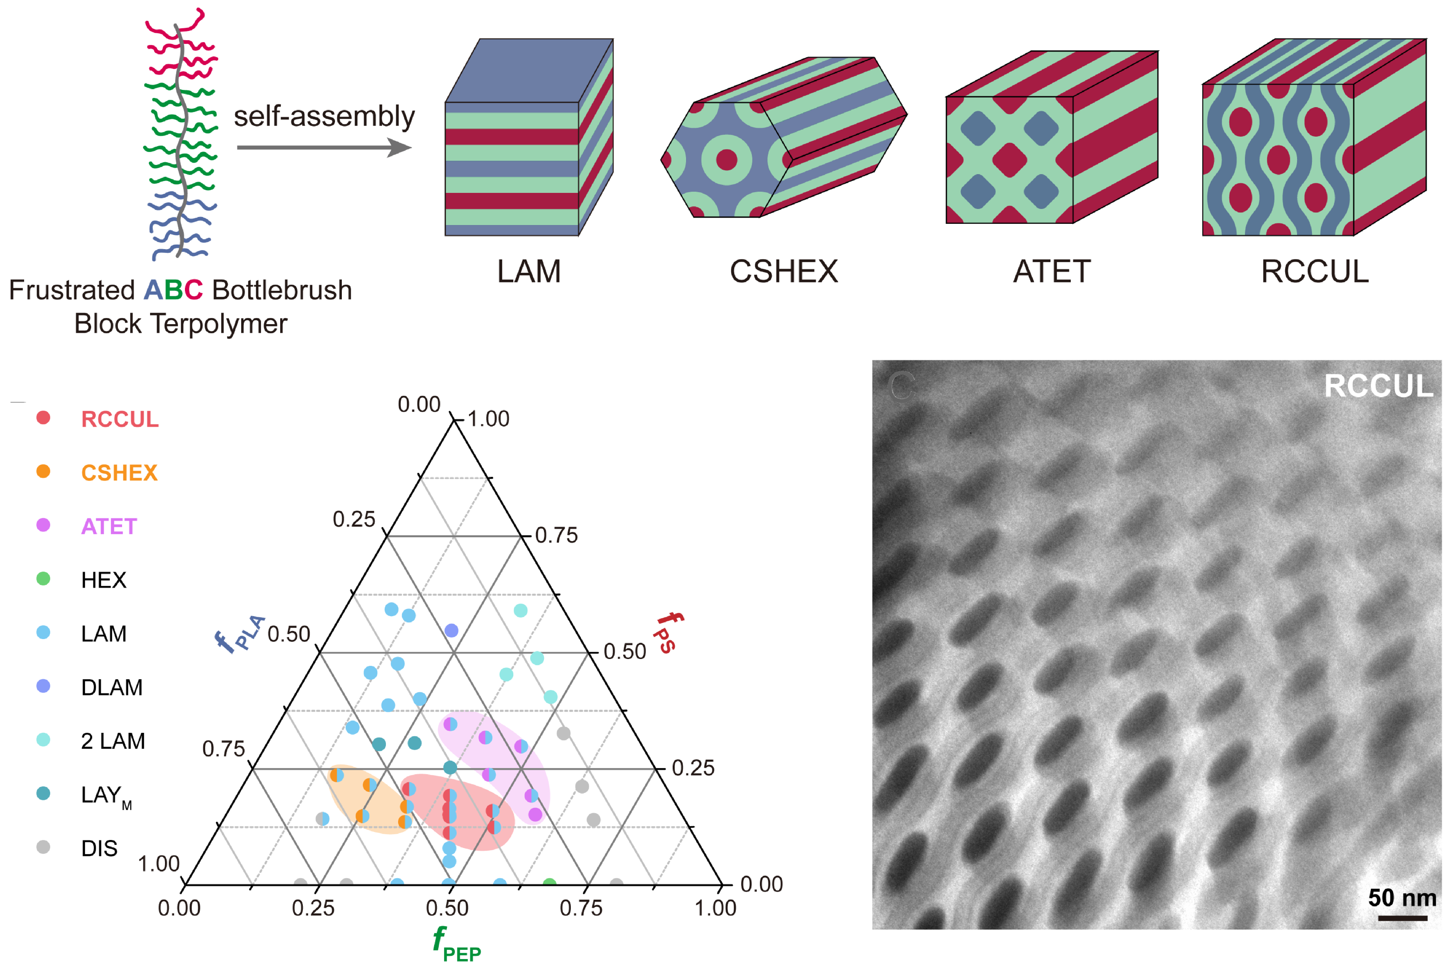
University of Minnesota MRSEC
DMR-2011401
Mesoscopic Morphologies in Frustrated
ABC Bottlebrush Block Terpolymers
F. S. Bates, T. P. Lodge (IRG-2)
Bottlebrush block polymers, characterized by densely grafted side chains on a linear backbone, have recently garnered attention. A particularly attractive feature is the accessibility of ordered morphologies with large domain spacings d = 50–500 nm, which is challenging to achieve with linear block polymers. These large morphologies make bottlebrush block polymers promising for applications, especially, as photonic crystals and optical metamaterials. However, structures achieved in AB diblock bottlebrushes are generally limited to lamellar and cylindrical phases, which restricts potential applications. To address this, UMN MRSEC IRG-2 researchers investigated the self-assembly of ABC bottlebrush block terpolymers. Morphological characterization in collaboration with the Bio-Pacific MIP at UC-Santa Barbara, revealed intriguing mesoscopic structures, including lamellae, core-shell hexagonally packed cylinders (CSHEX), alternating tetragonally packed cylinders (ATET), and an unprecedented morphology, rectangular-centered cylinders-in-undulating-lamellae (RCCUL). Molecular weight variations led to a range of unit cell dimensions (exemplified by RCCUL) from 40 to 130 nm. This work highlights the abundant potential for multiblock bottlebrushes to create materials with innovative structures and tailored domain dimensions.
S. Cui, E. A. Murphy, S. Santra, F. S. Bates, T. P. Lodge, ACS Nano, 2025, 19, 1211-1221, DOI: 10.1021/acsnano.4c13416.
Notes:
What Has Been Achieved: We investigated the self-assembly phase behaviors of frustrated bottlebrush block terpolymers PLA-PEP-PS synthesized via sequential ring-opening metathesis polymerization (ROMP) of norbornene-functionalized poly(D,L-lactic acid) (PLA), poly(ethylene-alt-propylene) (PEP), and polystyrene (PS). Structural characterization using small-angle X-ray scattering (SAXS) and transmission electron microscopy (TEM) revealed a diverse array of mesoscale morphologies. These included layered structures, core–shell hexagonally packed cylinders (CSHEX, plane group p6mm), alternating tetragonally packed cylinders (ATET, plane group p4mm), and a new morphology, rectangular-centered cylinders-in-undulating-lamellae (RCCUL, plane group c2mm). Tuning the molecular weight led to significant variations in unit cell dimensions, with the RCCUL structure exhibiting unit cell parameters ranging from 40 nm to over 130 nm.
Importance of the Achievement: Our findings underscore the potential of bottlebrush block polymers to generate a diverse set of well-defined morphologies with tunable dimensions. This structural versatility positions them as promising candidates for a wide range of applications.
How is the achievement related to the IRG, and how does it help it achieve its goals? Our findings highlight that bottlebrush block polymers can be used to create new morphologies with a broad range of dimensions. Combined with our previous work (S. Cui, B. Zhang, L. Y. Shen, F. S. Bates, T. P. Lodge, J. Am. Chem. Soc., 2022, 144, 21719-21727, DOI: 10.1021/jacs.2c09674; S. Cui, E. A. Murphy, W. Zhang, A. Zografos, L. Shen, F. S. Bates, T. P. Lodge, J. Am. Chem. Soc., 2024, 146, 6796-6805, DOI: 10.1021/jacs.3c13543), which reported the discovery of a core-shell gyroid network and a cylinders-in-undulating-lamellae morphology in non-frustrated ABC bottlebrush systems, the identification of new, large, and complex structures in the present study further underscores the promise of multiblock bottlebrush polymers for accessing unexpected mesoscale network phases – a key overall goal of the IRG.
Where the findings are published: S. Cui, E. A. Murphy, S. Santra, F. S. Bates, T. P. Lodge, ACS Nano, 2025, 19, 1211-1221, DOI: 10.1021/acsnano.4c13416.

