Slide 1
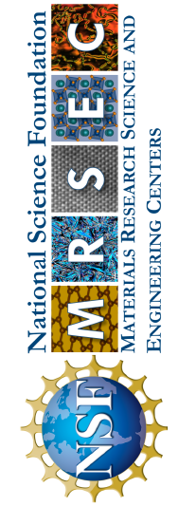
University of Minnesota MRSEC
DMR-2011401
Pushing the Limits of Topotactic Cycling Endurance
in Oxide Electrochemical Transistors
K. A. Stoerzinger (Seed), C. Leighton, V. E. Ferry (IRG-1)
Research in IRG-1 in the UMN MRSEC has brought oxide electrochemical transistors to the verge of applications. Cycling endurance and switching speed are the two final roadblocks to realistic devices. In this period, a collaboration between IRG-1 and a Seed investigator has led to record cycling endurance in ion-gel transistors based on topotactic redox cycling of La_{0.5}Sr_{0.5}CoO_{3-δ} (LSCO), improving on previous records by an order of magnitude. LSCO is one of the premier materials for such transistors, as gate-induced oxygen vacancy formation induces a topotactic structure change due to ordering of oxygen vacancies. The IRG/Seed team applied operando FTIR spectroscopy to probe the optical response of ion-gel gated LSCO during voltage cycling, uncovering a wealth of new mechanistic understanding including about the roles of humidity, device geometry, and electrode metal selection. This enabled optimized devices operating over at least 100 cycles. This sustained modulation of optical properties in the infrared motivates the use of LSCO in thermal camouflage, thermoregulation, and several other applications.
R. D. Chakraborty, J. Liang, N. Nandakumaran, T. A. Fasasi,
K. A. Stoerzinger, C. Leighton, V. E. Ferry, ACS Nano (2025).
10.1021/acsnano.5c01256
Notes:
What Has Been Achieved: Measurements of the cycling endurance of LSCO, showing record cycling endurance by an order of magnitude. The IRG-1 team used operando FTIR spectroscopy for the first time, correlated with electrochemical measurements, to gain mechanistic insight into endurance and the roles of relative humidity, device design, and electrode metal selection.
Importance of the Achievement: Cycling endurance is one of the key factors that determines translation of laboratory devices into technological applications. This study improved on cycling endurance by an order of magnitude, addressing both application needs in tunable photonic devices such as themoregulation systems, and giving insight into the mechanisms that limit endurance. The latter then points to additional strategies to improve endurance, which may be generalizable to other perovskite oxides.
How is the achievement related to the IRG, and how does it help it achieve its goals? La_{0.5}Sr_{0.5}CoO_{3-δ} (LSCO) is one of the key materials of interest in our IRG. Upon electrolyte-gating, as shown here, LSCO undergoes an electrochemical transformation between a metallic perovskite state and an insulating brownmillerite state. Understanding this transformation and its impact on a wide range of properties (electrical, magnetic, thermal, optical) is one of the primary accomplishments and goals of the IRG.
Where the findings are published: Chakraborty, R.D.; Liang, J.; Nandakumaran, N.; Fasisi, T. A.; Stoerzinger, K. A.; Leighton, C.; Ferry, V. E. “High Metal-Insulator Topotactic Cycling Endurance in Electrochemically Gated La_{0.5}Sr_{0.5}CoO_{3-δ} Probed by Humidity-Dependent Operando FTIR Spectroscopy,” ACS Nano (2025).
1

