Slide 1
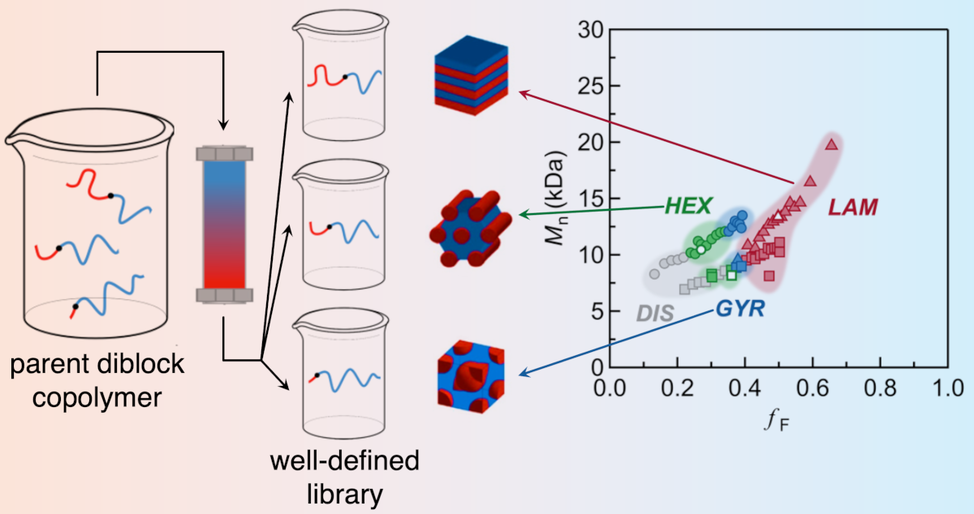

UC Santa Barbara MRSEC
DMR-2308708
Rapid Generation and Screening of Complex Polymer Morphologies
Chris Bates and Craig Hawker (UC Santa Barbara)
Block copolymers, with their complex morphologies, are widely used in many applications. A grand challenge associated with these materials is accelerating their design and discovery.
UC Santa Barbara MRSEC researchers have developed a versatile and efficient strategy by rapidly building expansive, high-quality, and detailed block copolymer libraries through a combination of controlled polymerization and chromatographic separation. X-ray scattering studies aid in screening block copolymer morphology.
A family of 16 parent diblock copolymers was synthesized and separated, leading to over 300 distinct and well-defined samples at the multigram scale, and spanning a wide range of compositions with exceptional resolution in volume fraction and domain spacing.
The precise location of order-order boundaries and the identification of morphologies with extremely narrow windows of stability are possible with these methods.
Scheme of the synthesis and separation of block copolymers and a typical morphology analysis as a function of molecular weight and phase fraction.
Murphy, Skala, Kottage, Kohl, Li, Zhang, Hawker, Bates, Accelerated discovery and mapping of block copolymer phase diagrams, Phys. Rev. Mater. 8 (2024) 015602. DOI: 10.1103/PhysRevMaterials.8.015602
Notes:
What Has Been Achieved: Please see above.
Importance of the Achievement: These methods decrease by orders-of-magnitude, the time taken to screen block-copolymer chemistries and morphologies.
How is the achievement related to the IRG, and how does it help it achieve its goals? An important goal of IRG-1 is to develop new and more sustainable polymers for a variety of applications.
Where the findings are published: Murphy, Skala, Kottage, Kohl, Li, Zhang, Hawker, Bates, Accelerated discovery and mapping of block copolymer phase diagrams, Phys. Rev. Mater. 8 (2024) 015602. DOI: 10.1103/PhysRevMaterials.8.015602

