Slide 1
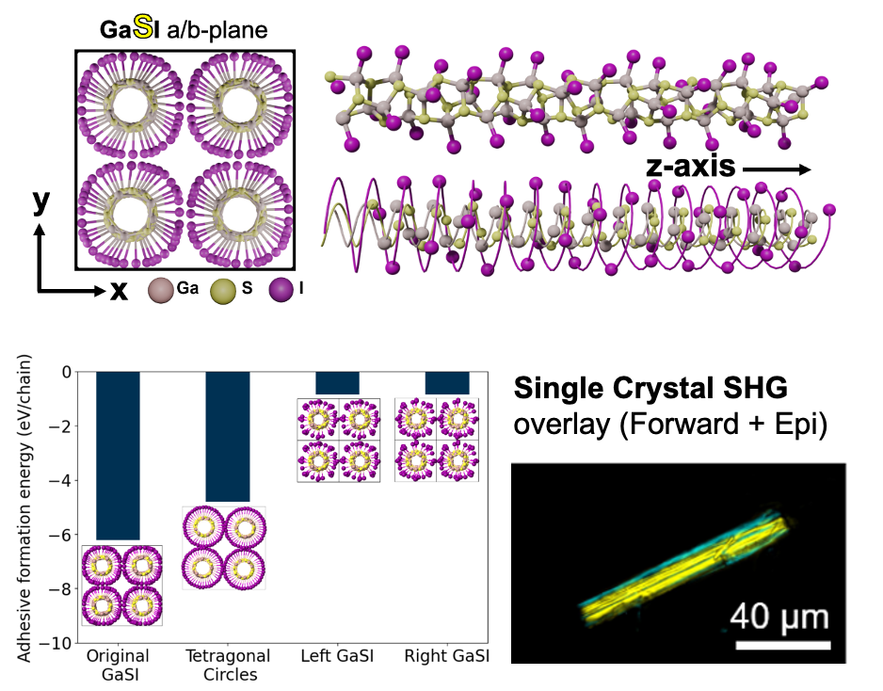

2025 Seed Intellectual Merit
UCI MRSEC
DMR-2011967
Discovery of Helical Inorganic Crystals as Building Blocks for Chiral and Non-reciprocal Excitations
M. Arguilla, W. Ho, I. Krivorotov, E.M.Y. Lee,
J. Romhanyi, and R. Wu (University of California, Irvine)
The realization of chiral and non-reciprocal excitations in inorganic crystalline materials necessitates the development of new atomically-precise chiral solid state crystals and understand their fundamental optical/electronic states that arise from the resulting structures
Developed the chemistry to synthesize single crystals of a new 1D van der Waals helical crystal, GaSI, belonging to the deep class of III-VI-VII tetrahelices
From first principles calculations and single crystal X-ray diffraction, we observed a stable, non-natural helical cross section in GaSI chains which manifests as a “squircle” geometry (hybrid between a square and a circle), imparting an oscillating curvature and torsion along the chain
The 3.7 eV band gap GaSI packs in a newly observed non-centrosymmetric primitive unit cell (P-4) which led to the observation of pronounced second harmonic generation (SHG)
Dold, K.G.,º Cordova, D.L.M.,º Singsen, S., Nguyen, J.Q., Milligan, G.M., Marracci, M., Yao, Z.F., Ziller, J.W., Fishman, D.A., Lee, E.M.Y., Arguilla, M.Q.,* 2024. GaSI: A Wide-Gap Non-centrosymmetric Helical Crystal. J. Am. Chem. Soc., 2024, 146, (33), 22881-22886.
Notes:
What Has Been Achieved: By understanding the compositional boundaries of the Ga-based tetrahelices in the III-VI-VII class of 1D van der Waals helices, we demonstrated, for the first time, the discovery of a bulk single crystal that features weakly bound helical chains of GaSI which is characterized by a non-natural helical cross section in a “squircle” geometry (hybrid between a square and a circle). Complementary to experimental single crystal X-ray diffraction, we confirmed the stability of the squircular geometry using first principles calculations of both the thermodynamic stability and the electronic band structure. The variability of short and long bonds along the helical chain imparts a unique oscillating curvature and torsion that has never been observed both in organic and inorganic helical phases known in the literature. Due to this pseudo-four-fold symmetry, GaSI crystallized in an unprecedented non-centrosymmetric primitive unit cell (P-4) which, owing to its lack of inversion symmetry, manifests pronounced second harmonic generation from 800 nm to 400 nm.
Importance of the Achievement: This is a significant breakthrough in the discovery of new inorganic helical crystals that will manifest chiral collective states. This will also lead to a deeper understanding of how compositional parameters directly alter both the chiral ordering in extended lattices and their resulting physical states. Our discovery is a step closer towards developing a chemical and materials design rules to deterministically program helicity in the solid state.
How is the achievement related to the IRG, and how does it help it achieve its goals? This achievement, and its broader implications in the understanding of the chemistry and physics of helical solid state materials, is one of the two pillars of the SEED project wherein we seek to couple chiral/helical materials with magnetic materials to realize unique hybridized chiral/non-reciprocal excitations (magnon-polaron) at the solid-solid interface. This discovery, along with the realization of novel helical inorganic crystals based on this model phase, addresses the significant and non-trivial materials vacuum of available chiral/helical materials that can be interfaced with magnetic materials to achieve our goal of inducing interfacial hybridized chiral/non-reciprocal excitations.
Where the findings are published: J. Am. Chem. Soc., 2024, 146, (33), 22881-22886.

