Slide 1
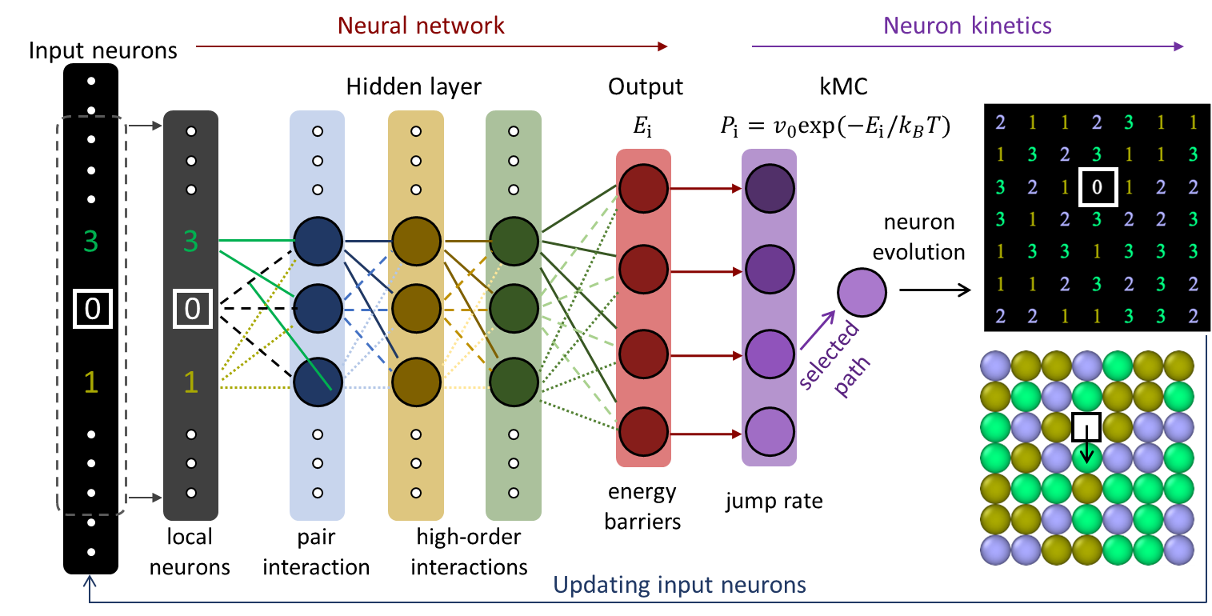
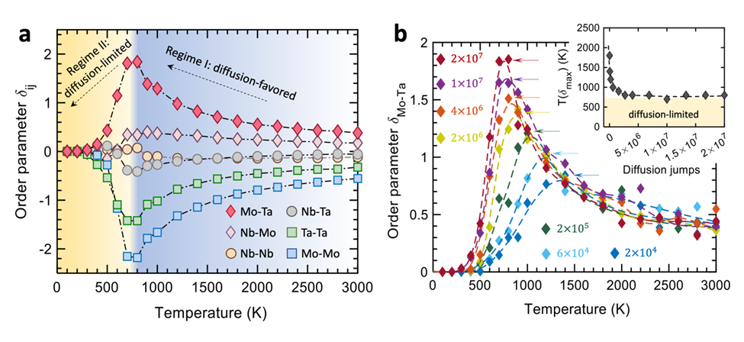

2025 IRG-1 Intellectual Merit
UCI MRSEC
DMR-2011967
Neural Network Kinetics: Exploring Diffusion Multiplicity and Chemical Ordering in Compositionally Complex Materials
B. Xing, W. Zou, T.J. Rupert, X.Q. Pan, and P. Cao
(University of California, Irvine)
We introduce a neural network kinetics (NNK) scheme that predicts and simulates diffusion-induced chemical and structural evolution in complex concentrated chemical environments.
The framework is grounded on efficient on-lattice structure and chemistry representation combined with neural networks, enabling precise prediction of all path-dependent migration barriers and individual atom jumps.
Using this method, we study the temperature-dependent local chemical ordering in refractory NbMoTa alloy and reveal a critical temperature at which the B2 order reaches a maximum.
Our atomic jump randomness map exhibits the highest diffusion heterogeneity (multiplicity) in the vicinity of this characteristic temperature, which is closely related to chemical ordering and B2 structure nucleation.
Neural network kinetics (NNK)
The critical temperature giving rise to the maximum B2 order
B. Xing, TJ. Rupert, X Pan, and P Cao. Nature Communications 15, no. 1 (2024): 3879.
Notes:
What Has Been Achieved: Developed a generic framework NNK to solve diffusion problems in CCMS.
Importance of the Achievement: It’s addressing a long standing challenge in modeling diffusion and chemical ordering in CCMs.
How is the achievement related to the IRG, and how does it help it achieve its goals? It directly supports IRG 1’s scientific goal of understanding kinetics- and thermodynamics-induced interface ordering and disordering.
Where the findings are published: The paper has been submitted.

