Slide 1
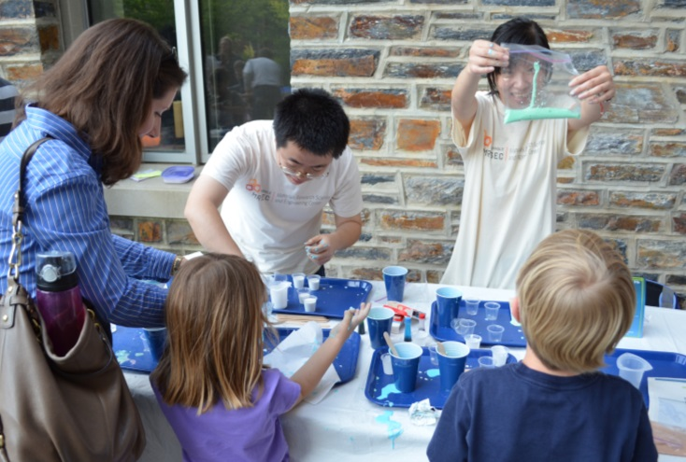
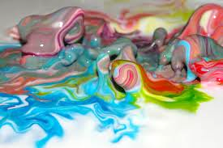
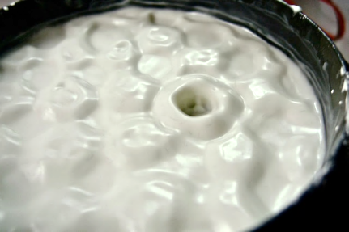
Goo, Goop, and Gak: Public Outreach with the North Carolina Science Festival
“Goo, Goop, and Gak: The Science of Squishy Materials” - Gooey, goopy materials and a lecture about the wonders of snot were the stars of a family-friendly, hands-on evening of science on the Duke University campus (Apr. 17th, 2012), sponsored by Triangle MRSEC. This event was part of the NC Science Festival, a state-wide multi-day celebration showcasing science and technology in NC.
Faculty and students shared hand-on, interactive demos with “oobleck” cornstarch polymers, polymer origami that folds itself magically, and other “soft matter” with unusual properties.
The evening also featured tours of facilities including the DiVE virtual reality simulator, and a guest lecture, “The Science of Snot,” by Dr. Richard Superfine UNC-Chapel Hill
Post-event assessment data confirmed that respondents thought the event “made STEM learning fun” and made them more aware of STEM in their daily lives.
Notes:
The long term goal of the ΔMRSEC outreach program is to develop sustained partnerships with G5-12 schools, teachers, and students, to bring STEM concepts into the classroom, and increase the diversity and enrollment of domestic students in STEM degree programs. ΔMRSEC has made significant progress in this direction by partnering with the North Carolina Central University (NCCU) Women’s Center which is in its third year of a program with Shepard Middle School in Durham, NC. This program, entitled Women Inspiring Learning Momentum (W.I.L.L.), is designed to encourage middle school girls to pursue STEM careers, and pairs girls from Shepard Middle School with NCCU female undergraduate students and working STEM professionals, for a six week Saturday experience. During Saturdays in the 2012 spring semester, middle school students came to NCCU's campus, to participate in mentoring sessions, academic enrichment activities, hands-on scientific experiments, a field trip, and seminars focused on breaking the barriers faced by women in the sciences. Two ΔMRSEC undergraduates helped to plan the 2012 curriculum and to chair the experiments committee. ΔMRSEC fellow Kallon served as a graduate student mentor to two of the 20 WI.L.L. participants. ΔMRSEC Co-Director Hall and Investigator Taylor, were two of the professional mentors recruited to speak to the middle school girls (Fig. 2).

