Slide 1
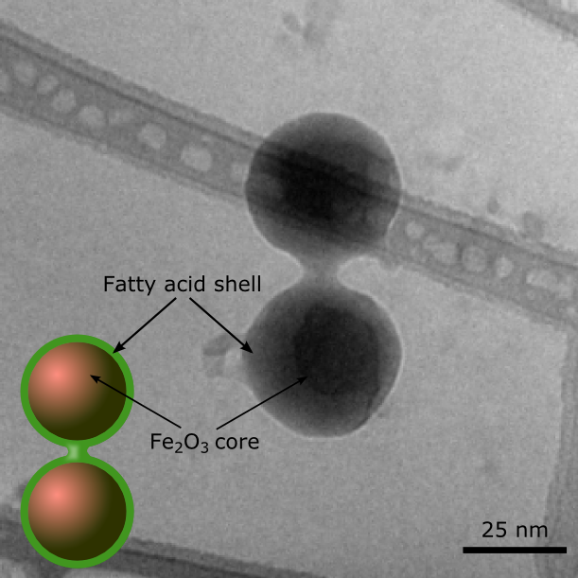
DUKE | NCCU | NCSU | UNC-CH
Nanocapillarity-mediated magnetic assembly of nanoparticles into ultraflexible filaments and reconfigurable networks
Bhuvnesh Bharti¹, Anne-Laure Fameau² Michael Rubinstein³ and Orlin D. Velev¹
¹Deptartment of Chemical and Biomolecular Engineering, North Carolina State University, Raleigh
²National Institute of French Agricultural Research, Nantes ³Department of Chemistry, University of North Carolina, Chapel Hill
New principle of binding of liquid-coated nanoparticles by nanocapillary bridges from oily fatty acids
External magnetic field directs the iron oxide nanoparticle assembly into linear filaments
The filaments are highly responsive and ultraflexibilible because of the liquid mediated particle linkages
Fatty acid crystallization upon decreasing the temperature fragments the filaments, which can be reformed upon increasing the temperature and reforming the capillary bridges
Mechanically damaged filament networks can be healed by external magnetic field
Visit ΔMRSEC at http://mrsec.duke.edu
NSF DMR 1121107
Nature Mat. (2015); DOI: 1038/nmat4364
Notes:
Mixtures of sand and water (as in sandcastles) are one of the best known examples of a reconfigurable material. The water wets the surface of the grains and forms capillary bridges between them, holding the sand particles together into a complex shape. For the first time we show that bridging capillary forces can be used to “glue” particles at nanoscale. The capillarity-mediated binding between magnetic nanoparticles coated with a liquid lipid shell can be used for the assembly of ultraflexible microfilaments and network structures. These filaments can be magnetically regenerated on mechanical damage, owing to the fluidity of the capillary bridges between nanoparticles and their reversible binding on contact. Nanocapillary forces offer opportunities for assembling dynamically reconfigurable multifunctional materials that could find applications as micromanipulators, microbots with ultrasoft joints, or magnetically self-repairing gels.
Reference:
Nanocapillarity-mediated magnetic assembly of nanoparticles into ultraflexible filaments and reconfigurable networks
Nature Mat., (2015) DOI: 1038/nmat4364
Bhuvnesh Bharti¹, Anne-Laure Fameau² Michael Rubinstein³ and Orlin D. Velev¹
¹Deptartment of Chemical and Biomolecular Engineering, North Carolina State University, Raleigh
²National Institute of French Agricultural Research, Nantes
³Department of Chemistry, University of North Carolina, Chapel Hill
Corresponding author: odvelev@ncsu.edu
Acknowledgement:
The authors gratefully acknowledge support from the US National Science Foundation (NSF) Triangle MRSEC on Programmable Soft Matter (DMR-1121107) and the US Army Research Office (ARO) (W911NF-15-1-0115). M.R. acknowledges financial support from the NSF under grants DMR-1122483, DMR-1309892 and DMR-1436201, from the National Institutes of Health (NIH) under grants P01-HL108808 and 1UH2HL123645, and from the Cystic Fibrosis Foundation. A.L.F. thanks BIA-INRA Nantes for her new faculty fellowship. We gratefully acknowledge C. Gaillard for the cryo-TEM experiments done at the BIBS Plate-forme INRA Nantes, France. We acknowledge the experimental assistance of B. Houinsou-Houssou, N. Galinsky, J. Zhao and J. C. Ledford. We are also grateful to L. Reynolds, J. Tracy and G. H. Findenegg for discussions on the data and their interpretation.

