Slide 1
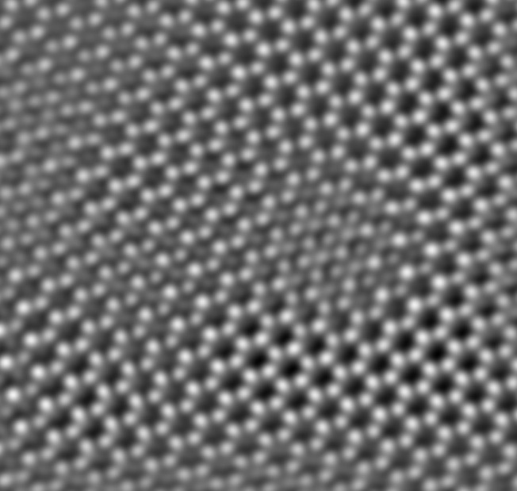
Tip-based functionalization of Group IV graphenes
Writing Surface functionalization on a 2D crystal
IRG-2 has established the controlled tip-based absorption (writing) and desorption (deleting) of hydrogen on C/Si/Ge/Sn graphene materials at atomic length scales.
This allows new explorations on the effect of spatial patterns on a 2D material on the electronic transport properties in an ultraclean environment.
This methodology will enable the creation of efficient nanoelectronic and spintronic devices via controllable chemical functionalization.
2.0 nm
J. Gupta, R. Kawakami, E. Johnston-Halperin, & W. Windl,
The Ohio State University
Notes:
A powerful route towards the preparation and understanding of the effect of surface functionalization on group IV Graphane materials involves the STM-tip based modification of sp² graphene precursor phases grown in UHV. The methodologies for the UHV growth, characterization and hydrogenation of graphene have been developed. The tip of a scanning tunneling microscope was used in field-emission mode to crack H₂ physisorbed on the surface, in situ, producing ordered regions of hydrogenated graphene within a micron-scale area local to the tip. This process could be reversed by STM imaging at higher bias. STM images after the dehydrogenation process showed the same atomic lattice and Moiré pattern as the pristine graphene. These methods are being extended towards Si-, Ge- and Sn-based graphene analogues 2D materials. Few monolayer films of Ge on Cu(111) were deposited and characterized to form a honeycomb lattice. This represents the first growth of germanene on Cu, and is observed to be considerably less buckled and more single-phase than other materials. Additionally, the methodology to probe simultaneous STM and transport measurements in these single layer materials was developed. These studies allow the correlation of local changes in atomic and electronic structure with device level transport characteristics.

