Slide 1
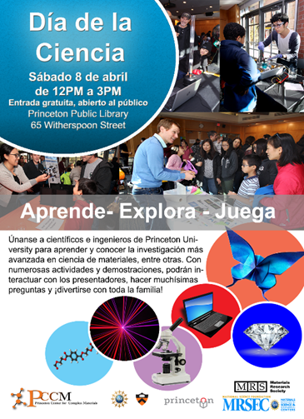
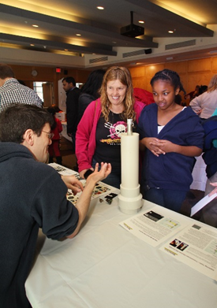
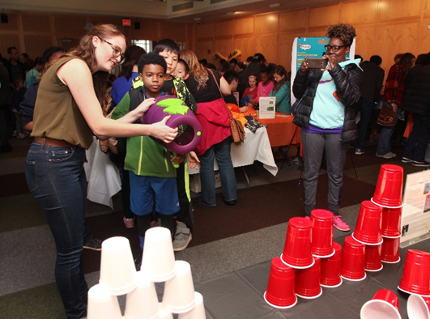
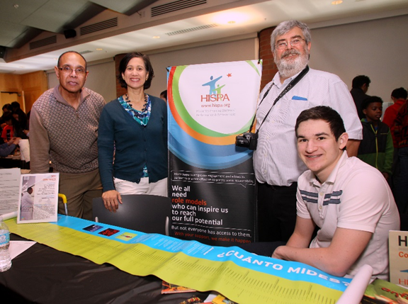
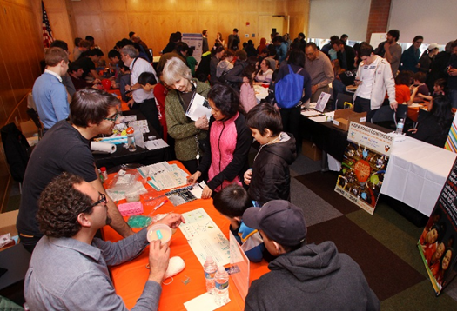
Princeton MRSEC: Dia De la Ciencia/Science Day
DMR 142051
2016
Princeton Center for Complex Materials (PCCM)
Daniel Steinberg,
On April 8, 2017, PCCM held its first Día de la Ciencia at the Princeton Public Library. Forty scientists, mostly PCCM members, at 20 tables, met with over 500 members of the community. In an attempt to improve outreach to all members of the community, PCCM created Día de la Ciencia to reach the large Latino/Latina population in the town of Princeton, NJ and surrounding region. PCCM piloted Día de la Ciencia with science demos and at least one Spanish speaking presenter at each table. PCCM worked with leaders in the community and Princeton University to help with the program. Advertisements in both Spanish and English were sent to local schools and flyers were distributed in the community. Partners included Hispanics Inspiring Students’ Performance and Achievement (HISPA), PPPL, PRISM, YMCA, Princeton Public Library, BMS and others.

