Slide 1
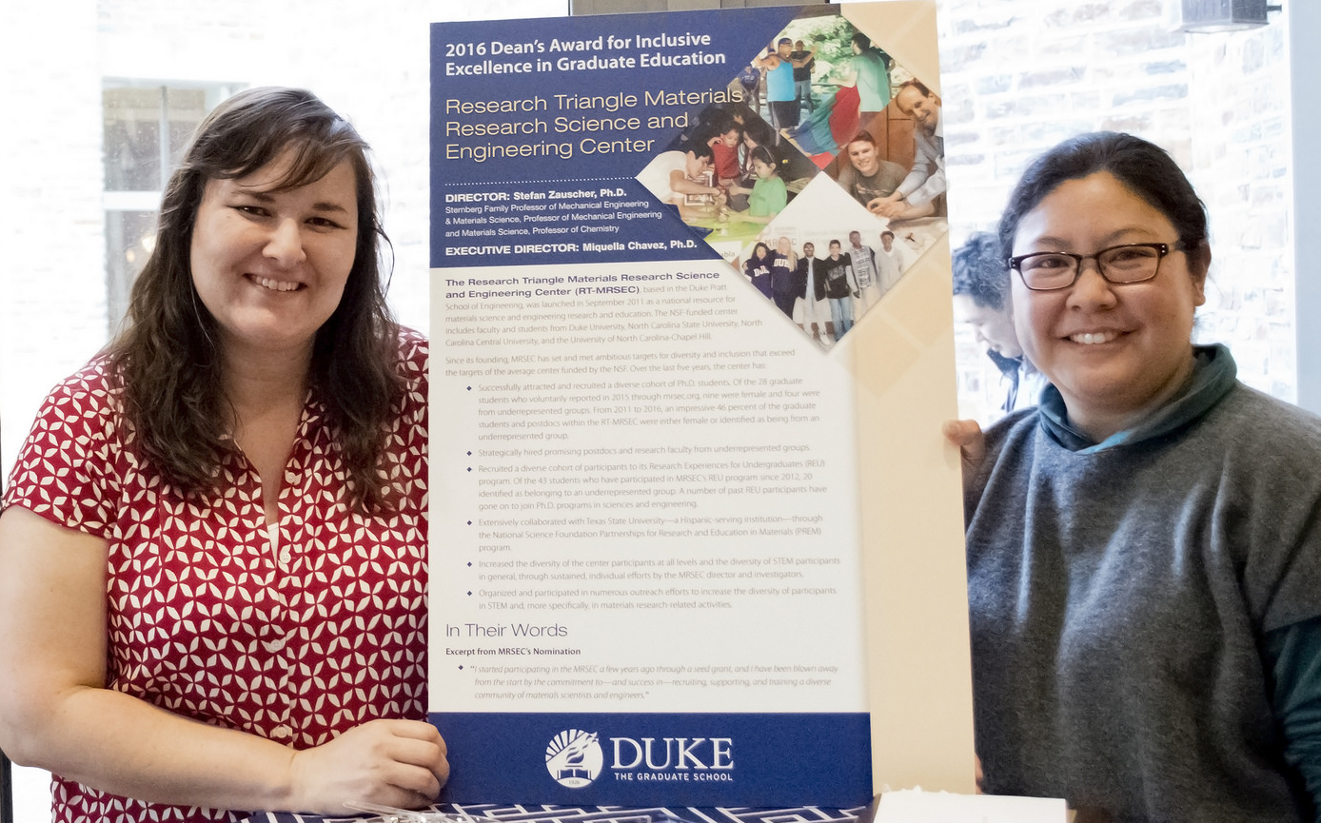
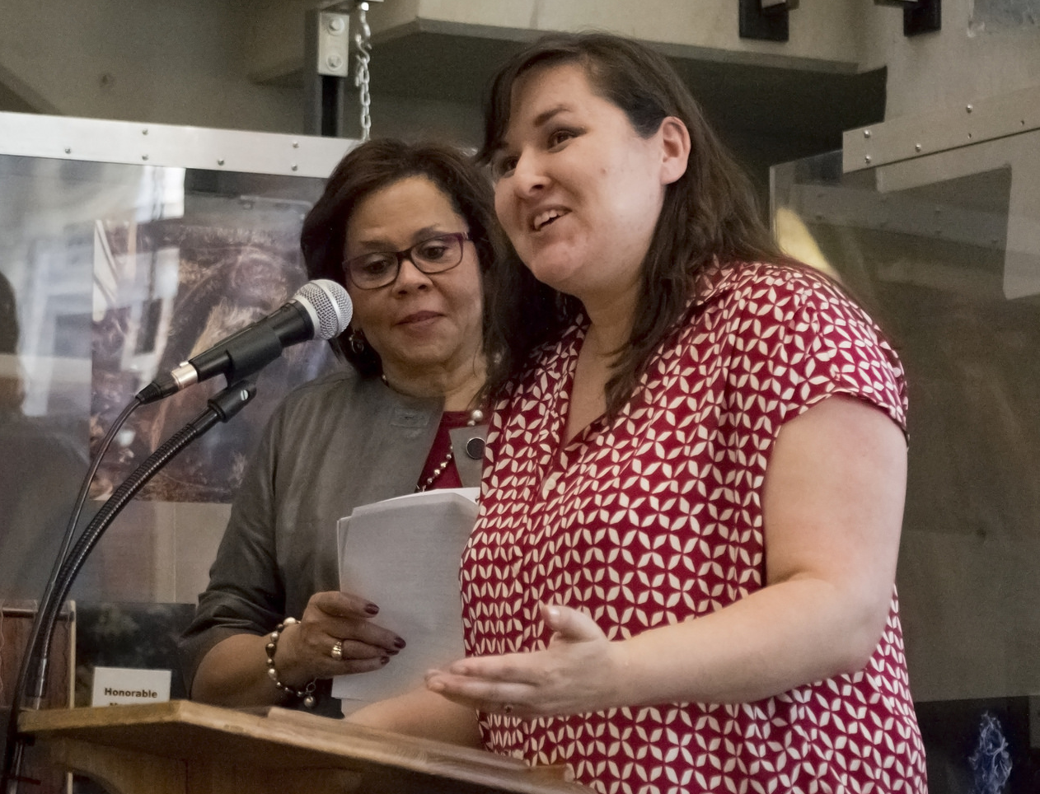
Duke Graduate School Dean’s Award -
Mentoring and Inclusive Excellence
Two exciting awards were presented March 30th, 2016 to the RT-MRSEC and one of its Fellows. RT-MRSEC won Duke’s Graduate School Dean’s Award for Inclusive Excellence in Graduate Education while RT-MRSEC Fellow, Wyatt Shields, won the Graduate Student Excellence in Mentoring Award!
The Inclusive Excellence award recognizes RT-MRSEC’s commitment to excellence, equity, and inclusion in its graduate programming , creating a
welcoming environment that promotes diversity in the intellectual development of its students. Inclusive excellence in education means not only diversity in demographics, but also in the program climate, curriculum, intellectual discourse, and recruitment, retention and graduation of individuals underrepresented in the discipline, field, or area.
The Excellence in Mentoring award recognizes the considerable efforts and accomplishments of graduate students who consistently serve as effective mentors and is an important example of the university’s and RT-MRSEC’s continuing efforts to cultivate a culture of mentoring.
Acknowledgement: NSF RT-MRSEC DMR-1121107

