Slide 1
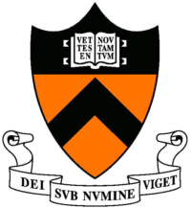
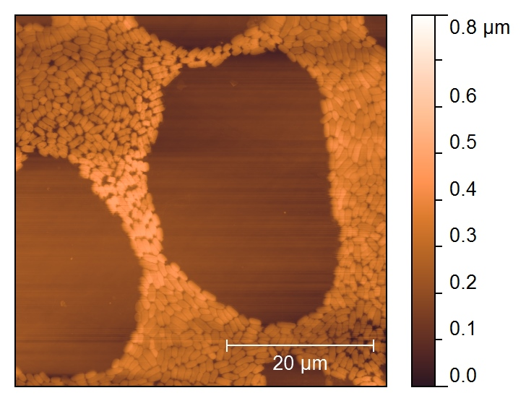
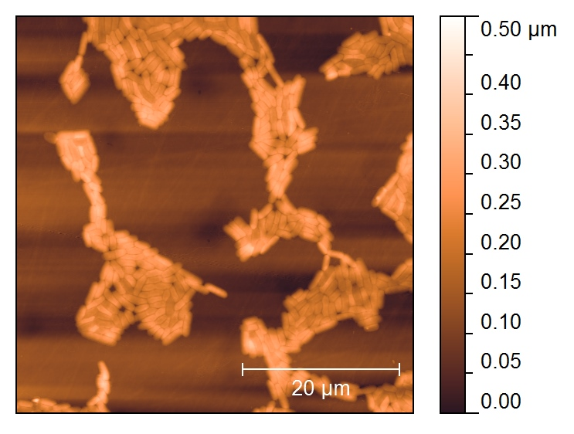
SEED: ATP metabolism and its impact on biofilms
Principal Investigators: Mark P. Brynildsen and A. James Link
Graduate Students: Kristin Adolfsen, Jonathan Robinson, and Jessica Pan
DMR-0819860 Princeton Center for Complex Materials (PCCM)
Biofilms are soft, largely organic, highly heterogeneous, self-generated, self-repairing thin films comprised of macromolecules, inorganic ions, and living matter. These films corrode petroleum pipelines and storage tanks, increase drag on shipping vessels, and account for the majority of hospital-treated infections. The mapping between microbial physiology and the material properties of biofilms is complex, of considerable economic importance, and largely uncharted. To date, physiology-biofilm material property relationships have been of limited scope, focusing on the effect of a few enzymes or differences between species and culture conditions. The goal of this project was to define the role of ATP metabolism in the formation, physiology, and material properties of biofilms. Using computational and experimental approaches we found that efficient ATP production and consumption are critical to biofilm formation and morphology, suggesting that ATP metabolism may be an effective anti-biofouling strategy [1]. 1. Adolfsen et al, manuscript in preparation.
Figure 1: AFM images of biofilms from wild-type (top) and an ATP synthase mutant (bottom), demonstrating that deletion of ATP synthase leads to highly disordered biofilms.

