Slide 1
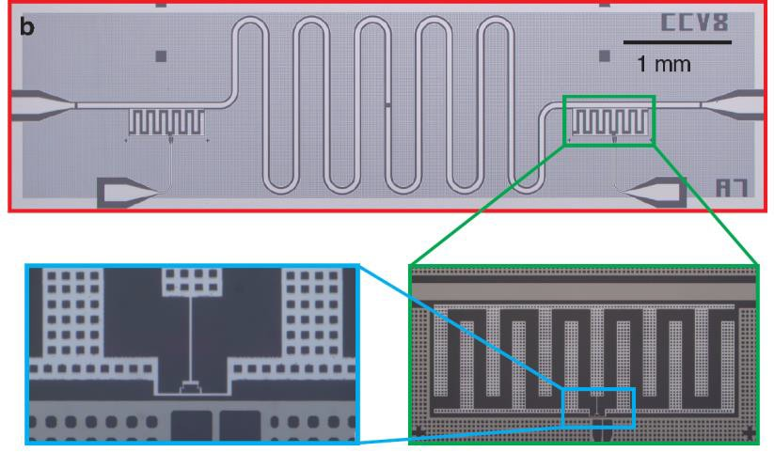
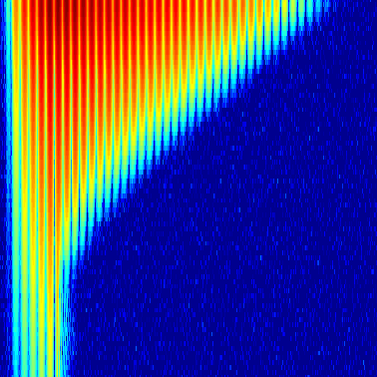
Observation of a Dissipation-Induced Classical to Quantum Transition
IRG-D: J. Raftery, D. Sadri, S. Schmidt, H. E. Tureci, A. A. Houck
Princeton Center for Complex Materials (DMR 0819860)
In this work, we study a novel dynamical phase transition of light, where photon-photon interactions and dissipation into the environment are key aspects of the physics. Together they give rise to a transition from a region of classical behavior into a regime where quantum effects dominate. The transition was observed in a Jaynes-Cummings dimer built from two coupled microwave cavities (shown in the upper picture. In this system, photons repel each other due to the presence of nearby superconducting qubits. At high photon numbers, the system undergoes classical oscillations as photons tunnel between the two cavities. Over time photon loss causes the system to spontaneously freeze, trapping photons and preventing tunneling. By monitoring the photons leaking out of the system, we have mapped out a dynamical phase diagram for this transition, shown in the lower figure. This experiment can also be considered a small-scale realization of a new class of quantum simulator, uniquely suited to the study of many-body phenomena out of equilibrium.
Delocalized
Localized
200
Initial Photon Number
100
50
20
Initialization
Reference
J. Raftery, D. Sadri, S. Schmidt, H. E. Tureci, and A. A. Houck, “Observation of a Dissipation-Induced Classical to Quantum Transition,” Phys. Rev. X (in press); arXiv:1312.2963v1
10
5
0 0.5
1 1.5 2
Time (μs)

