Slide 1
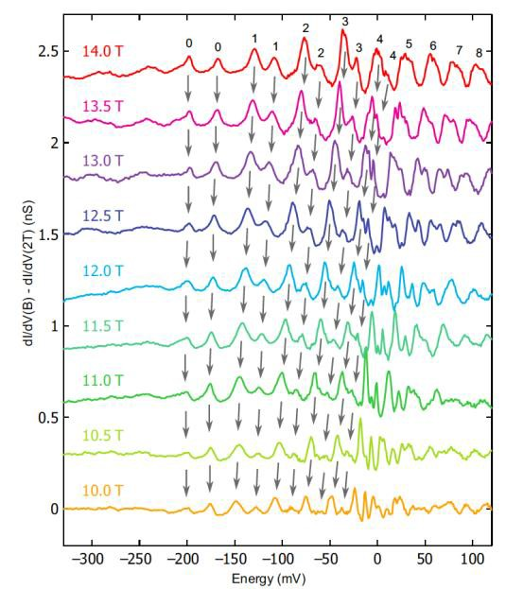
Landau Quantization and Quasiparticle Interference in the
3D Dirac Semimetal Cd₃As₂
IRG-A: Robert J. Cava and Ali Yazdani
Princeton Center for Complex Materials (DMR-0819860)
Condensed matter systems provide a rich setting to realize Dirac and Majorana fermionic excitations and the possibility to manipulate them in materials for potential applications.
Recently, it has been proposed that Weyl fermions, which are chiral, massless particles, can emerge in certain bulk materials or in topological insulator multilayers and can produce unusual transport properties, such as charge pumping driven by a chiral anomaly. A pair of Weyl fermions protected by crystalline symmetry, effectively forming a massless Dirac fermion, has been predicted to appear as low energy excitations in a number of candidate materials termed three-dimensional (3D) Dirac semimetals. This paper reports the first scanning tunneling microscopy (STM) on one promising host material, the II-V semiconductor Cd₃As₂. The study provides the first atomic scale probe of Cd₃As₂, showing that defects mostly influence the valence band, consistent with the observation of ultra-high mobility carriers in the conduction band. By combining Landau level spectroscopy and quasiparticle interference (QPI) at ultra low temperatures and high magnetic fields, they distinguish a large spin-splitting of the conduction band in a magnetic field and its extended Dirac-like dispersion above the expected regime. A model band structure consistent with the experimental findings suggests that for a specific orientation of the applied magnetic field, Weyl fermions are the low-energy excitations in Cd₃As₂.
(Right) Landau level spectra of the local tunneling density of states at high magnetic fields and low temperatures of Cd₃As₂
. (Left) Analysis of such data can be used to map the Dirac band structure of this material over a wide range energy both below and above the chemical potential.
Reference:Sangjun Jeon, Brian B. Zhou, Andras Gyenis, Benjamin E. Feldman, Itamar Kimchi, Andrew
C. Potter, Quinn D. Gibson, Robert J. Cava, Ashvin Vishwanath and Ali Yazdani
Nature Materials (2014), in press.

