Slide 1
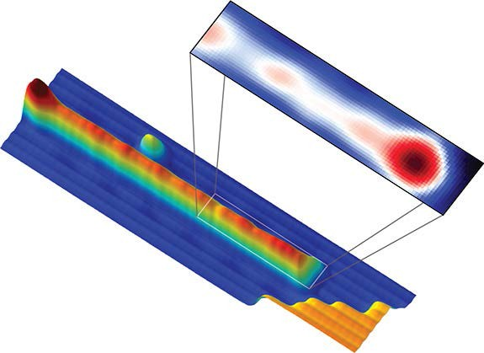
Observation of Majorana fermions in a ferromagnetic chains on a superconductor Princeton Center for Complex Materials (DMR-0819860)
Stevan Nadj-Perge, Ilya K. Drozdov, Jian Li, Hua Chen, Sangjun Jeon, Jungpil Seo, Allan H. MacDonald, B. Andrei Bernevig, and Ali Yazdani.
Topological superconductors are a distinct form of matter that is predicted to host boundary Majorana fermions. These quasi- particles are the emergent condensed matter analogs of the putative elementary spin-1/2 particles originally proposed by Ettore Majorana in the 1930’s with the intriguing property of being their own anti-particles. The search for Majorana quasi-particle bound states in condensed matter systems is motivated in part by their potential use as topological qubits to perform fault-tolerant computation aided by their non-Abelian characteristics. We introduce a new platform for realizing one-dimensional topological superconductors and detected their Majorana quasi-particle edge modes with the scanning tunneling microscope. The use of STM achieves both spatial and spectral resolution overcoming the short coming of the previous methods of detection.
The experimental platform consist of an array of magnetic atoms (Fe) on the surface of strong spin-orbit superconductor (Pb). We demonstrated that magnetic atoms are in a ferromagnetic state (using spin-polarized STM) but yet they can support proximity superconductivity because of strong-spin interaction in Pb. The combination of Zeeman and spin-orbit interaction is predicted to make the superconductivity on or near this chain topological. The signature of Majorana edge mode is resolved at the end of the chain using spectroscopic mapping with the STM.
(Bottom) An STM image of a one-atom wide self-assembled Fe chain on the surface of Pb (110). (Top) High resolution spectroscopic map at zero energy maps the probability density of the Majorana fermion bound to the edge of the atomic chain.
Reference: Stevan Nadj-Perge, Ilya K. Drozdov, Jian Li, Hua Chen, Sangjun Jeon, Jungpil Seo, Allan H. MacDonald, B. Andrei Bernevig, and Ali Yazdani, Science 346, 602 (2014).

