Slide 1
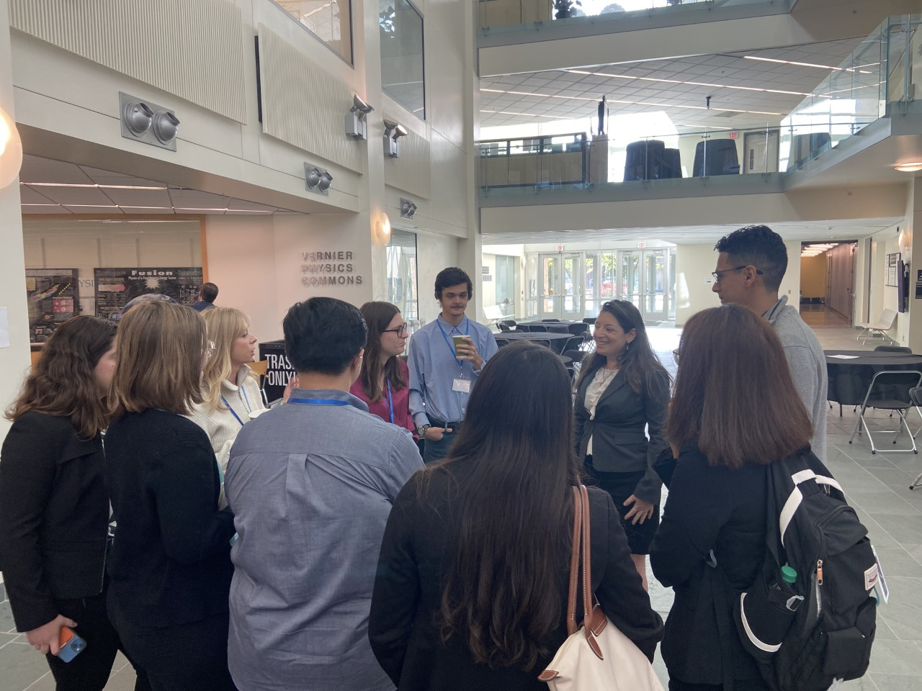
Strengthening Networks: Connecting MRSEC and PREM Students with Academic and Industry Representatives
The Ohio State University MRSEC
DMR-2011876
Richard (OSU), Pak (UCSB), Nawwar (OSU), Endsley (UCSB), Tak (UCSB)
The Ohio State University and University of California, Santa Barbara MRSECS partnered to host the Conference Across MRSECs and PREMs (CAMPS) in October 2022.
The CAMPS workshop brought together a diverse group of students to allow them to interact and discuss, to build professional networks across academia and industry, and to deepen their collaboration skills.
50 participants from 27 institutions across the country and Puerto Rico attended CAMPS. There were 10 MRSECs and 9 PREMs represented. The audience was comprised of:
46% undergrad and 54% graduate students
56% females
46% URMs
Students enjoyed and benefited from the conference, especially the networking time with professionals from industry and academia, as well as their peers. One student expressed the following sentiment:
I enjoyed having more networking time with the industry professionals, university faculty, and other participants. Being an undergraduate it was an amazing opportunity to speak with Master and PhD students from other universities which I do not get to do often, if at all.
Dr. Yannika Schneider, from Eurofins EAG, chats with students during a coffee break.
Notes:
What Has Been Achieved: Add your narrative here.
Importance of the Achievement: Add your narrative here.
How is the achievement related to the IRG, and how does it help it achieve its goals? Add your narrative here.
Where the findings are published: Enter citation and DOI here.

