Slide 1
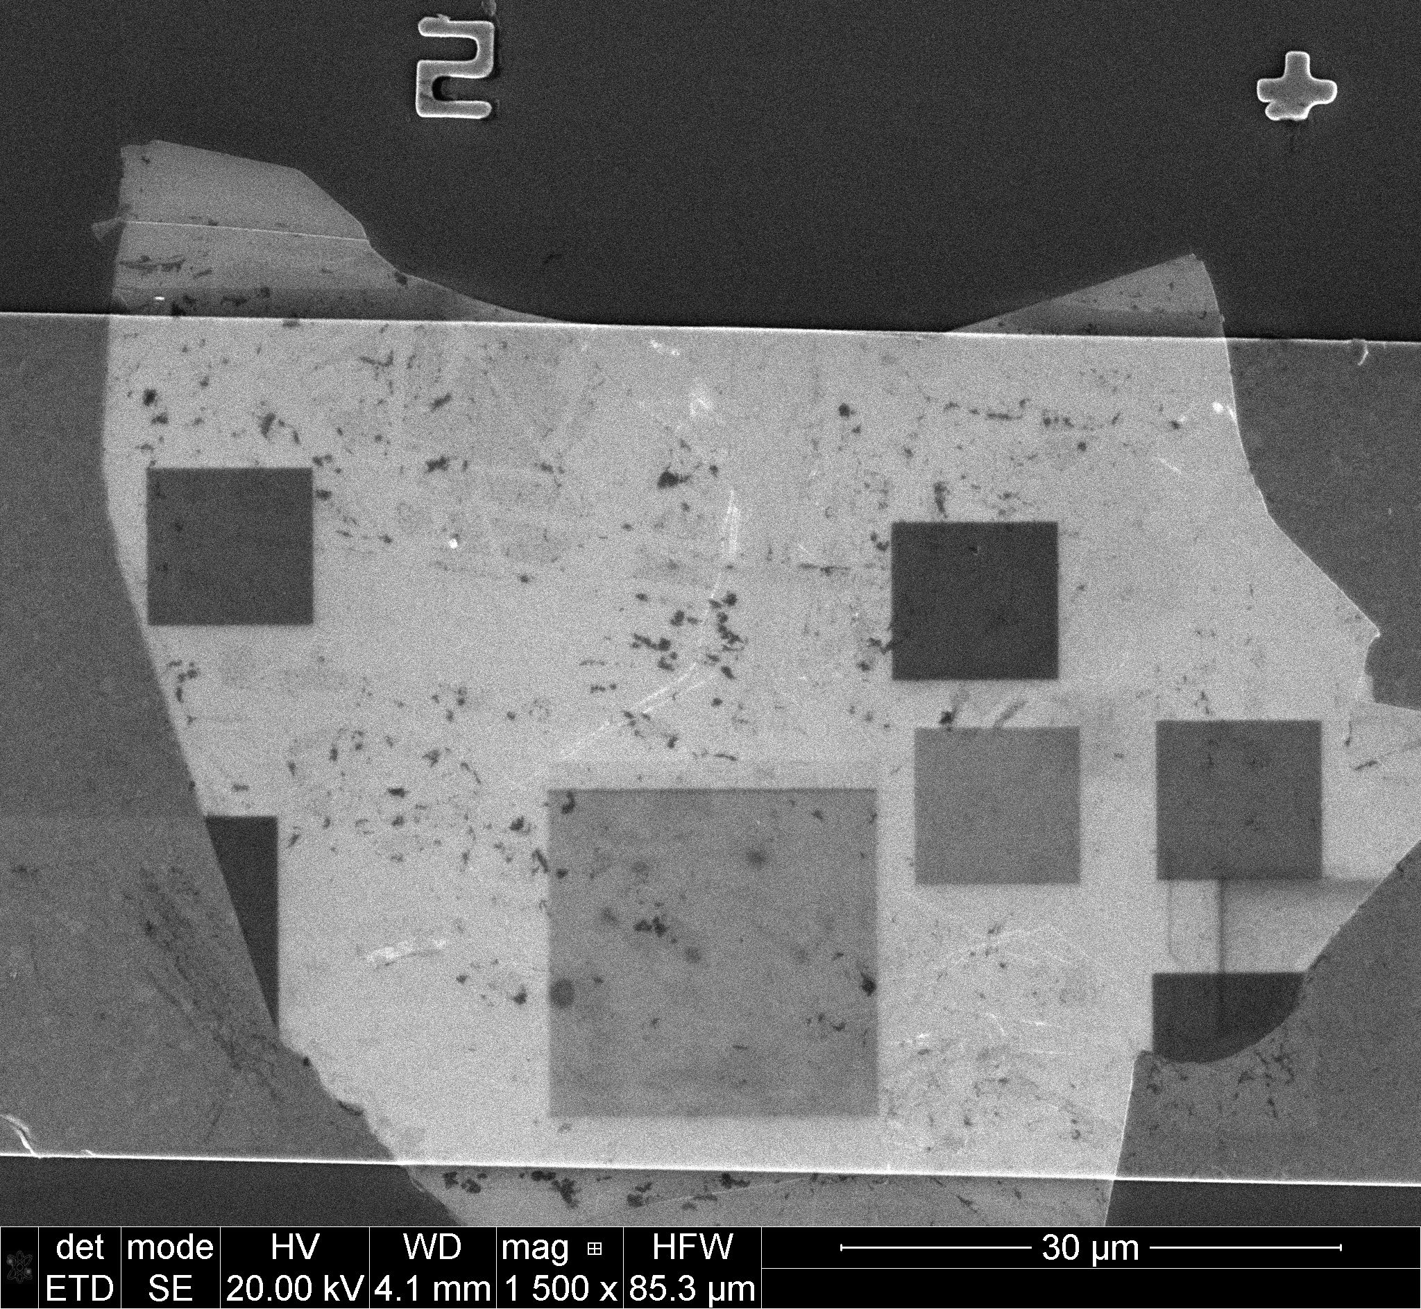
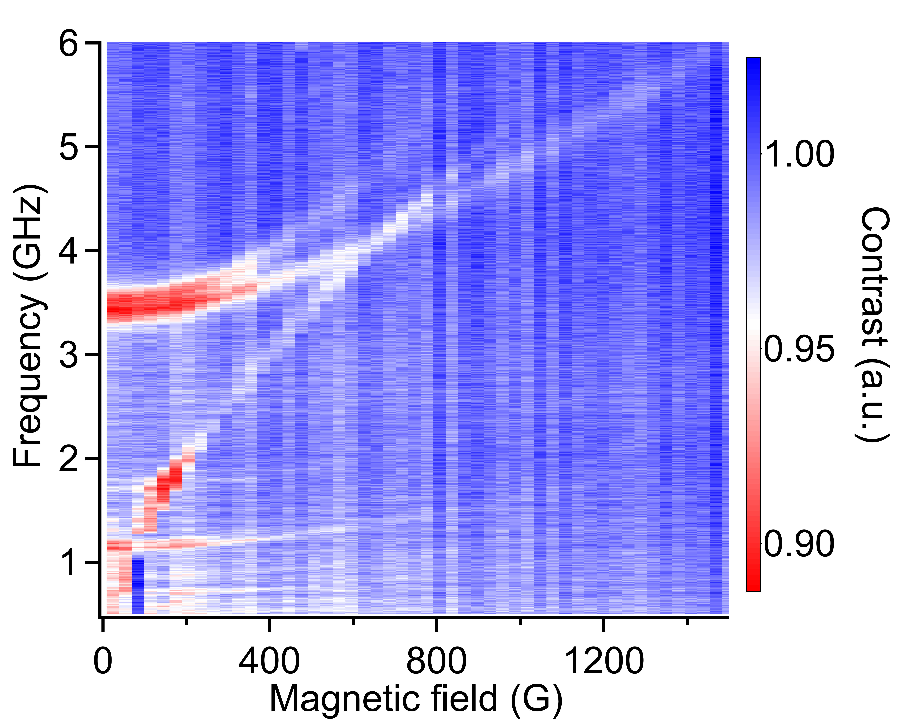
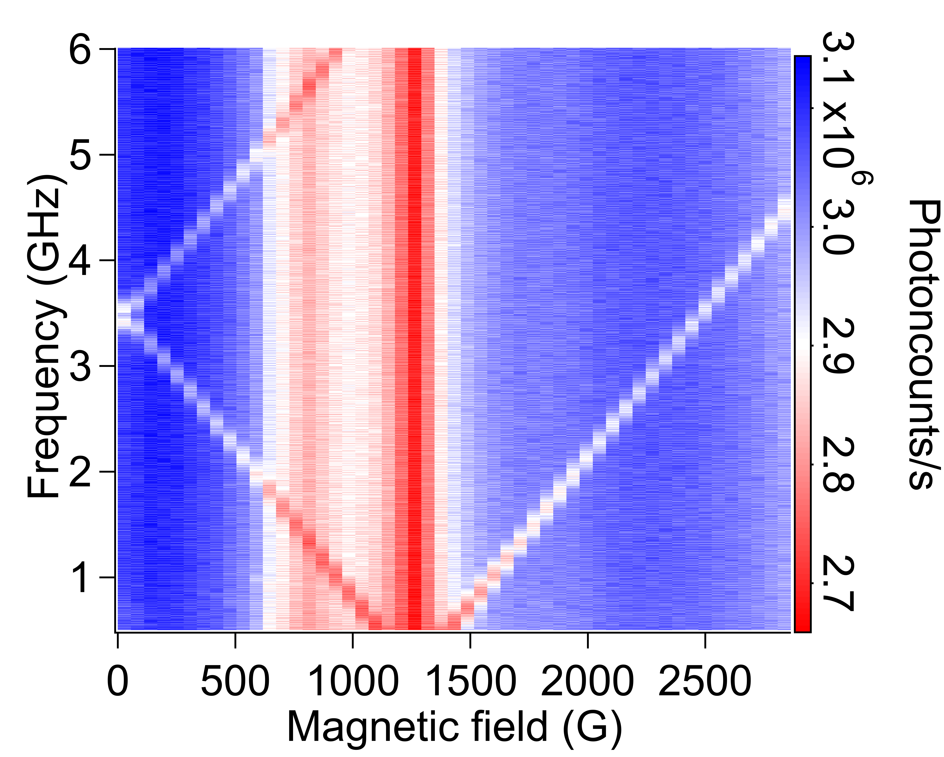
Ohio State University MRSEC
DMR-2011876
Quantum Sensing of Spin Dynamics Using Boron-Vacancy Centers
in Hexagonal Boron Nitride
P. Chris Hammel, Fengyuan Yang (OSU), Jyoti Katoch, Simranjeet Singh (CMU)
Quantum Sensing of Spin Dynamics Using Boron-Vacancy Centers in Hexagonal Boron Nitride
Optically active, spin bearing defects embedded in solid-state systems are appealing for quantum sensing of materials and for quantum science and engineering
Spin-sensitive photoluminescence of these spin defects in van der Waals based materials, such as the boron-vacancy (BV) centers in hexagonal boron nitride (h-BN), enables spatially localized, quantum sensing of weak static and dynamic magnetic fields
Using relaxometry, the team optically detected ferromagnetic resonance (ODFMR) in yttrium iron garnet (YIG) demonstrating sensitive detection of magnon dynamics
This work establishes BV centers in h-BN as a modular quantum sensing platform that can be seamlessly integrated with emergent and vdW systems to probe a wide range of static and dynamic phenomena
Das, et al., Phys. Rev. Lett 133 166704 (2024)
(a)
(b)
BV
10umx10um
Boron
Nitrogen
(c)
(d)
ODMR
ODFMR
Figure 1. (a) Schematic of BV center in hBN (b) Regions of exfoliated hBN containing BV centers created by scanned Ga ion-irradiation are visible in hBN exfoliated onto a microwave waveguide on top of the sample (c) Optically detected magnetic resonance of BV centers showing expected linear dispersion (magnetic field perpendicular to the plane) (d) optically detected FMR of YIG employing relaxometry of BVs by magnons.
Notes:
Sensing magnetic dynamics using boron vacancy color centers: Resonant fluctuating fields change relative population between spin states decreasing photoluminescence
Most commonly used example is the NV center in diamond here we show the effectiveness of BV centers in the widely used vdW material hBN.
Detection of FMR takes advantage of the fluctuations of magnetic fields that emanate from the magnons excited by FMR. These fluctuating fields enhance the relaxation rate of the electron spin of the BV center thus altering its photoluminescence. Thus measuring photoluminescence reveals the strength of magnon-generated dynamic fields allowing determination of densities of magnons, provides insight into magnon-magnon scattering and, combined with spatially localized detection, allows magnon transport to be measured.

