Slide 1
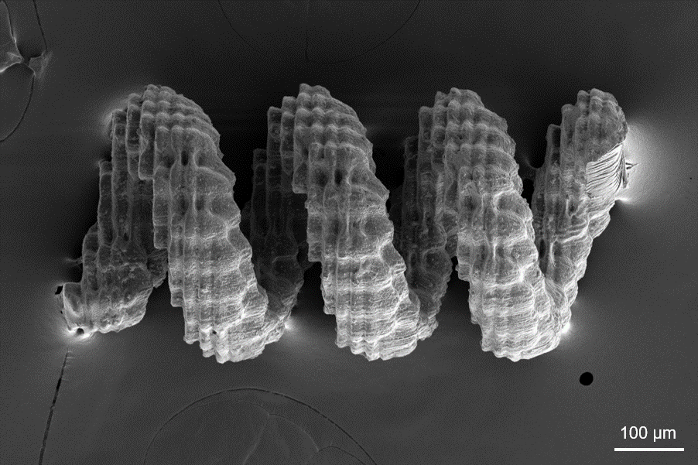

University of Michigan MRSEC
DMR-2309029
Dopamine Polymer Coatings for Microstructures
Shuo Zhang et al., John T. Heron, Jinsang Kim, Abdon Pena-Francesch
Materials Science & Engineering, University of Michigan
Magnetic microrobots are attractive tools for operation in confined spaces. Many of these microrobots are typically fabricated with dispersed nanoparticles or deposited coatings that present homogeneity and conformality problems. We have developed a solution-based polydopamine (PDA)-assisted electroless deposition (ELD) method to deposit a superparamagnetic thin film on 3D-printed microrobots.
We implemented and demonstrated these multilayer magnetic coatings on three archetypes of magnetic microrobots, each using distinct actuation working mechanisms. Due to the material-independent interfacial adhesive properties of DPA, this strategy can open up new fabrication schemes with a broad compatibility with materials and structures and without limitations of PVD coating methods.
This work supports IRG2 by providing a versatile coating and particle functionalization method for composite nanofillers, with the goal of facilitating the repair and recycling of composites via dynamic particle bonding.
This is a collaboration between the Heron (IRG1), Kim (IRG2), and Pena-Francesch (IRG2) groups.
Dopamine biopolymers enable functional coatings for 3D-printed microrobots.
Alt-text: Electron microscopy image of helical 3D-printed structure.
Notes:
What Has Been Achieved: Magnetic microrobots are attractive tools for operation in confined spaces. Many of these microrobots are typically fabricated with dispersed nanoparticles or deposited coatings that present homogeneity and conformality problems. We have developed a solution-based polydopamine (PDA)-assisted electroless deposition (ELD) method to deposit a superparamagnetic thin film on 3D-printed microrobots.
Importance of the Achievement: We implemented and demonstrated these multilayer magnetic coatings on three archetypes of magnetic microrobots, each using distinct actuation working mechanisms. Due to the material-independent interfacial adhesive properties of DPA, this strategy can open up new fabrication schemes with a broad compatibility with materials and structures and without limitations of PVD coating methods.
How is the achievement related to the IRG, and how does it help it achieve its goals? This work supports IRG2 by providing a versatile coating and particle functionalization method for composite nanofillers, with the goal of facilitating the repair and recycling of composites via dynamic particle bonding. This is a collaboration between the Heron (IRG1), Kim (IRG2), and Pena-Francesch (IRG2) groups.
Where the findings are published: Zhang, Shuo, et al. "Polydopamine‐Assisted Electroless Deposition of Magnetic Functional Coatings for 3D‐Printed Microrobots." Advanced Intelligent Systems (2025): 2400702. DOI: 10.1002/aisy.202400702

