Slide 1
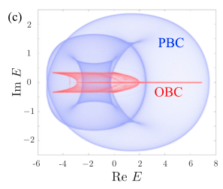
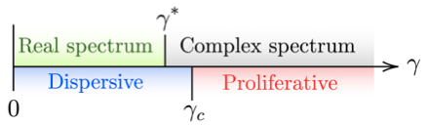
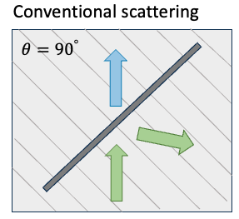
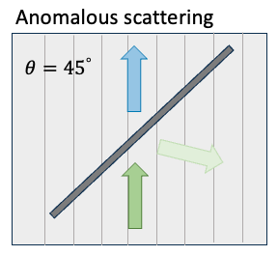
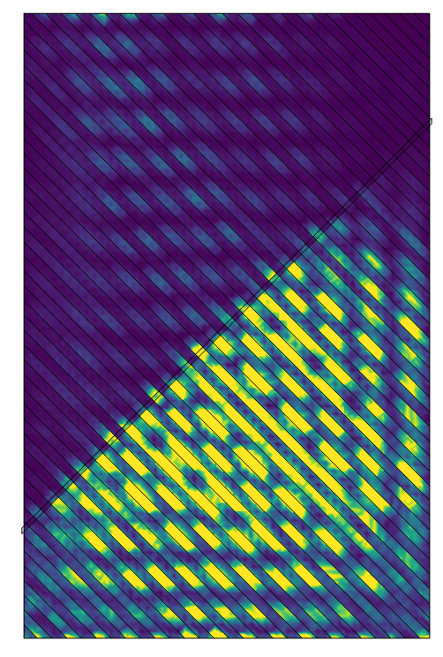
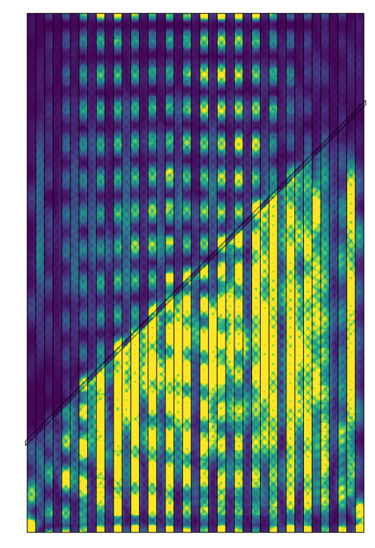

University of Michigan MRSEC
DMR-2309029
Viscoelastic Metamaterials Based On Non-Hermitian Physics
Xiaoming Mao (UM), Kai Sun (UM), Nan Cheng (UM), Wenting Cheng (UM)
What has been achieved?
(i) In the past year, we focused on developing mechanical metamaterials where viscoelasticity is used to achieve unusual dynamical properties. We published one paper on a fundamental theory for non-Hermitian systems (Fig 1). We are currently experimentally studying viscoelastic metamaterials for wave manipulation (Fig 2). (ii) We initiated a new project with the Kieffer group to examine relaxational dynamics and phase transitions of CANs.
Why is this achievement important?
Achievement (i) opens novel applications of CANs as tunable metamaterials and functional materials. Achievement (ii) is expected to reveal fundamental relations between macroscale characteristics and internal mechanisms.
How is the achievement related to the IRG/MRSEC, and how does it help it achieve its goals?
Achievement (i) is an important part for the implementation of CANs for novel materials. Achievement (ii) supports the fundamental theory building of CANs. Both are important aspects of IRG 2 research.
Fig 1
These are figures from our paper. It shows how different boundary conditions strongly affect the complex spectra in non-Hermitian systems and how our theory predicts invariant moments and describes phase transitions.
Fig 2
These are figures from our ongoing project. It shows how viscoelasticity metamaterials achieve anomalous scattering and directional invisibility through non-Hermitian physics (COMSOL simulation shown left, exp ongoing)
Notes:
What Has Been Achieved: (i) In the past year, our work has been focusing on developing mechanical metamaterials where viscoelasticity is used to achieve unusual dynamical properties. We have published one paper on a fundamental theory for non-Hermitian systems which directly applies to viscoelastic metamaterials and reveals novel phase transitions (Fig 1). We are currently experimentally studying viscoelastic metamaterials for wave manipulation (Fig 2). (ii) We initiated a new project with the Kieffer group where we recover the dielectric function of CANs by fitting it with Maxwell-Wagner-Sillars interfacial polarization model capturing electrode polarization and segmental relaxation.
Importance of the Achievement Achievement (i) opens novel applications of CANs to the broad field of metamaterials and functional materials. The special tunability of CANs provide a highly valuable control for these applications. Achievement (ii) is expected to reveal relations between macroscale characteristics and internal mechanisms, an input for building fundamental theories.
How is the achievement related to the IRG, and how does it help it achieve its goals? Achievement (i) is an important part for the implementation of CANs for novel materials. Achievement (ii) supports the fundamental theory building of CANs. Both are important aspects of IRG 2 research.
Where the findings are published: one paper published https://journals.aps.org/prl/abstract/10.1103/PhysRevLett.133.216401
Alternative text for Fig 1: Left panel: Complex energy spectra plotted in the complex plane for a non-Hermitian system under periodic (PBC, blue) and open (OBC, red) boundary conditions, showing spectral deformation and non-Hermitian skin effect. Right panel: A schematic phase diagram along the γ-axis, showing three regions—dispersive (blue), real spectrum (green), and proliferative (red)—separated by critical points γ_c and γ*, marking transitions from dispersive to complex spectrum behavior.
Alternative text for Fig 2: Two color maps showing wave scattering patterns under different incident angles. Left: “Conventional scattering” with a 90° incident angle shows a regular interference pattern confined within a triangular region. Right: “Anomalous scattering” at a 45° angle shows a qualitatively different interference structure with complex modulations and vertically oriented fringes. Insets illustrate the incident and scattered wave directions relative to a periodic structure, with arrows indicating wave propagation and scattering geometry.

