Slide 1
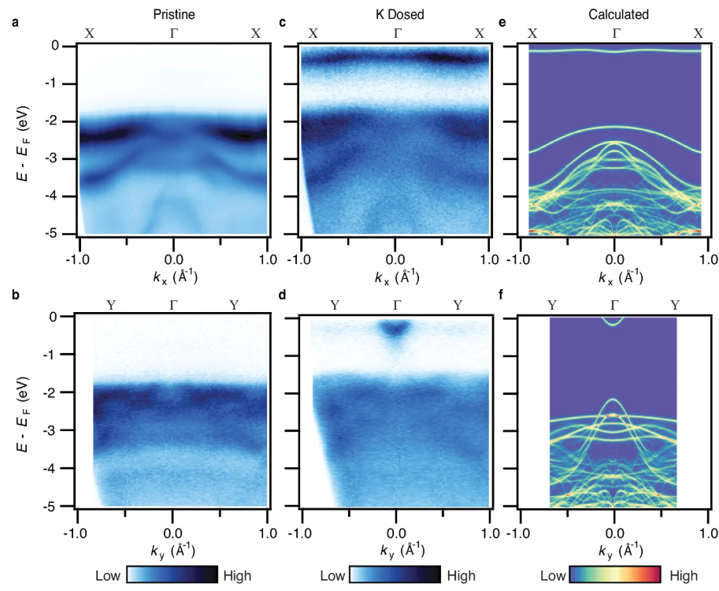
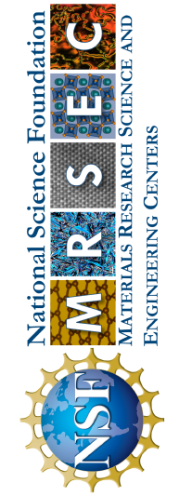
University of Michigan MRSEC
DMR-2309029
Large exciton binding energy in a bulk van der Waals magnet from quasi-1D electronic localization
What has been achieved?
We reported an exceptionally large exciton binding energy in single crystals of the bulk van der Waals antiferromagnet CrSBr. Utilizing state-of-the-art angle-resolved photoemission spectroscopy and self-consistent ab-initio GW calculations, we present direct spectroscopic evidence supporting electronic localization and weak dielectric screening as mechanisms contributing to the amplified exciton binding energy. Furthermore, we report that surface doping enables broad tunability of the band gap.
Why is this achievement important?
Tunability of the band gap offering promise for engineering of the optical and electronic properties. Our results indicate that CrSBr is a promising material for the study of the role of anisotropy in strongly interacting bulk systems and for the development of exciton-based optoelectronics.
How is the achievement related to the IRG/MRSEC, and how does it help it achieve its goals?
This work represents a collaboration among three different MRSEC groups. Specifically, through this project, we established an effective collaborative workflow integrating angle-resolved photoemission spectroscopy experimental results with ab-initio calculations to enhance our understanding of materials.
This work is published Nat. Commun. 16, 1134 (2025)
DOI: 10.1038/s41467-025-56457-x
Shane Smolenski ¹, Ming Wen², Qiuyang Li¹, Eoghan Downey¹, Adam Alfrey³, Wenhao Liu⁴, Aswin L. N. Kondusamy⁵, Aaron Bostwick⁶, Chris Jozwiak⁶,Eli Rotenberg⁶, Liuyan Zhao¹, Hui Deng¹, Bing Lv^{4,5}, Dominika Zgid^{1,2}, Emanuel Gull¹ & Na Hyun Jo¹
1) Department of Physics, University of Michigan, Ann Arbor, MI, USA. 2) Department of Chemistry, University of Michigan, Ann Arbor, MI, USA. 3) Applied Physics Program, University of Michigan, Ann Arbor, MI, USA. 4) Department of Physics, The University of Texas at Dallas, Richardson, TX, USA. 5) Department of Materials Science and Engineering, The University of Texas at Dallas, Richardson, TX, USA. 6) Advanced Light Source, Lawrence Berkeley National Laboratory, Berkeley,CA, USA
* MRSEC participants are marked as bold.
Plots of the band structure for pristine CrSBr (a-b) and K-dosed CrSBr (c-d), along with the corresponding self-consistent ab initio GW calculations (e-f).
Notes:
What Has Been Achieved: Excitons, bound electron-hole pairs, influence the optical properties in strongly interacting solid-state systems and are typically most stable and pronounced in monolayer materials. Bulk systems with large exciton binding energies, on the other hand, are rare and the mechanisms driving their stability are still relatively unexplored. Here, we report an exceptionally large exciton binding energy in single crystals of the bulk van der Waals antiferromagnet CrSBr. Utilizing state-of-the-art angle-resolved photoemission spectroscopy and self-consistent ab-initio GW calculations, we present direct spectroscopic evidence supporting electronic localization and weak dielectric screening as mechanisms contributing to the amplified exciton binding energy. Furthermore, we report that surface doping enables broad tunability of the band gap offering promise for engineering of the optical and electronic properties.
Importance of the Achievement: Tunability of the band gap offering promise for engineering of the optical and electronic properties. Our results indicate that CrSBr is a promising material for the study of the role of anisotropy in strongly interacting bulk systems and for the development of exciton-based optoelectronics.
How is the achievement related to the IRG, and how does it help it achieve its goals? This work represents a collaboration among three different MRSEC groups. Specifically, through this project, we established an effective collaborative workflow integrating angle-resolved photoemission spectroscopy experimental results with ab-initio calculations to enhance our understanding of materials.
Where the findings are published: This work is published Nat. Commun. 16, 1134 (2025) DOI: 10.1038/s41467-025-56457-x

