Slide 1
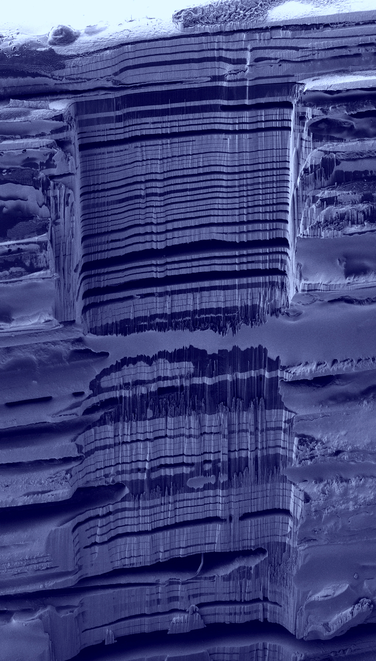
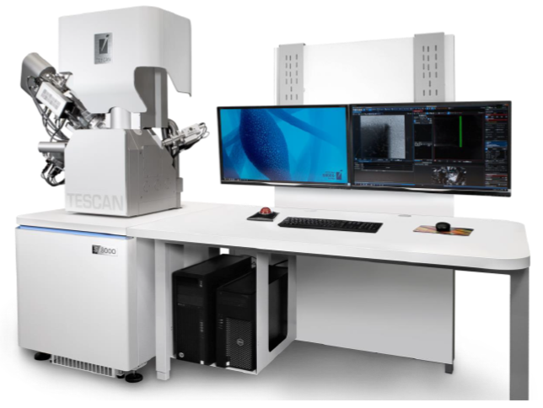
Focused Ion Beam / Scanning Electron Microscope: TESCAN S8000X
DMR: 1720530
2020
Eric A. Stach, Mark Allen, Marija Drndic and Deep Jariwala University of Pennsylvania
In the Fall of 2019, the LRSM installed a uniquely equipped focused ion beam / scanning electron microscope from the TESCAN corporation. The instrument has a high flux xenon source, allowing rapid sample removal. It is equipped with two novel accessories, a cryogenic transfer system and a time-of-flight secondary ion mass spectrometer (ToF-SIMS). These two capabilities will allow the development of novel methods for the microanalytical characterization of soft matter and soft/hard matter interfaces.
650 µm
The system was installed in the Singh Center for Nanotechnology’s Nanoscale Characterization Facility and funded by an NSF-MRI grant with matching support from the LRSM, the School of Engineering and Applied Science (SEAS) and the School of Arts and Sciences (SAS). The instrument is now being used by research groups across SEAS and SAS, as well as outside academic and industrial users.
Secondary electron image of a microfabricated metal/polymer multilayer structure. A conventional gallium FIB would take days to remove such a large amount of material. Images like these provide input for three dimensional reconstructions of materials structure.

