Slide 1
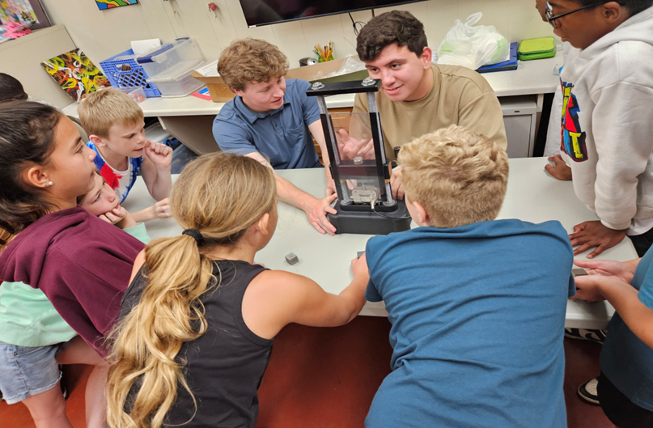
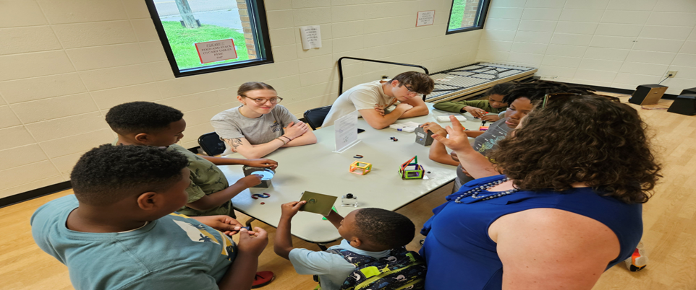

UTK- MRSEC
DMR-2309083
Expanding CAMM’s Impact: REU Summer Outreach with Knoxville Youth
The Center for Advanced Materials and Manufacturing
(CAMM) inspired hundreds of high school students during
the 2024–2025 school year through lab tours and panel discussions. Over the summer, CAMM expanded its outreach by bringing hands-on STEM workshops directly to younger learners in Knoxville.
Partnering with Christenberry, E.V. Davidson, and Deane Hill community centers, CAMM’s Education, Community Outreach, and Recruitment (ECOR) team, along with REU students, delivered engaging activities that introduced elementary and middle school students to the world of materials research.
Students explored concepts through interactive lessons such as tensile testing, a materials matching game, ferrofluids, shape memory alloys, and crystalline materials.
These efforts provided safe and engaging learning opportunities for local youth, helped to expand awareness of CAMM and NSF funded programs in the local community, and gave REU participants a valuable experience in science communication. CAMM continues to bridge advanced research and accessible education, strengthening its role in STEM outreach.
University of Tennessee, Knoxville (UTK)
Center for Advanced Materials and Manufacturing (CAMM)
Notes:
What Has Been Achieved: The familiarity of STEM futures is not always present in the youth of today. We were able to edutain our participants, further the leadership skills of our REU students, and plant seeds into the minds and scientists of tomorrow.
Importance of the Achievement: There is an ignorance to what all is available in the STEM culture. Material Science is an aspects that further defining for primary and secondary students would impact and invite more students that have an interest, a natural talent, but are not familiar with the path. Our REU students planted similar seeds in our city’s youth as were once planted in their minds.
How is the achievement related to the IRG, and how does it help it achieve its goals? Outreach is also a goal of UTK-MRSEC’s mission. Being able to further recruit primary and secondary students’ interests in STEM through edutainment strategies has remained an efficient route for expanding interests in the field
Where the findings are published: Not Applicable outside of Social media–Linkedin: https://www.linkedin.com/feed/update/urn:li:activity:7349556603240505345

