Slide 1
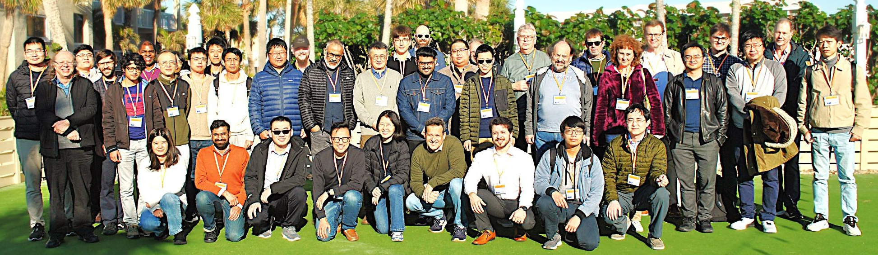
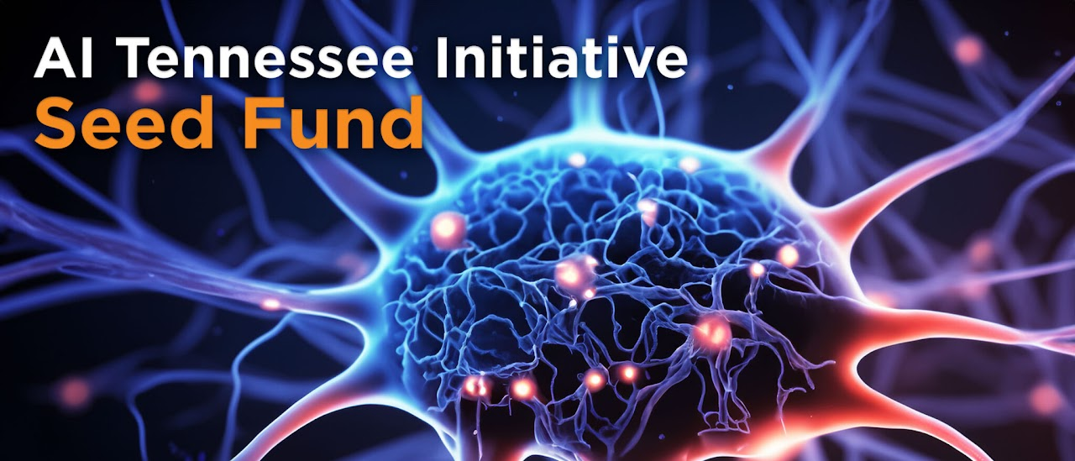
UTK-MRSEC
DMR-2309083
Quantum Materials and Machine Learning Workshop
January 8th-10th - Tampa, Florida
Yang Zhang (UTK-MRSEC), Jacob Gayles (USF), Yishu Wang (UTK-MRSEC), David Mandrus (UTK-MRSEC / Oak Ridge), Student Organizer - Louis Primeau (UTK-MRSEC)
The recent Quantum Materials and Machine Learning Workshop brought together 22 invited speakers and in total 50 graduate students, postdoc, faculty attendees from 18 different institutions for an intensive exploration of cutting-edge developments at the intersection of quantum physics, materials science, and machine learning. The program featured established researchers alongside three postdoctoral fellows, fostering meaningful dialogue between different career stages.
Novel phenomena in bilayer and higher-stacking structures and 2D quantum materials were a major theme. These talks highlighted gaps in data analysis and materials design in which machine learning could be applied. Other talks on exotic quantum phenomena included quantum phase transitions, fractionalization in moiré materials and spin liquids.
Several of the workshop talks focused on advances in variational Monte Carlo methods using neural quantum states. Speakers demonstrated how these techniques enable more efficient simulation of strongly correlated quantum systems. Postdoctoral researchers delivered three outstanding presentations that highlighted emerging directions in the field. The presence of 17 graduate students enriched the discussions. A special lunchtime talk by Samindranath Mitra from Physical Review Letters added perspective on the direction of publishing in scientific and physics research.
This workshop fostered collaboration between theorists, experimentalists, and computational scientists across career stages. The event highlighted both current achievements and future directions in applying machine learning techniques to quantum materials research.
Notes:
What Has Been Achieved: This workshop allowed attendees to see the state of the art in theoretical and experimental investigations of quantum materials. It also exposed new directions and current approaches to machine learning in the investigation of exotic quantum phases.
Importance of the Achievement: The quantum materials and machine learning workshop encouraged collaboration between researchers from CAMM, USF and other institutions. It also exposed attending graduate students to current research in this field and featured the research of postdoctoral scholars in the early stages of their career.
How is the achievement related to the IRG, and how does it help it achieve its goals? The content of the workshop is directly applicable to IRG1’s mission statement. Talks were given on all four of the IRG’s research methodologies, including neutron scattering and AI modelling of quantum phenomena. Increased collaboration and communication with external institutions will continue to advance the state of the art in materials research and machine learning.
Where the findings are published: N/A

