Slide 1
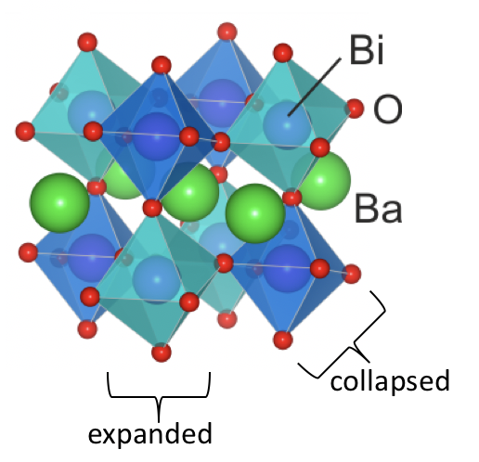
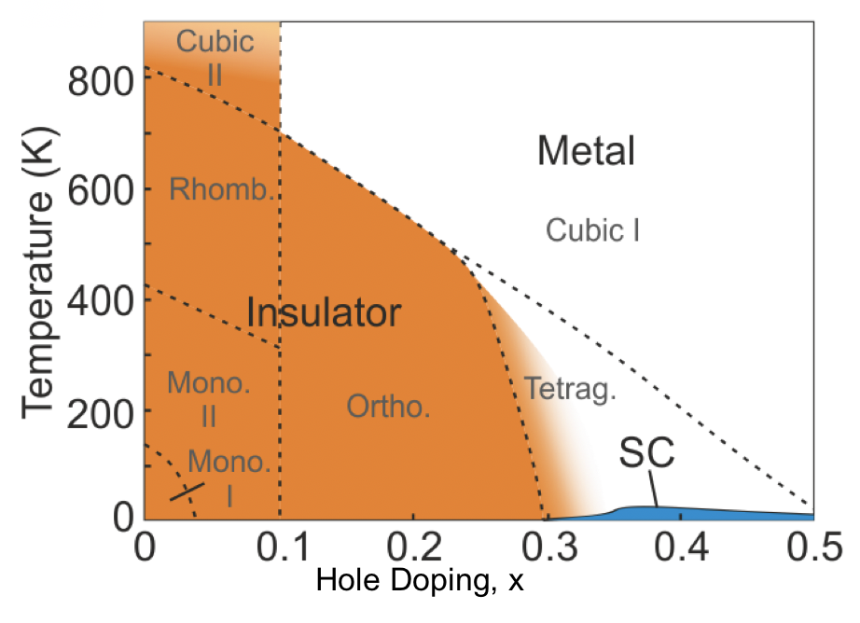
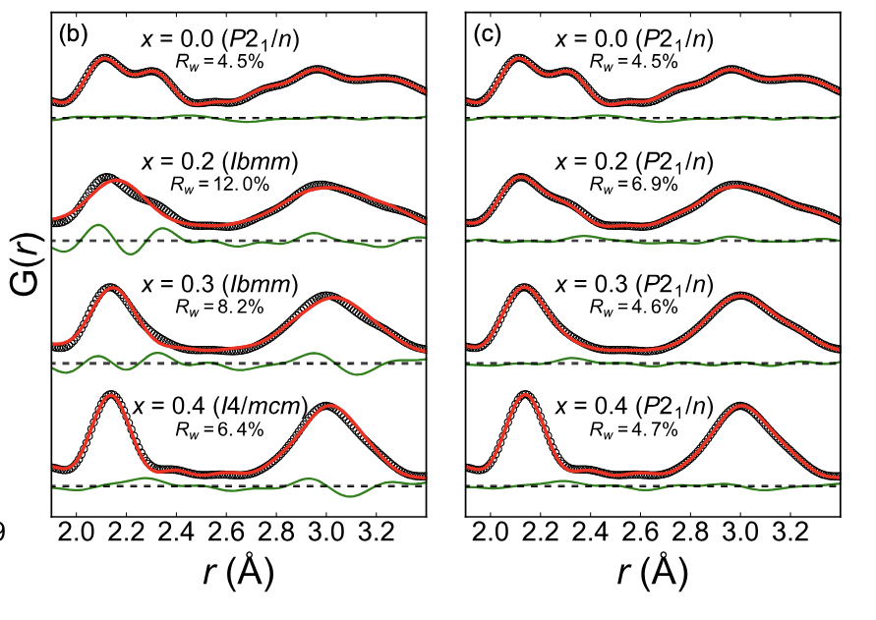
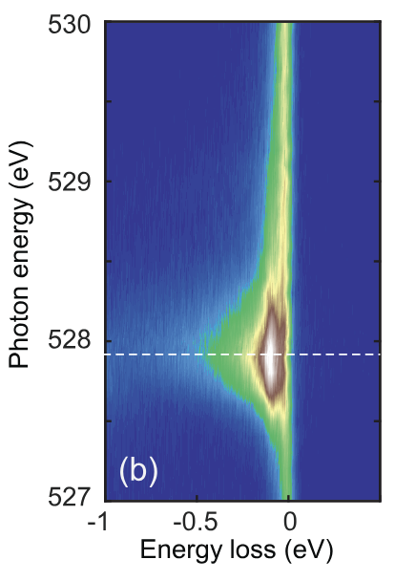

UTK-MRSEC
DMR-2309083
Persistence of small polarons in doped bismuthate superconductors
University of Tennessee, Knoxville (UTK)
Center for Advanced Materials and Manufacturing (CAMM)
Bismuthates like Ba_{1-x}K_{x}BiO₃ (BKBO) host high-T_{c} superconductivity via doping a charge-density-wave insulating phase.
While electron-phonon (𝑒-ph) coupling is proposed to play a key role, the bismuthate normal state is anomalous and poorly understood.
Researchers from IRGs 1, 2, and the Paul-Sherre Institute combined resonant inelastic x-ray and neutron total scattering techniques with advanced modeling to address this problem.
The team found that the doped system hosts short-range structural distortions of the lattice with a sizable 𝑒-ph coupling deep into the material’s metallic phase.
These findings demonstrate that BKBO’s metallic phase is an anomalous and highly sought after bipolaronic liquid.
Total neutron scattering
RIXS
Reference: M. Naamneh et al., Phys. Rev. Res. 7, 043082 (2025).
Notes:
What Has Been Achieved: Bipolaronic superconductivity is an exotic pairing mechanism proposed for materials like Ba1-xKxBiO3 (BKBO); however, conclusive experimental evidence for a (bi)polaron metallic state in this material remains elusive. We combined resonant inelastic x-ray and neutron total scattering techniques with advanced modeling to study the local lattice distortions, electronic structure, and electron-phonon (𝑒−ph) coupling in BKBO as a function of doping. We found that the doped system maintained short-range breathing distortions with a sizable 𝑒-ph coupling, even at doping levels deep within the material’s superconducting regime (x = 0.4). Through detailed comparisons with exact diagonalization and determinant quantum Monte Carlo calculations, we demonstrated that these findings are consistent with a model in which polaron formation is driven by e-ph coupling to the bond-stretching Bi-O phonon modes, highlighting the crucial role of this interaction in this material. Combined, our results provide compelling evidence that BKBO’s metallic phase hosts a liquid of small (bi)polarons derived from local breathing distortions of the lattice, with implications for understanding the low-temperature superconducting instability.
Importance of the Achievement: This work has provided definitive evidence that BKBO’s normal state is an exotic bipolaron liquid, a highly sought-after state of matter. This finding has important implications for how we approach modeling the superconducting state and sets the stage for determining how BKBO and its related materials ultimately superconduct. This work also has implications for the recently discovered antimonates (Ba1-xKxSbO3), where superconductivity arises from an ordered insulating phase, similar to that of BKBO.
How is the achievement related to the IRG, and how does it help it achieve its goals? This project was a collaboration between personnel working in both IRG1 (Prof. Johnston, modeling) and IRG2 (Prof. Maik Lang, total neutron scattering). By combining resonant inelastic X-ray and neutron total scattering techniques with advanced modeling, this work showcases our ability to extract models from multi-model data streams. Moving forward, members of CAMM can explore future applications of these techniques to solving the inverse scattering problem.
Where the findings are published: M. Naamneh et al., Phys. Rev. Res. 7, 043082 (2025). DOI: https://doi.org/10.1103/s3p1-cy1s

