Slide 1
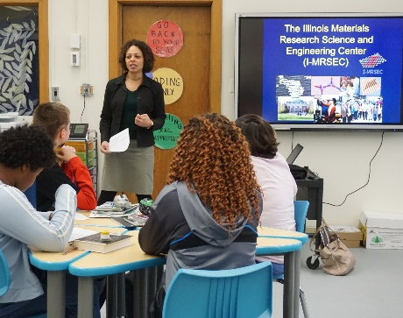
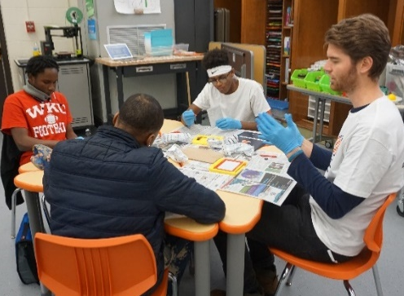
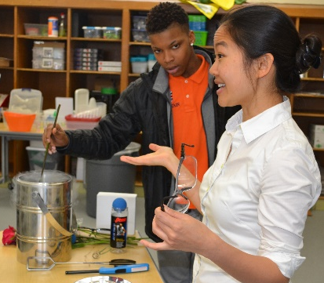
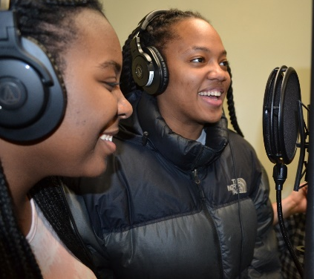
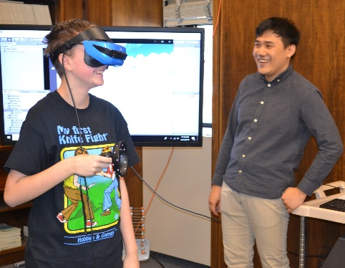
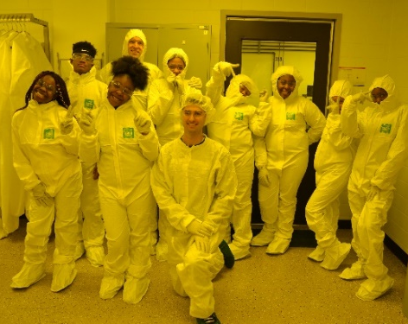
Musical Magnetism: Engaging Middle School Students in Materials Science
Illinois MRSEC
DMR- 720633
2019
The Illinois MRSEC developed and implemented an 8-week program called “Musical Magnetism” that engages middle school students in materials science using the popular platform of music. The program combines engaging lessons and demos, researching a topic, turning that research into lyrics, and recording a song. 35 8th graders at Franklin STEAM Academy participated.
Faculty led lessons, developed with teachers, that included hands-on demos to teach about materials science and magnetism. Students and postdocs led activities, tours, and demos. Students and teachers from Franklin also visited the MRSEC and Materials Research Lab, where they used instruments like the SEM and x-ray diffractometer, enjoyed VR activities, and suited up for cleanroom tours. The program culminated with a listening party to share the songs they wrote about magnetism.
The I-MRSEC plans to run the program again at Franklin in the 2019-2020 academic year.
University of Illinois at Urbana-Champaign
a)
b)
c)
d)
e)
f)
Fig. 1: a) I-MRSEC Director Mason introduces the MRSEC on the first day of the program; b) MRSEC grad student participates in “Destroy a Toy” lesson alongside several 8th graders; c) MRSEC faculty Huang leads the class in demos to teach about materials science; d) Two 8th graders record a song they wrote; e) MRSEC grad student Kang leads a VR activity during the field trip to MRL; f) a group of students and their teachers at the end of a cleanroom tour during the field trip to MRL.
Photos c) – f) by B. Innes.
Read more: “I-MRSEC’s Musical Magnetism Curriculum Uses Hip Hop to Teach Science” (3/12/19) http://www.istem.illinois.edu/news/imrsec.musical.magnetism.html “I-MRSEC, Champaign Educator Jamie Roundtree, Embrace Hip Hop/Rap to Reach Youth at Their Level” (2/14/19) http://www.istem.illinois.edu/news/imrsec.roundtree.html “Franklin STEAM Academy Students Experience High-Tech Science at MRL” (3/27/19) http://www.istem.illinois.edu/news/franklin.mrl.visit.html

