Slide 1
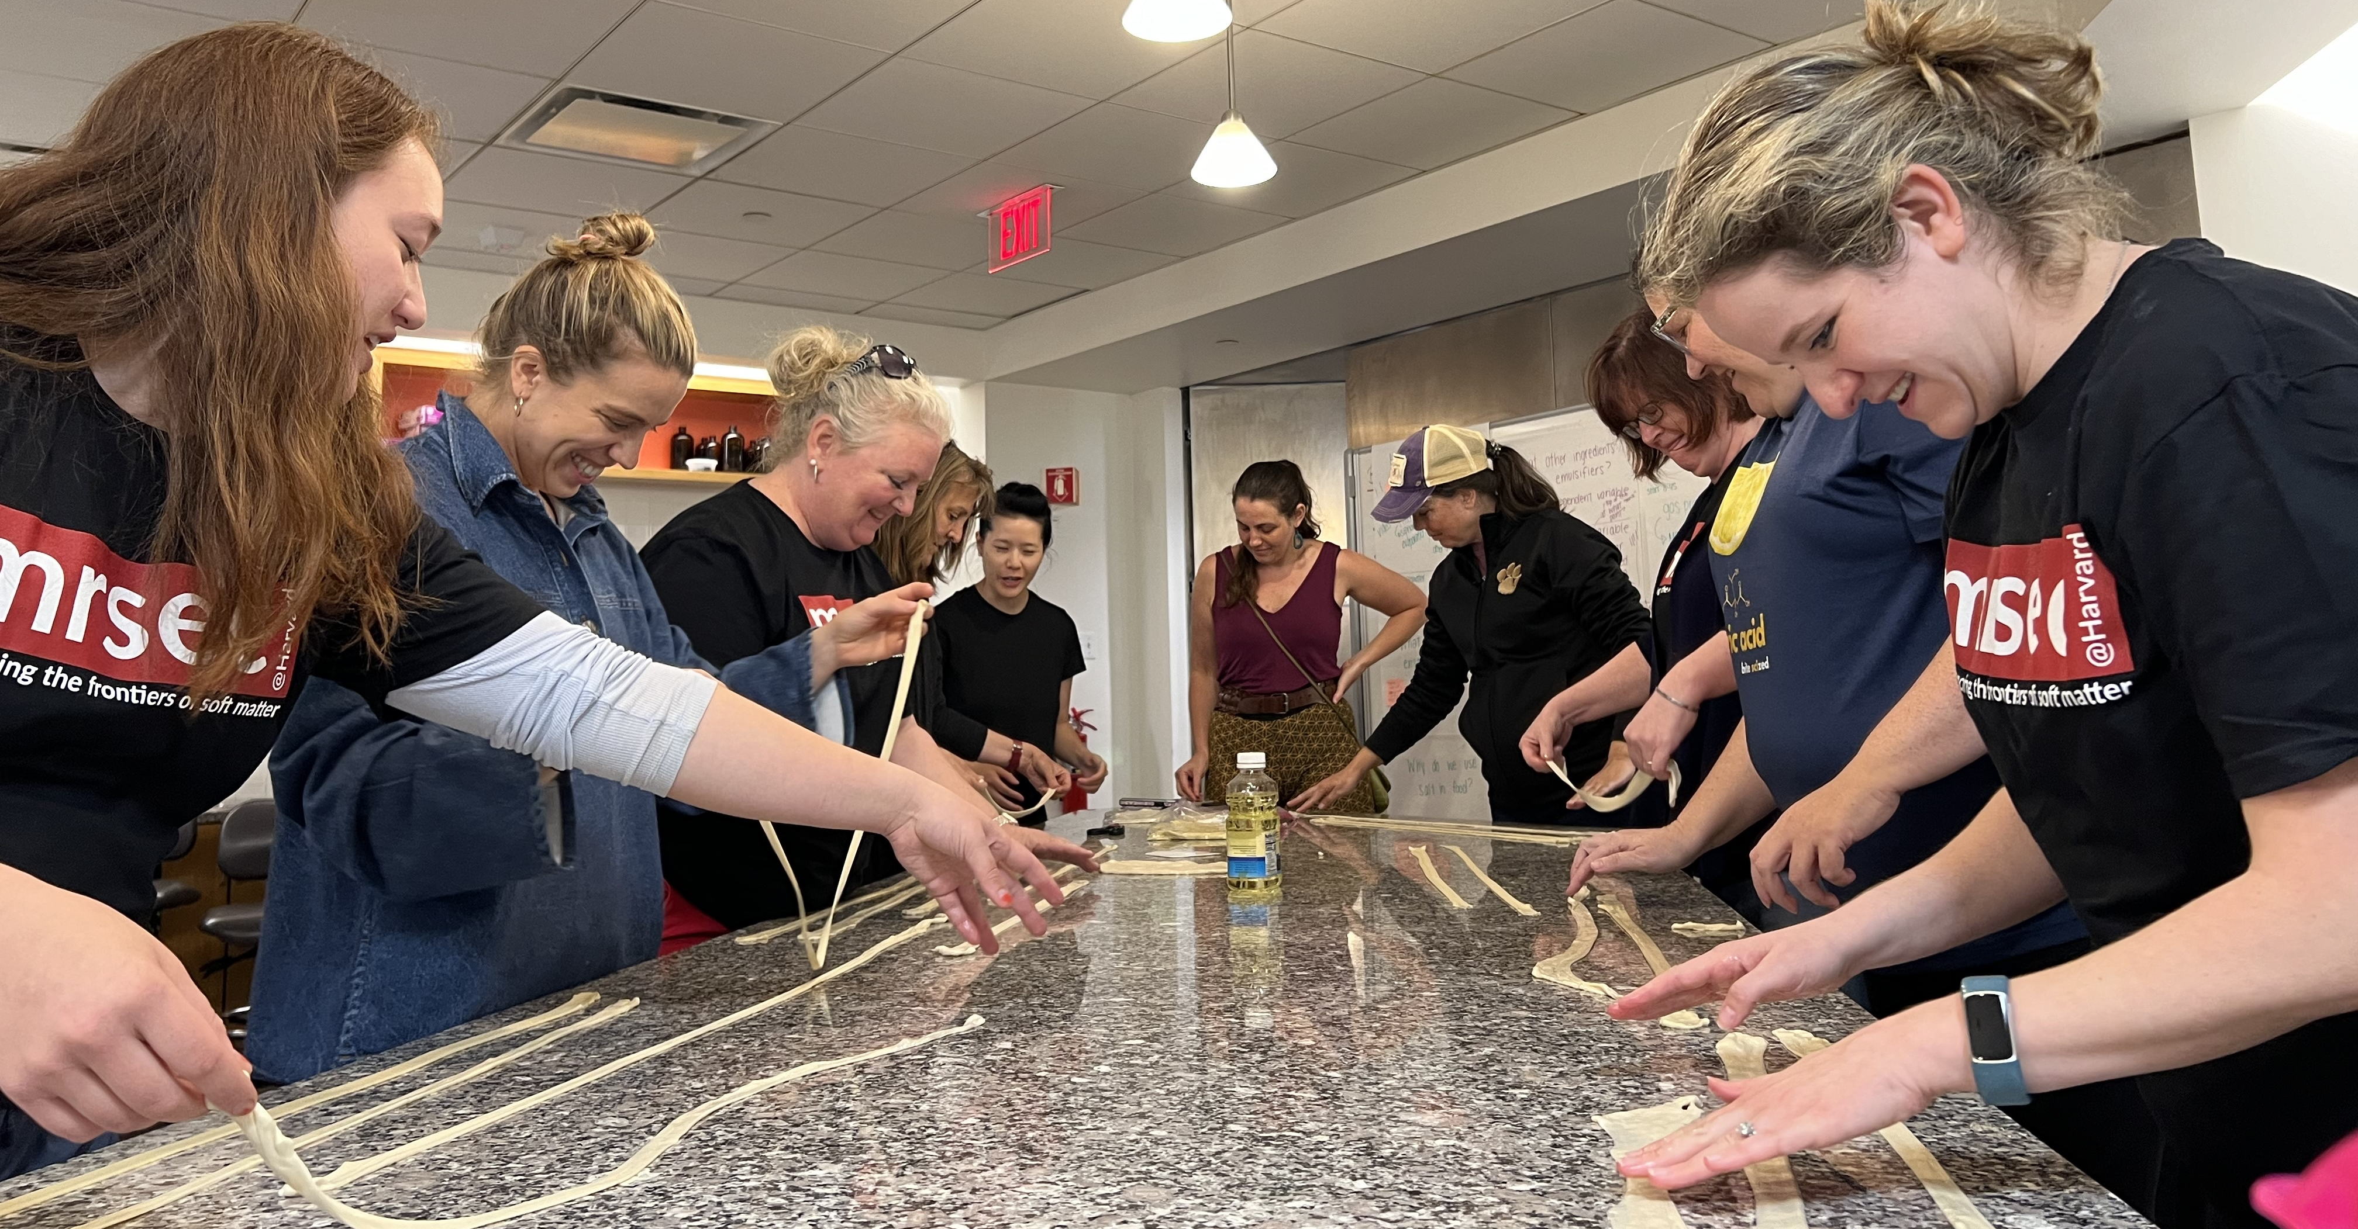
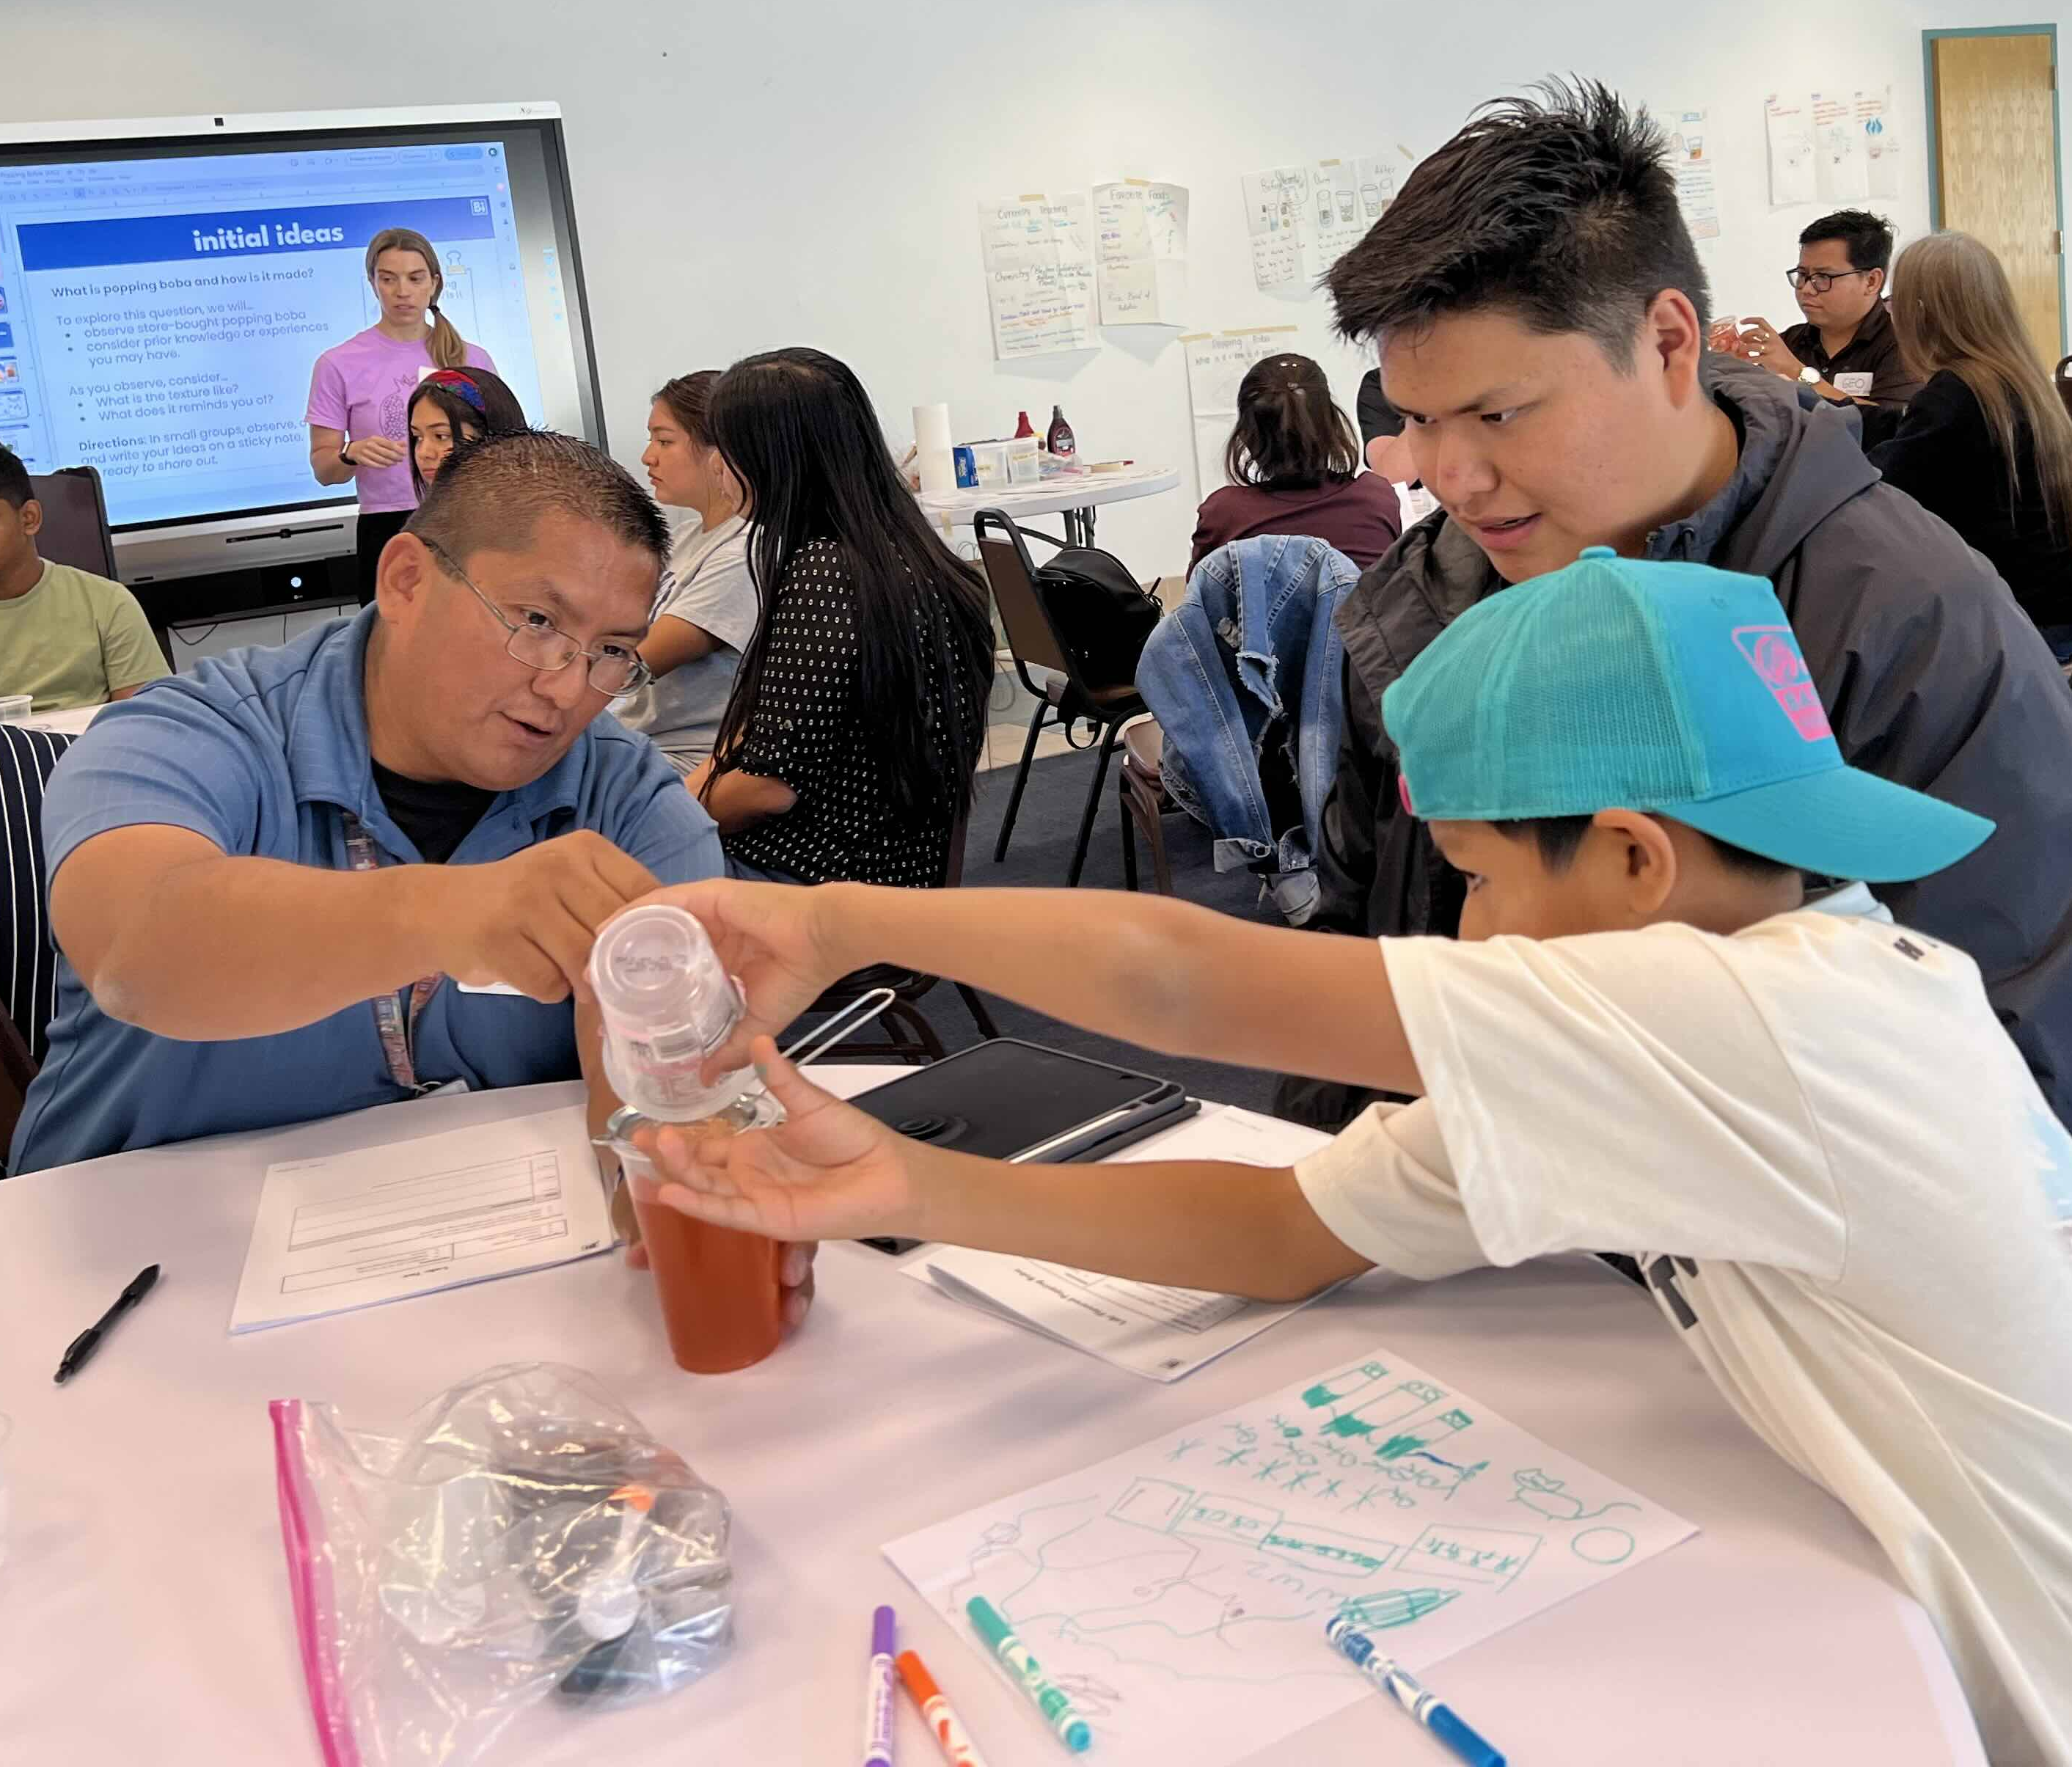
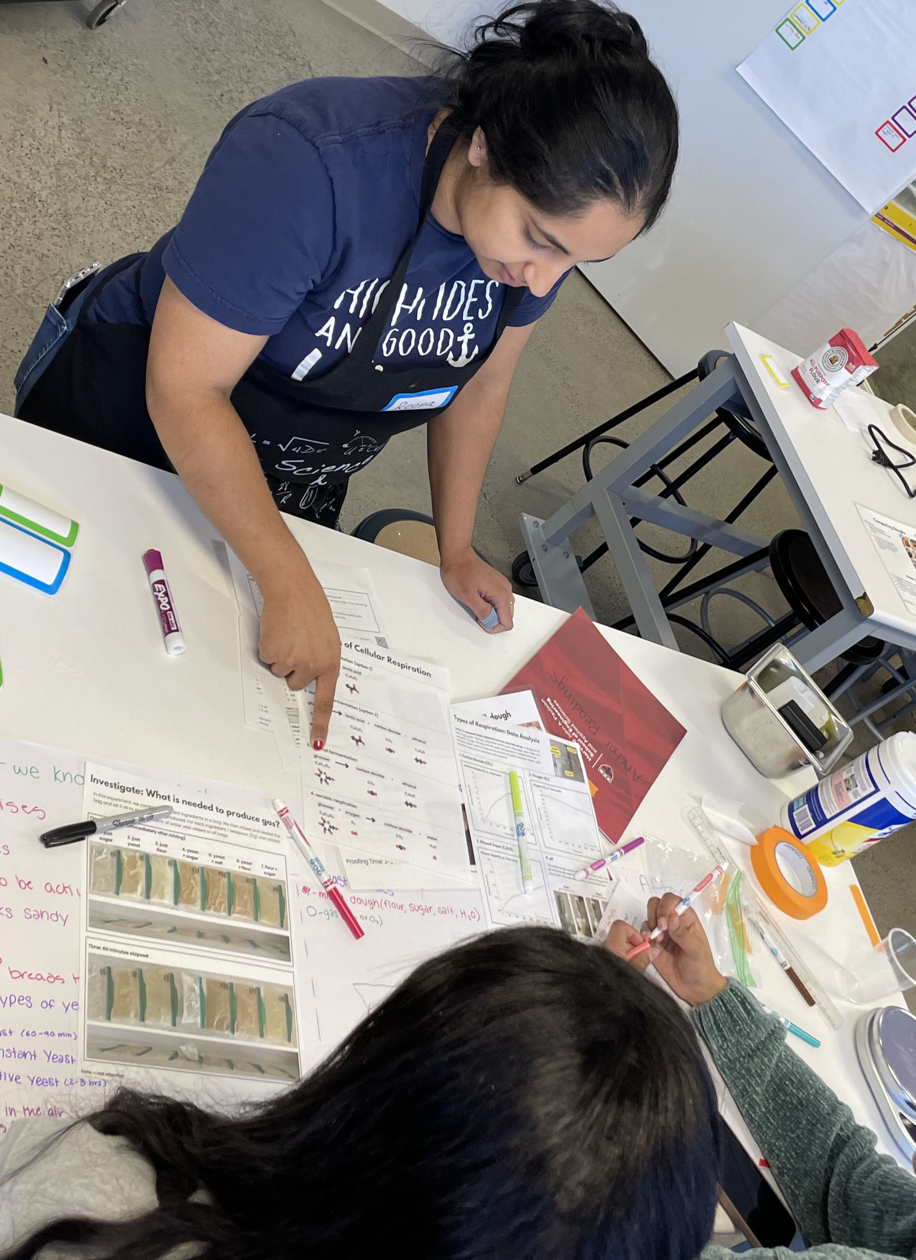
Everyday Materials Science:
Teacher and Student Workshops on Science & Cooking
Harvard MRSEC
DMR-2011754
David Weitz, Kathryn Hollar, Pia Sörensen, and Kate Strangfeld
The Harvard MRSEC engages K-12 teachers and students through the science of everyday materials. Led by former HS teacher Strangfeld, the MRSEC hosts workshops for teachers and K-12 students that are modeled on the undergraduate Science and Cooking course developed by Weitz and Brenner, which is now led by Sörensen.
In 2024-25, this partnership grew substantially, training 32 teachers through 3 hybrid in-person/virtual workshops. Intensive follow-up during the academic year helped these teachers reach over 1870 students in 17 states, averaging 15-30 hours of new instructional materials implemented. In a partnership with Navajo Technical University, Strangfeld also led a day-long workshop in Crownpoint, New Mexico, for teachers in rural New Mexico and Arizona.
In February 2025, Strangfeld and Sörensen, with the help of MRSEC researchers, piloted a 4-day program at Harvard for high school students during school break.
Top: Teachers learn about the science of noodles with local chef Tracy Chang during summer 2024 in-person teacher workshop. Bottom left: Teachers learn about the science of boba and encapsulation at Navajo Technical University. Bottom right: MRSEC student Reena Paink works with high school students during a February 2025 workshop.
Notes:
What Has Been Achieved:
Importance of the Achievement: These workshops are highly accessible and effectively teach students and teachers science concepts through everyday materials – food. Teachers tailor the workshops to their unique classroom environments and their students’ backgrounds.
How is the achievement related to the MRSEC, and how does it help it achieve its goals? Workshops link back to current MRSEC research and education programs, showing novel pathways into materials science.
Where the findings are published: Findings have been disseminated at teacher workshops at the National Science Teachers Association.

