Slide 1
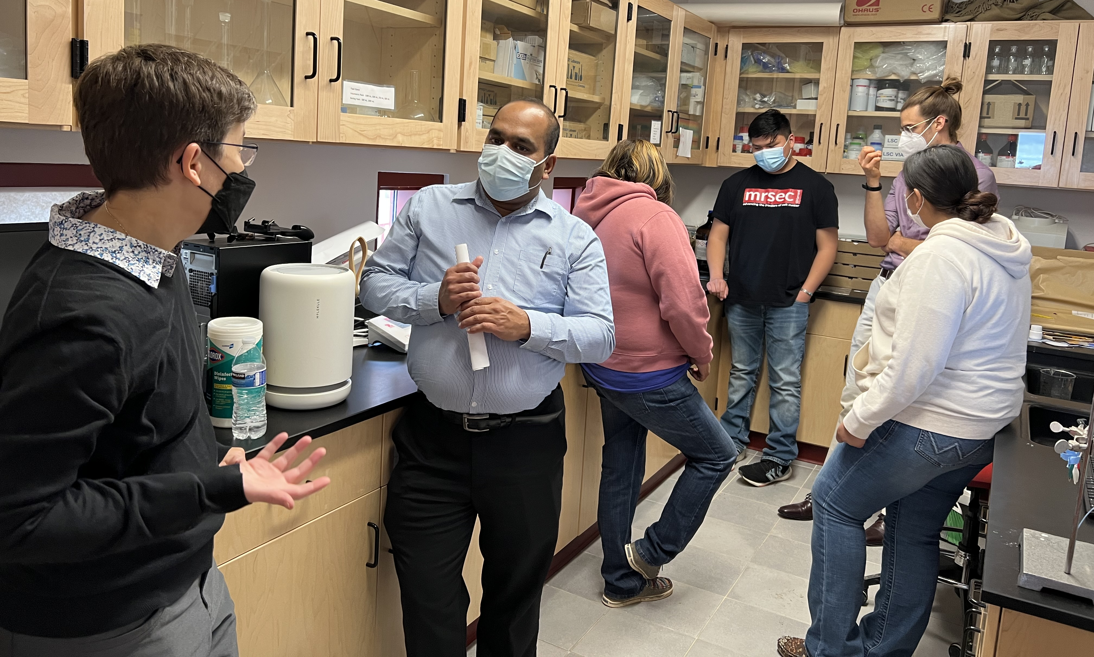
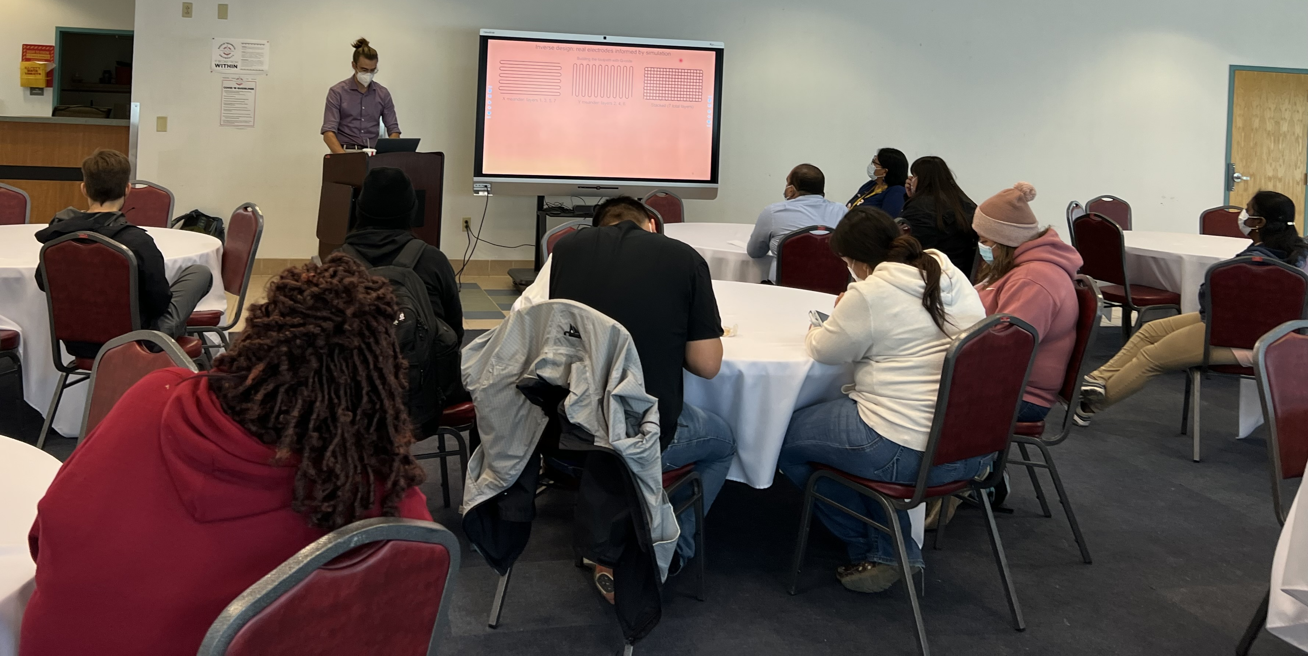
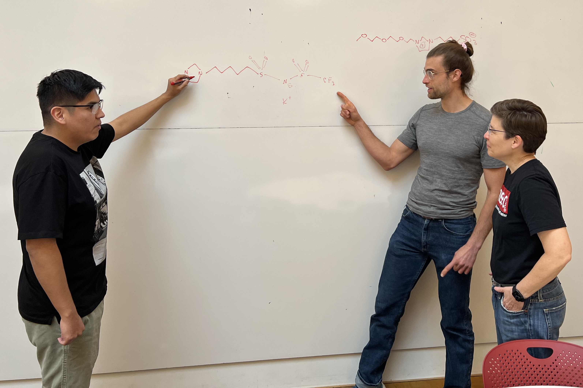
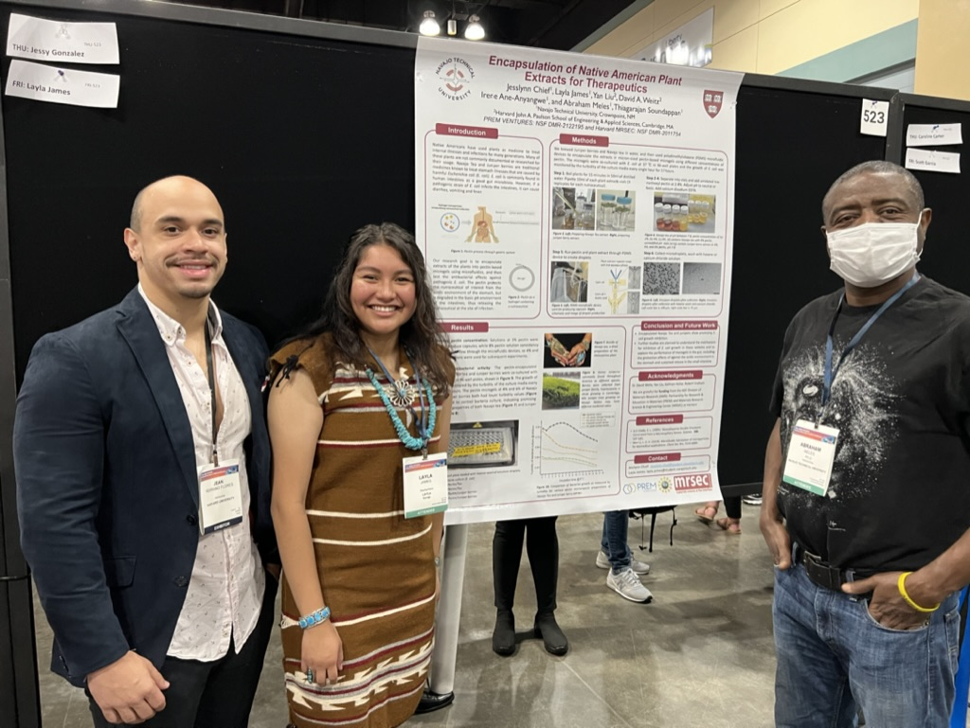
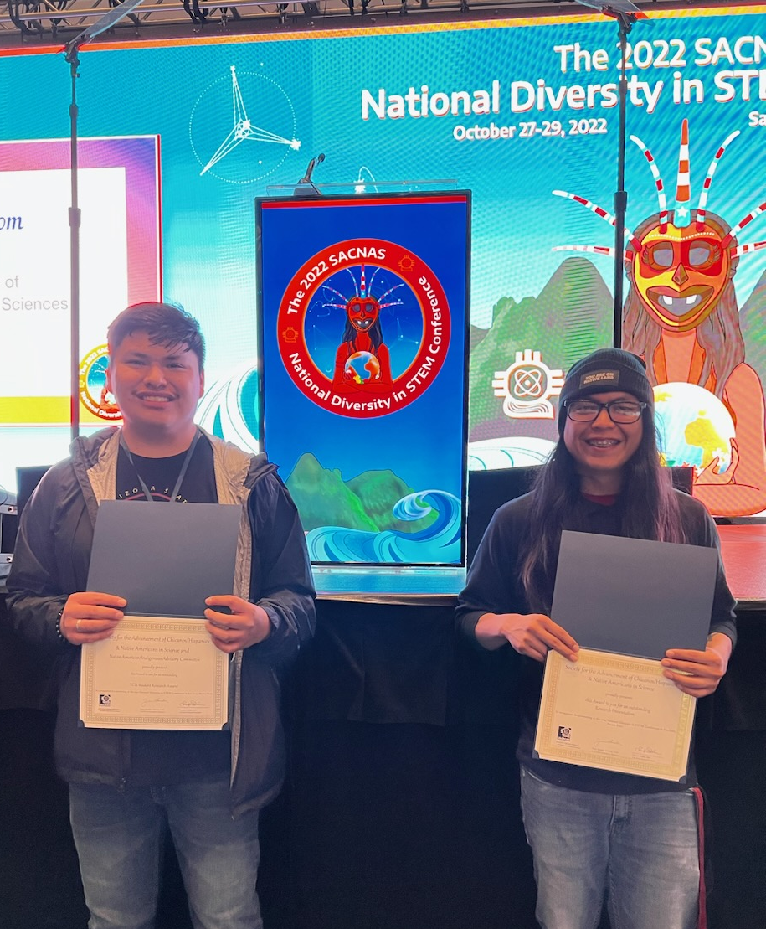
Harvard MRSEC
DMR-2011754
Partnership in Research and Education in Materials with Navajo Tech:
Inspiring STEM Pathways from High School to Graduate Studies
The Partnership for Research and Education in Materials between Navajo Technical University and the MRSEC based at Harvard focuses on developing culturally-informed, sustainable pathways into materials science-related careers and advanced studies for Navajo students. The partnership includes reciprocal visits, including a visit to Navajo Tech in fall 2022 by MRSEC director Jennifer Lewis, education director Kathryn Hollar, and postdoctoral fellow Dylan Barber. They met with faculty, undergraduates, and high school students to further develop research collaborations and encourage students to pursue STEM careers.
The partnership also supports intensive research experiences at Harvard, including summer internships and a new post-baccalaureate program at Harvard. Throughout the academic year, MRSEC-led professional development in scientific communication has greatly increased the number of students presenting and winning awards at national conferences.
Jennifer Lewis (HU), Thiagarajan Soundappan (NTU), Kathryn Hollar (HU)
(top left) NTU students and faculty demonstrate new laboratory facilities in materials science at NTU. (top right) Dylan Barber, postdoc in the Lewis group, presents recent research at Harvard in 3D printing of electrodes with PREM students Justin Platero, Samantha Francis, and post-baccalaureate student Michael Nelwood. (bottom left) Post-baccalaureate student Michael Nelwood with Jennifer Lewis and Dylan Barber at Harvard. (bottom center) Layla James with mentors Jean Carlos Serrano Flores (HU) and Abraham Meles (NTU) at SACNAS. (bottom right) Justin Platero and Jonathan Chinana won 3 awards for their posters at SACNAS in fall 2022.
Notes:
What Has Been Achieved: The team has collaboratively established pathways for Navajo students to engage in research both at NTU and Harvard that will have an impact on the economic development of the Navajo Nation, through summer and term-time undergraduate research, and the establishment of a post-baccalaureate program at Harvard SEAS.
Importance of the Achievement: These new pathways for students did not exist previously, and have inspired students to explore advanced studies, as well as providing the exposure, skills and experience to choose and succeed in a path for themselves. The input of the Navajo students also influences how Harvard mentors think about applications of their research.
How is the achievement related to the PREM, and how does it help it achieve its goals? Students participating in the summer REU and post-baccalaureate programs, as well as grad programs, lead the way for future students. To date, 3 students have participated in the post-baccalaureate bridge-to-PhD program at Harvard. Two students are currently enrolled in Ph.D. programs, one at Harvard (after previously participating in the post-baccalaureate program), and one at Arizona State University.
Where the findings are published: SACNAS (2022) and AISES (2022) proceedings

