Slide 1
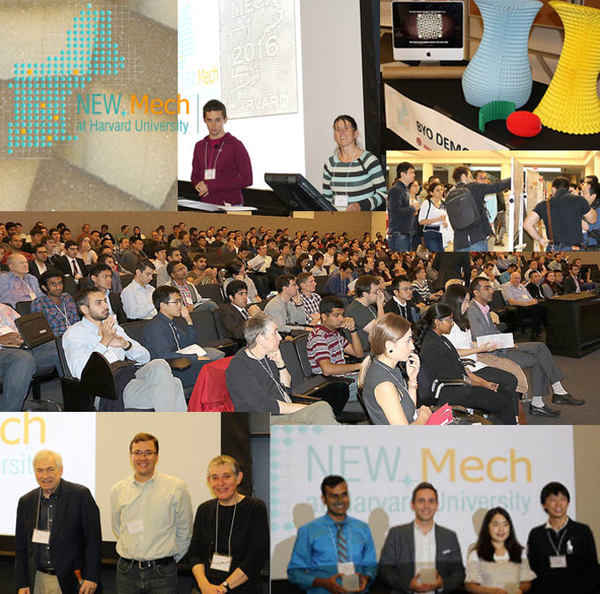
New.Mech Workshop for the New England Mechanics Community
Harvard MRSEC
DMR-1420570
2016-2017
Katia Bertoldi (MechEng), James R. Rice (EnvSciEng and Geol) and Christopher H. Rycroft (ApplMath)
The MRSEC co-sponsored NEW.Mech, a one-day workshop held in October 2016 at Harvard. The annual conference brings together researchers to explore new directions in the mechanics of materials and structures. The workshop, organized by Katia Bertoldi and Christopher Rycroft (top center), was heavily subscribed with over 300 attendees. Invited speakers (lower left) included James Rice (Harvard), Lorna Gibson (MIT), and Ryan Hayward (UMass). The workshop also featured student sound-bite talks, poster sessions, and hands-on demonstrations. The audience voted on-site for the top, sound-bite presentations and awards were presented to those students (lower right). This annual workshop is an important community builder for researchers in mechanics in the New England region.
Photos by Alaina Schraufnagel.

