Slide 1
Magnetic Particle Chains for Directionally Controlled Actuation of Soft Robots: Intellectual Merit
MRSEC 1121107
2017
Stefan Zauscher, Director, Research Triangle MRSEC, Duke University
Researchers at North Carolina State University and Elon University have developed soft robots based on magnetic field-directed self-assembly of magnetic particles into chains embedded in elastomer films. Using materials with greater complexity allows advanced functions, while still using simple device architectures. In a project led by a REU student, elastomer films containing chained iron microparticles were prepared through solvent casting and formed into magnetically actuated lifters, accordions, valves, and pumps. Cantilevers used as lifters were able to lift up to 50 times the mass of the polymer film. Applying magnetic fields to folded accordion structures caused extension and compression, depending on the accordion’s orientation. In peristaltic pumps comprised of composite tubes containing embedded chains, magnetic fields caused a section of the tube to pinch closed where the field was applied. These results will facilitate the further development of soft robots based on chained magnetic particles.
Chains of magnetic particles embedded in elastomers provide torque for directionally responsive soft robots
M. M. Schmauch, S. R. Mishra, B. A. Evans, O. D. Velev, J. B. Tracy, ACS Appl. Mater. Interfaces, 9, 11895 (2017).

Slide 2
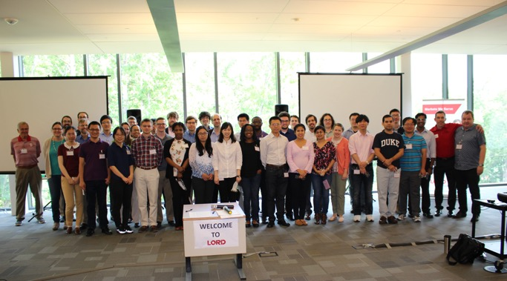
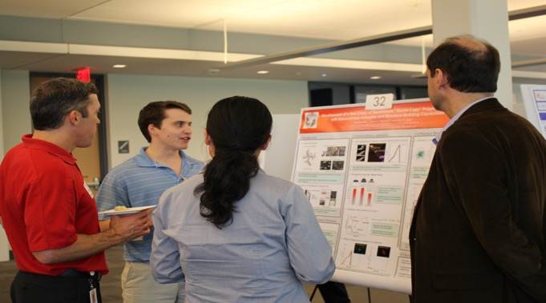
Magnetic Particle Chains for Directionally Controlled Actuation of Soft Robots: Broader Impacts
MRSEC 1121107
2017
Stefan Zauscher, Director, Research Triangle MRSEC, Duke University
Particles for the research on actuation of soft robots were provided by LORD Corporation in Cary, NC. As part of our Professional Development activities for graduate students and post-docs, LORD Corporation sponsored an Industry Poster session and Facilities Tour. The Triangle MRSEC graduate students and post-docs presented posters to an audience from LORD consisting of R&D Scientists and Engineers, Managers, and Directors as well as Business Development and New Technology Ventures representatives. At the conclusion of the poster session the MRSEC students had a tour of LORD Corporation facilities and labs. This was a unique opportunity to highlight the interaction between industry and academia.

