Slide 1
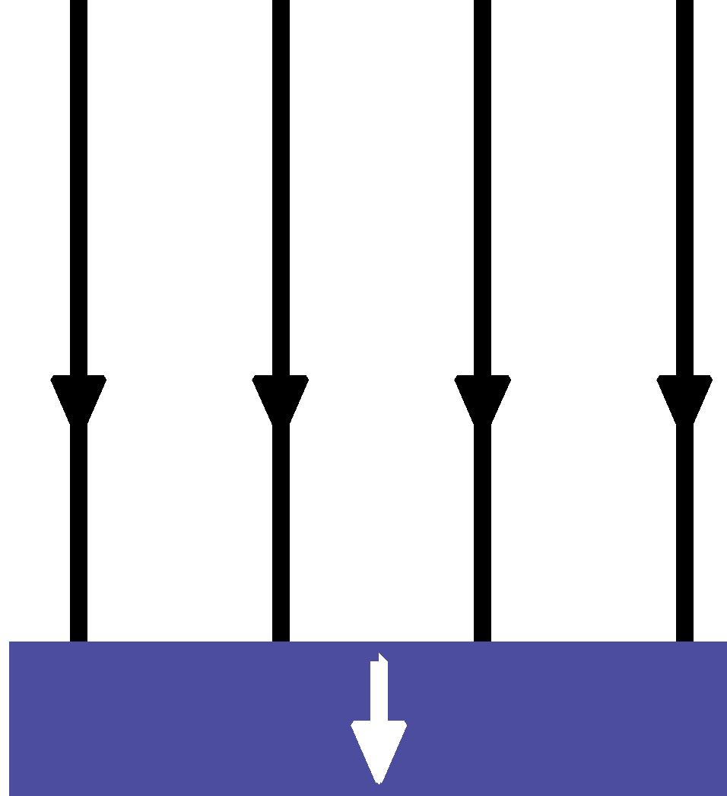
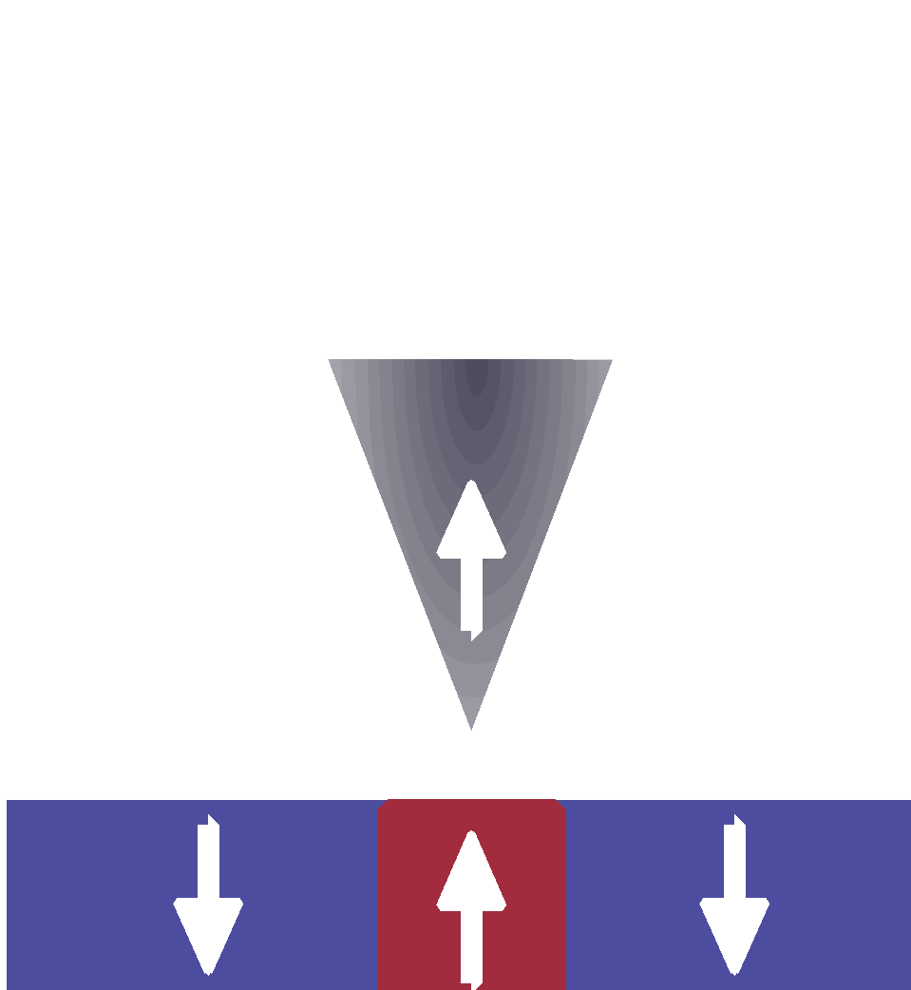
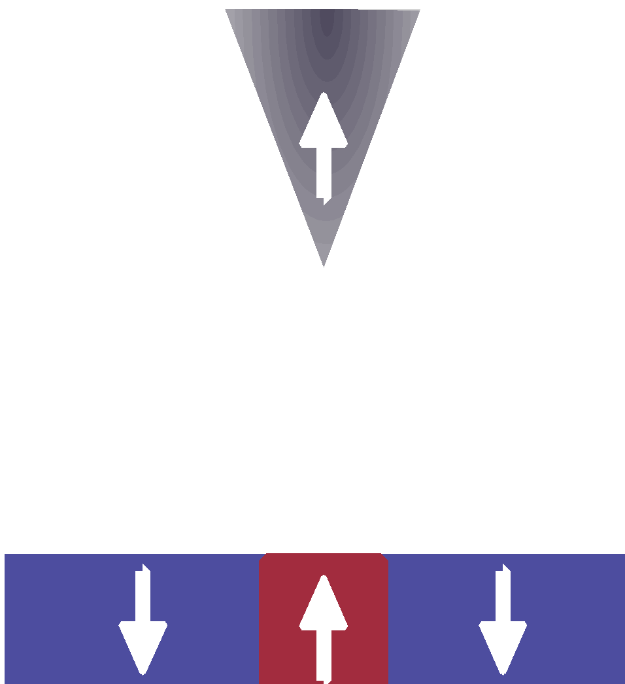
(Columbia University, 2024)
MRSEC: DMR-2011738
Programming magnetic domains in ferrimagnetic MnSb₂Te₄
Abhay Pasupathy, Columbia University Center for Precision-Assembled Quantum Materials (PAQM)
The highly intertwined magnetic and electronic properties of magnetic topological materials (MTMs) make MTMs valuable for electrical control of magnetism and vice versa, e.g. in spintronic devices, as well as for quantum electronics, as an ingredient in proposed topological quantum computation devices. Mn(Bi, Sb)₂Te₄, a family of MTMs with highly tunable properties, is an ideal playground for studying the interplay of band topology with magnetism. While previous work has focused on uniform ordered phases, here we ask: How can we control the electronic properties of Mn(Bi, Sb)₂Te₄ using the mesoscale structure of magnetism?
By combining domain manipulation and imaging in a cryogenic magnetic force microscope (MFM) with in-situ electrical transport measurements, we measure the impact of the local magnetic order on electrical transport in a device of ferrimagnetic MnSb₂Te₄ (FM-MST). We directly measure the impact of local magnetization on the electrical response, and the linear scaling of the anomalous Hall response with magnetic domain volume.
This work demonstrates that M(Bi,Sb)₂Te₄ can be used to introduce programmable magnetic landscapes into 2D materials heterostructures. Furthermore, our technique to control domain geometry through explicit manipulation accesses both “boundary” and “bulk” responses to magnetic domains, a tool for studying the interplay between magnetism and electrical response in MTMs more broadly.
(a) Initialize
(b) Write
(c) Image
MnSb₂Te₄
SiO₂
(a) MFM image of the FM-MST device ”initialized” to have magnetization directed opposite to the magnetization of the MFM tip. (b) V₁₃ measured as shown while writing a linear domain in the FM-MST. The linear decrease represents the linear scaling of the AHE with domain volume. (c) MFM image showing the line-shaped domain written with the MFM tip.
(d)
(e)
(f)
(d) V₁₃ measured while writing a square-shaped area in the middle of the device. (e) Data from d averaged along the fast scan direction to show the decrease in V₁₃ observed during the write. The trend can be understood as a linear decrease combined with deviations associated with the formation of an interior domain. (f) MFM image after writing the square area.
T. A. Webb, et al, arXiv:2308.16806 (2023).
Nano Letters (accepted, 2024).
Notes:
What Has Been Achieved: Imaging and manipulation of magnetic domains in magnetic topological insulators uing a magnetic force microscope, and simultaneously measuring the impact of magnetic domain structure on the anomalous Hall effect.
Importance of the Achievement: This work helps us understand the interplay between magnetic structure and electronic transport in the magnetic topological insulator family.
How is the achievement related to the IRG, and how does it help it achieve its goals? This work is a collaboration between several PIs, funded primarily by the MRSEC. One of the primary goals of IRG1 is to realize new materials platforms that host magnetically-induced topological phases of matter, and this work directly addresses this goal.
Where the findings are published: arXiv:2308.16806 (2023), accepted for publication in Nano Letters.

