Slide 1
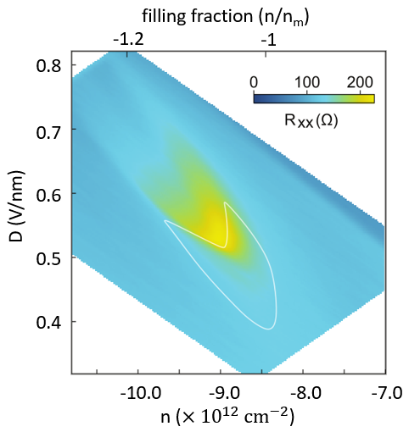
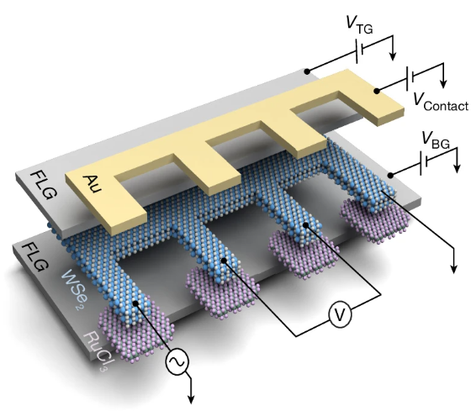
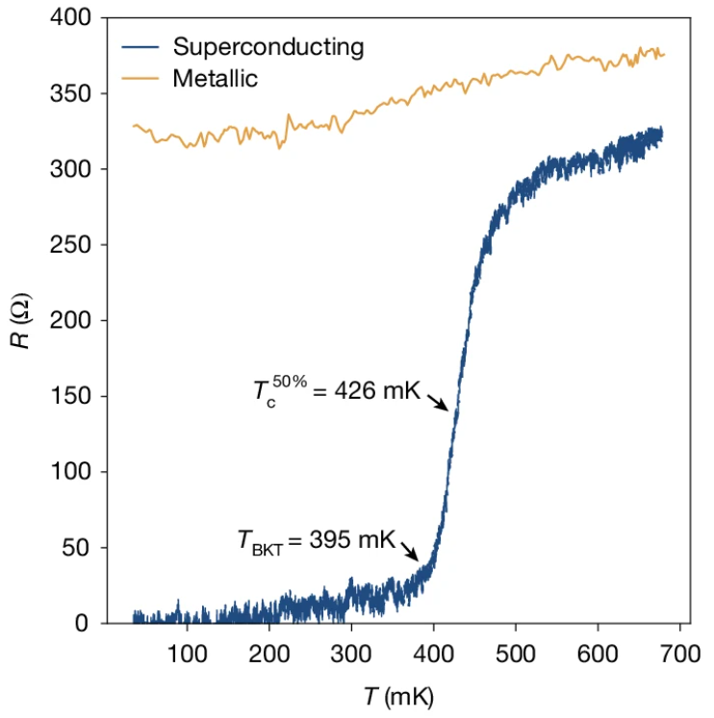
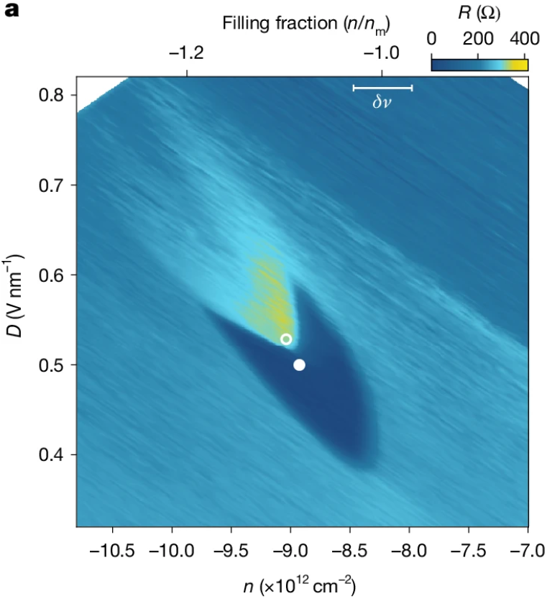
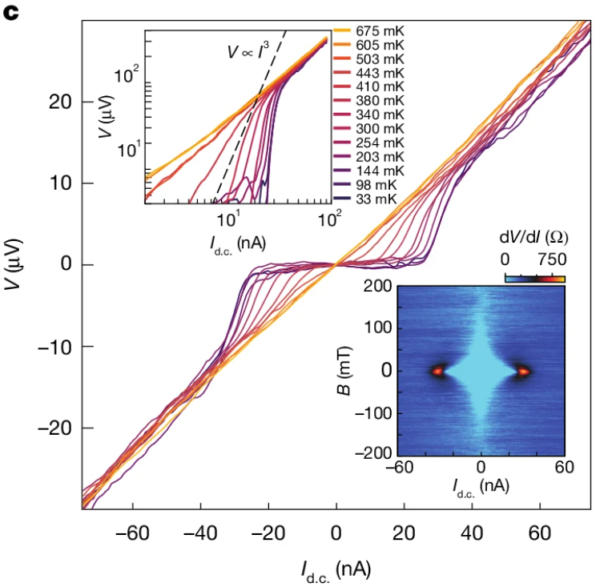
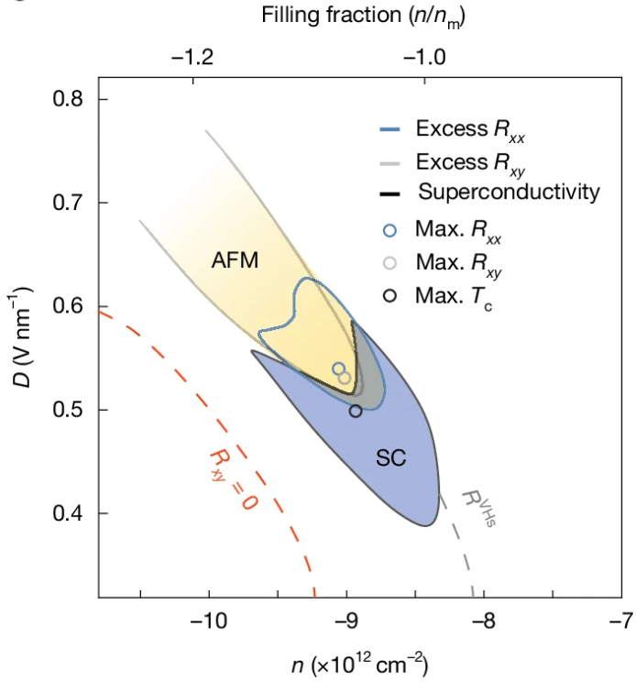
Columbia University PAQM MRSEC
DMR-2011738
Superconductivity in 5.0° twisted bilayer WSe₂
The discovery of superconductivity in twisted graphene systems has generated tremendous interest, where low-energy flat bands with strong correlations play a key role. Flat bands may also be induced by moiré patterning in the transition metal dichalcogenides (TMDs), however experimental observation of superconductivity has remained absent. This raises the question as to whether superconductivity is a universal feature in flat-band, two-dimensional systems or there is some unique graphene-specific feature that makes superconductivity favorable.
Here we report superconductivity (SC) in 5.0° twisted bilayer WSe₂, appearing in a limited region of displacement field and density adjacent to a metallic state. Theoretical calculation shows that the metallic state arises from a Fermi surface reconstruction due to antiferromagnetic (AFM) order. Analysis of the SC–AFM phase diagram suggests that the SC may have exotic order, stabilized by spin fluctuations.
Our results establish that moiré superconductivity extends beyond graphene structures. This has important implications on the theoretical models of superconductivity in 2D flat bands on general grounds, since it should now accommodate substantially different materials systems. Moreover, material properties that are absent in graphene but intrinsic among the TMDs such as a native band gap, large spin-orbit coupling, spin-valley locking and magnetism offer the possibility to access a broader superconducting parameter space than graphene-only structures.
Cory R. Dean, Columbia University
Center for Precision Assembled Quantum Materials (PAQM)
Cory R. Dean, Columbia University Center for Precision-Assembled Quantum Materials (PAQM)
(a)
(c)
(e)
(b)
(d)
33mK, 200mT
(f)
33mK, 0T
(a) Schematic illustration of the twisted WSe₂ device structure with graphite contacts doped by α-RuCl₃. (b) Resistance versus density and displacement field measured at 33 mK, showing the superconducting (SC) pocket. (c) Resistance versus temperature measured at solid circle in (b). The transition to zero resistance shows the characteristic behaviour of a two-dimensional superconductor. (d) Temperature–dependent voltage–current (V–I) response. In the low-temperature limit, a nonlinear response typical of superconductivity is observed. (e) Longitudinal resistance as a function of density and displacement field, measured at 33 mK, 200 mT. An antiferromagnetic (AFM) state is adjacent to, and overlapping with, the superconducting phase. (f) Relationship between SC and AFM states in the density-displacement field phase space.
Y. Guo, et al, Nature 637, 839–845 (2025)
Notes:
What Has Been Achieved: We demonstrated the emergence of superconductivity (SC) in 5.0° twisted bilayer WSe2, appearing in a limited region of displacement field and density adjacent to a metallic state. Theoretical calculation shows that the metallic state arises from a Fermi surface reconstruction due to antiferromagnetic (AFM) order. Analysis of the SC–AFM phase diagram suggests that the SC may have exotic order, stabilized by spin fluctuations.
Importance of the Achievement: The ability to induce correlated states in 2D materials by moire patterning has recently emerged as a new paradigm in materials engineering. Experimental Studies of twisted 2D heterostructures in which a moire pattern is induced by twist angle mismatch have uncovered numerous interaction driven grounds states including non trivial magnetic order and exotic topological ground states, appearing across wide ranges of material platforms. A foundational discovery in this effort was the observation of superconductivity in twisted bilayer graphene. Despite several years of intense study its origin remains highly debated. A critical question surrounding this debate is whether twisted induced superconductivity could be realized in other 2D materials or is confined to graphene systems only. Our results demonstrate for the first time a definitive answer to this question, namely that twisted induced superconductivity is indeed a generalized result that spans moire patterned systems beyond graphene. The expanded tunability of the phase diagram in WSe2, in comparison to twisted bilayer graphene, offers new avenues for further discovery. For example the ability to move throughout the magnetic/superconductor phase diagram via purely electrostatic gating offers unprecedented opportunity to identify universal versus material specific characteristics of this interplay and could provide new insight beyond what has been achieved. Moreover, material properties that are absent in graphene but intrinsic among the TMDs such as a native band gap, large spin-orbit coupling, spin-valley locking, and magnetism offer the possibility to access a broader superconducting parameter space than graphene-only structures.
How is the achievement related to the IRG, and how does it help it achieve its goals? One of the primary objectives of IRG1 is to identify new correlate driven phenomenon though a combination of improved material synthesis, novel device architectures, and theoretical modellign. The result here represents an exemplary demonstration of this interplay where techniques developed within the MRSEC team to reduce defect density in the TMDs, combined with a breakthrough discovery of improved contact engineering by charge transfer doping, allowed us to measure high mobility WSe2 devices in a previously inaccessible regime of density, displacement field and temperature. Collaborative work guide by theory enabled a full understanding of the complex phase diagram in twisted WSe2 allowing us to identify the important role played by magnetic frustration and its interplay with superconductivity in this system.

