Slide 1
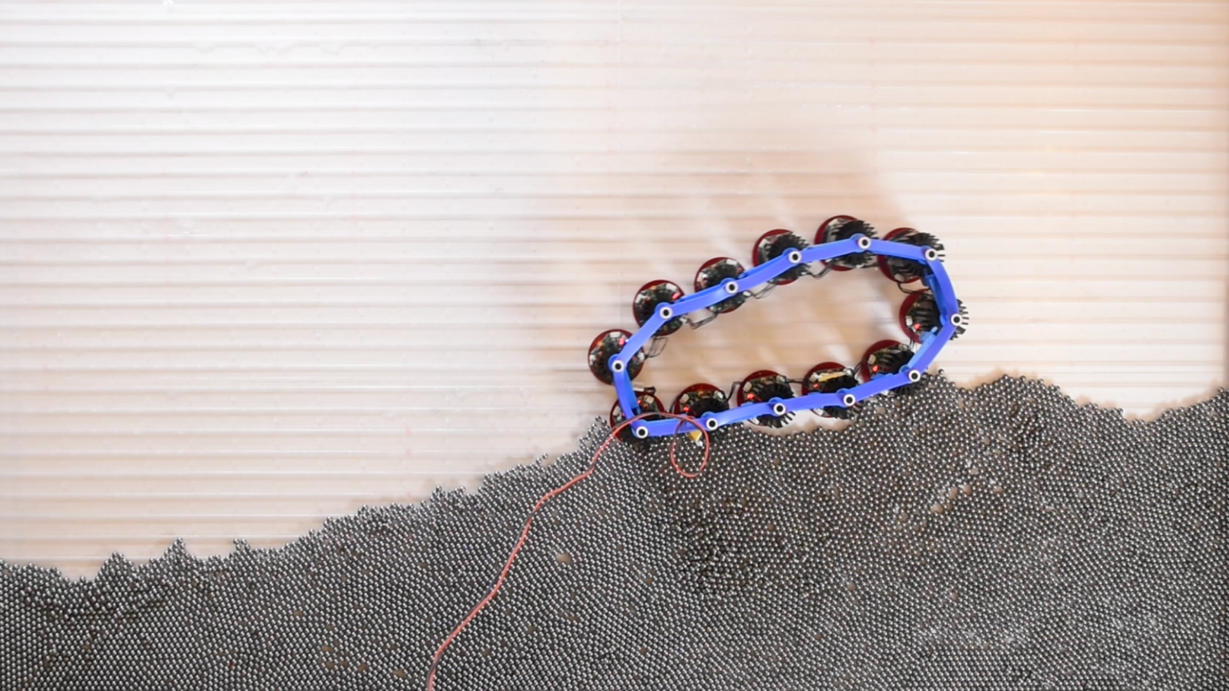

University of Chicago MRSEC
DMR-2011854
Chiral active solids with life-like properties
Active systems composed of energy-generating microscopic constituents are a promising platform to create autonomous functional materials that can, for example, locomote through complex and unpredictable environments. Yet coaxing these energy sources into useful mechanical work has proved challenging.
In this study, active solids were built out of centimetre-scale building blocks that perform adaptive locomotion. These prototypes exhibit a non-variational form of elasticity characterized by odd moduli, whose magnitude was predicted from microscopics using coarse-grained theories validated experimentally.
As a result, these chiral active solids are able to accelerate, adjust their gaits and locomote through a variety of terrains with a similar performance to more complex control strategies implemented by neural networks. This work establishes active solids as a bridge between materials and robots and suggests decentralized strategies to control the nonlinear dynamics of biological systems, soft materials and driven nanomechanical devices.
J. Veenstra, C. Scheibner, M. Brandenbourger, J. Binysh, A. Souslov, V. Vitelli, C. Coulais, Adaptive locomotion of active solids, Nature 639, 935–941 (2025).
IRG-2: Vitelli group
(a) Odd active solids exhibit adaptive locomotion on a granular terrain. When interacting with an external environment, chiral active solids spontaneously undergo limit cycles of shape changes, which naturally lead to locomotion such as rolling and crawling. The robustness of the locomotion is rooted in an emergent feedback loop between the active solid and the environment, which is mediated by odd elastic deformations and stresses.
Notes:
What Has Been Achieved: For the first time ever, the shape and mechanical response of millimeter-scale atomically thin polycrystalline films were probed in a mechanically free state using a counterintuitive solution: we float atomically thin films on water. Using this approach, we discovered that large scale membranes naturally wrinkle in a universal way, that is tunable, yet independent of atomistic details
Importance of the Achievement: A crucial feature of atomically thin films—their intrinsic 3D shape—remained poorly understood because to measure such an ultra-thin film, one first needs to simultaneously free it and stabilize it without introducing confining boundaries. We provided a general solution to this problem.
How is the achievement related to the IRG, and how does it help it achieve its goals? We use a combination of theory and modeling to show that a minimal continuum models are sufficient to describe the wrinkle shape via universal scaling laws regardless of whether the disordered curvature is smoothly distributed or atomically localized.
Where the findings are published: J. Yu, C. Scheibner, C. Liang, T.A. Witten, V. Vitelli, and J. Park, “Universal wrinkling of freestanding atomically thin films”, arXiv:2311.05096.

